Slide 1
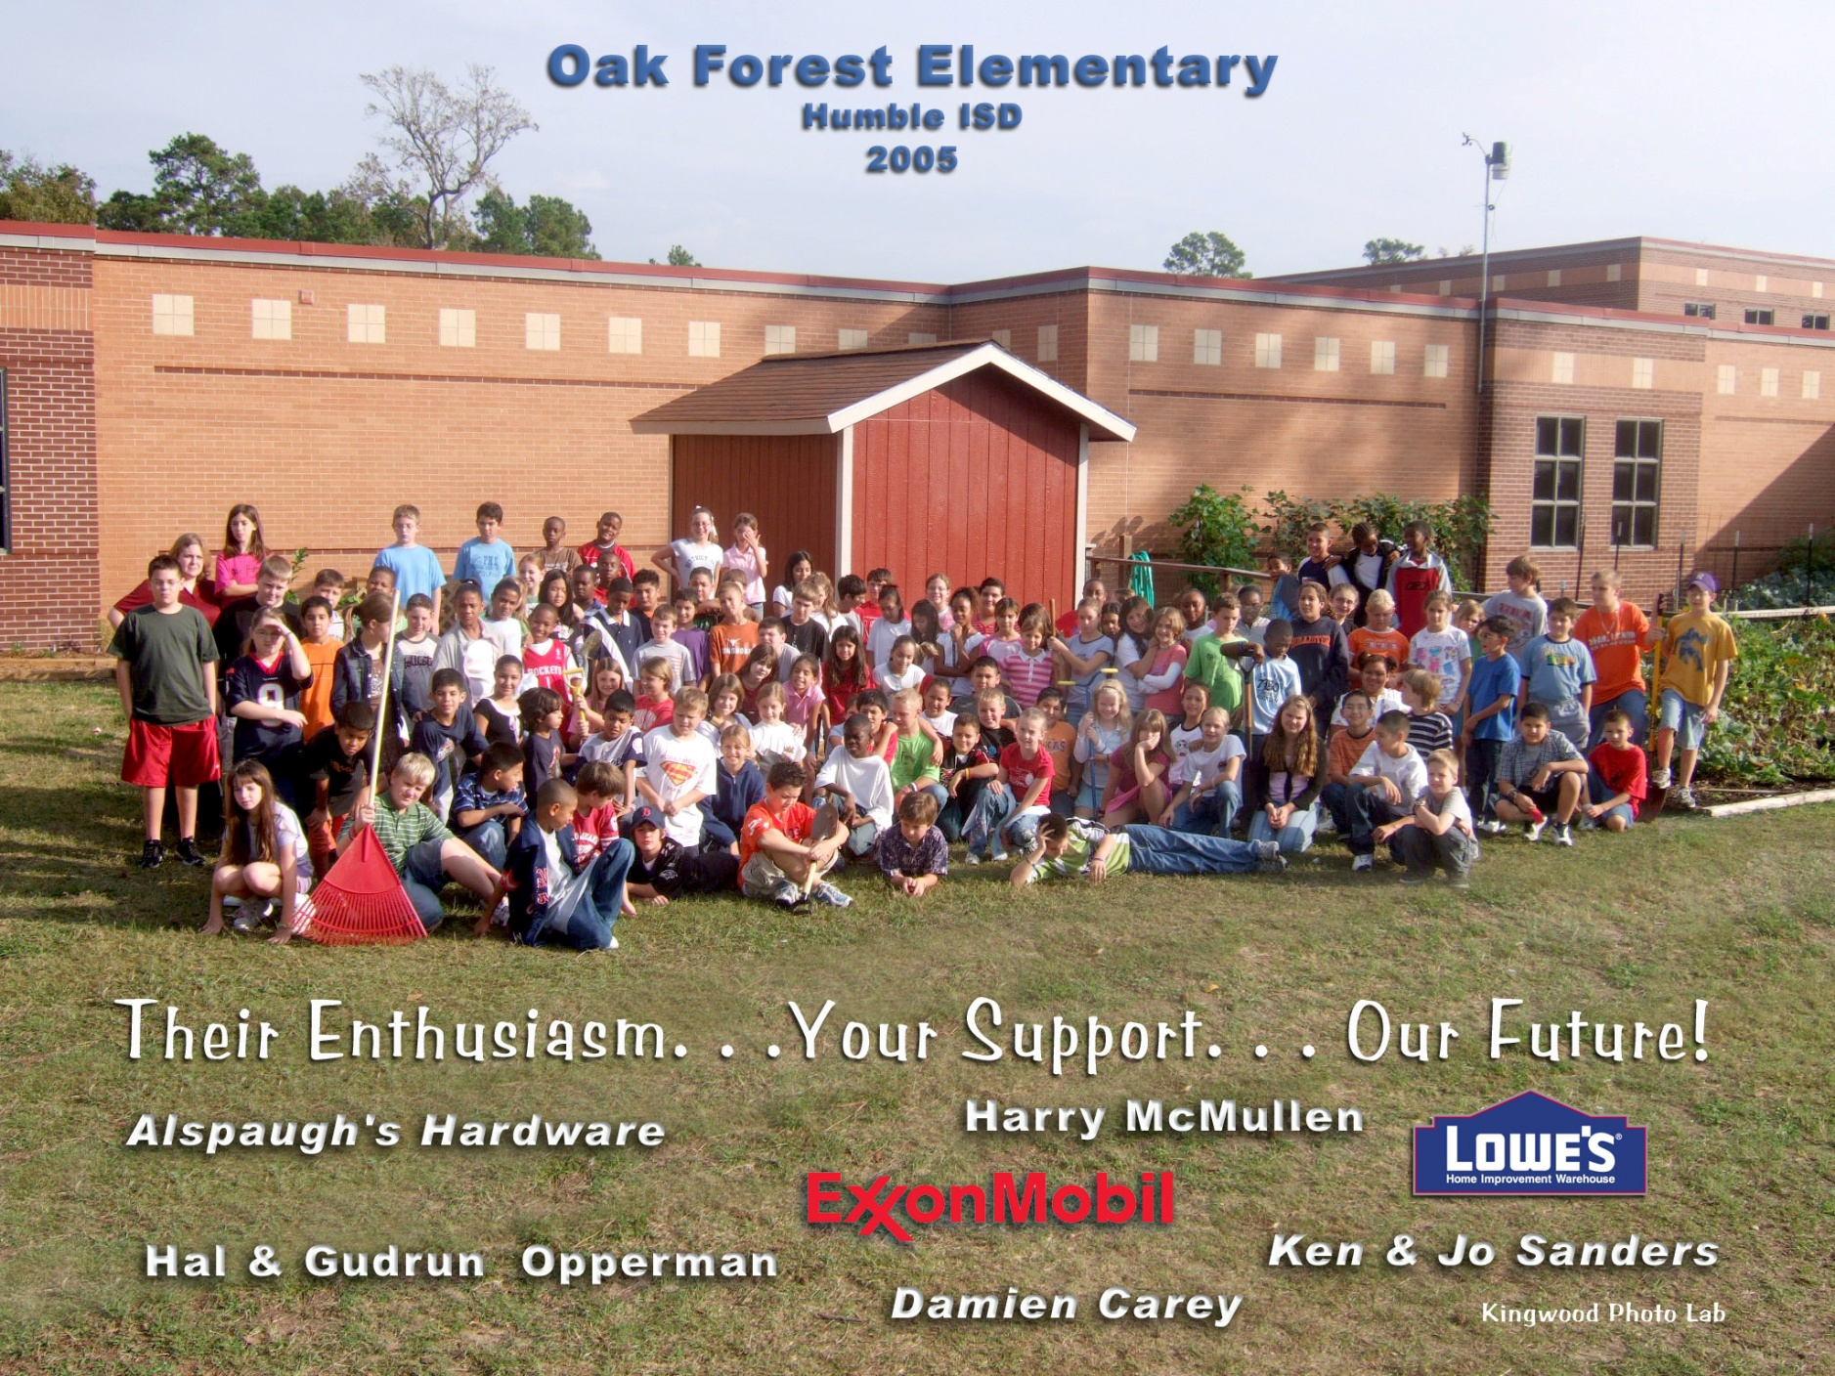
Fifth Grade Gardening

Slide 2
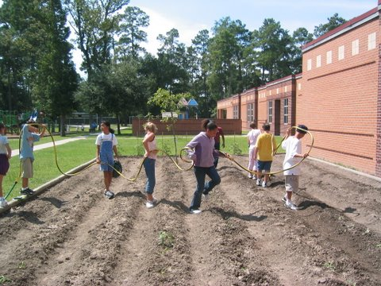
The 5th grade garden - 2003

Slide 3
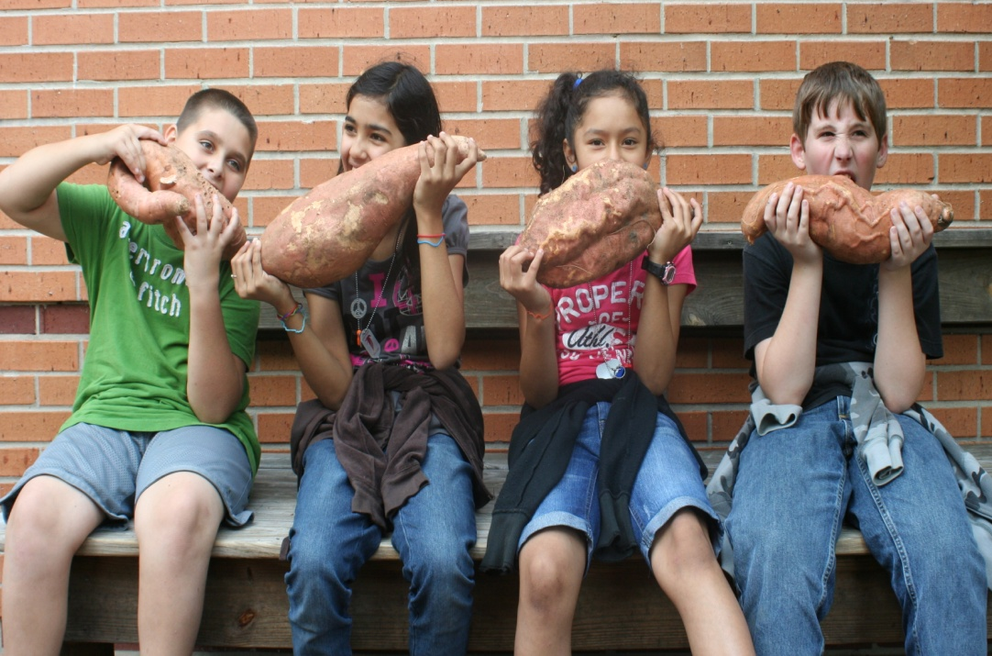
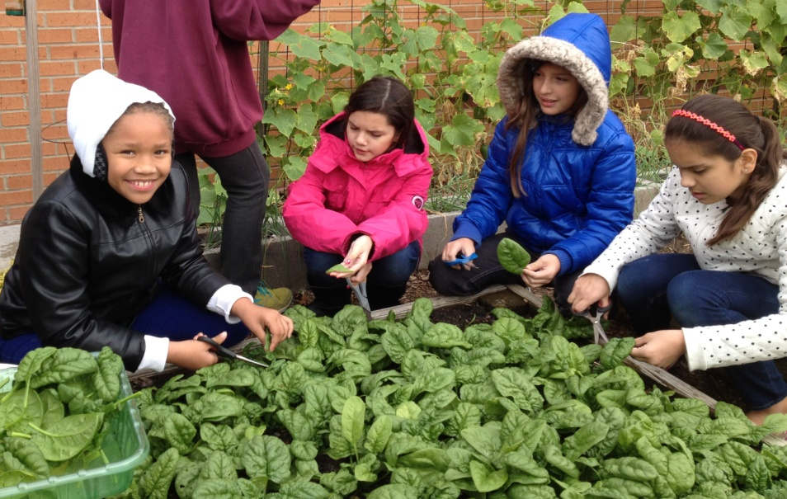
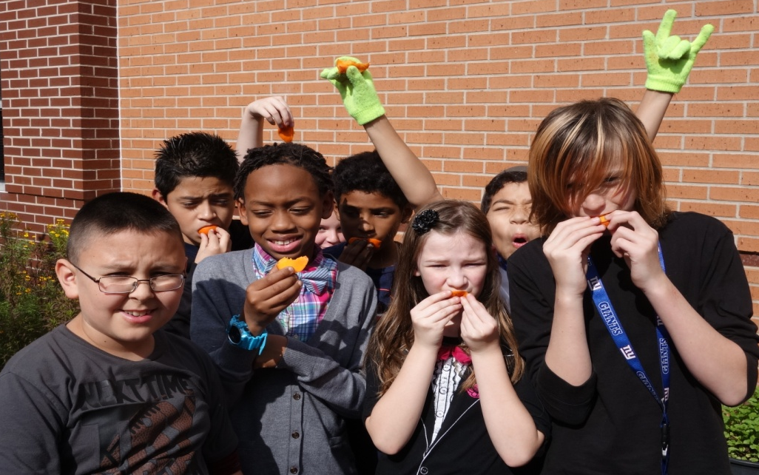
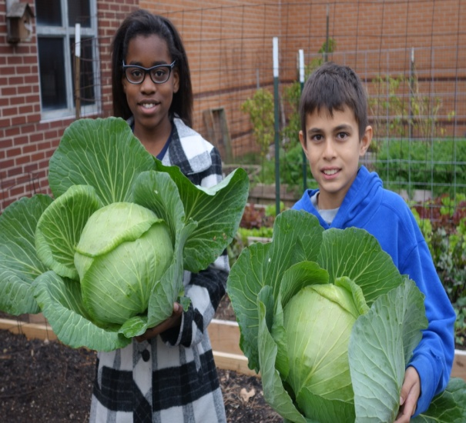
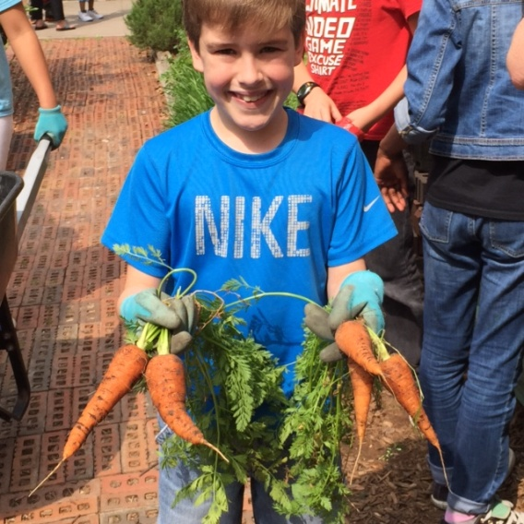
Gardening is fun!

Slide 4
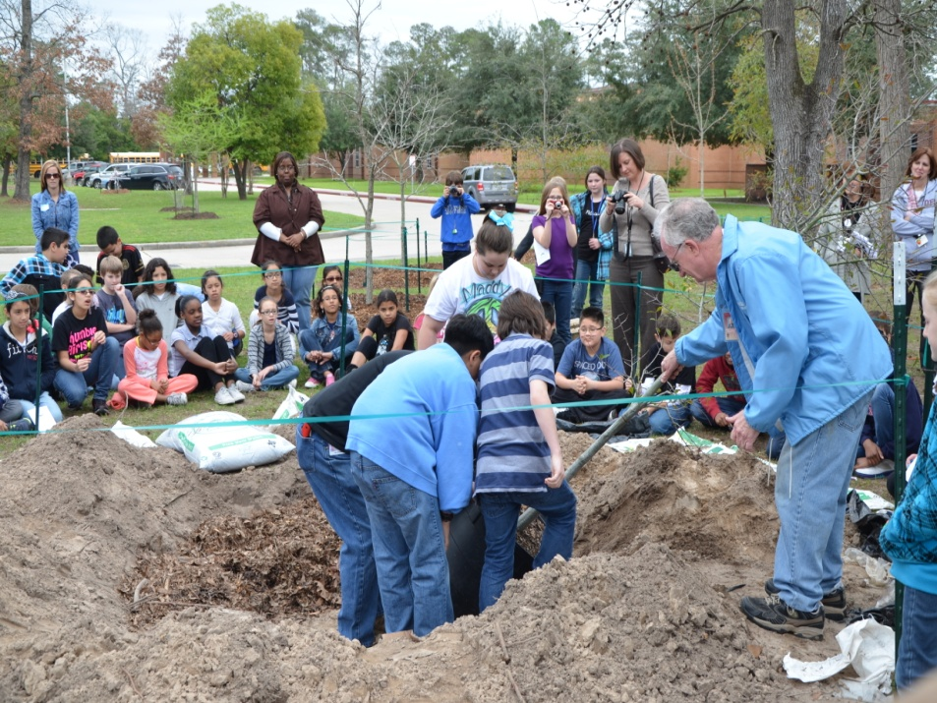
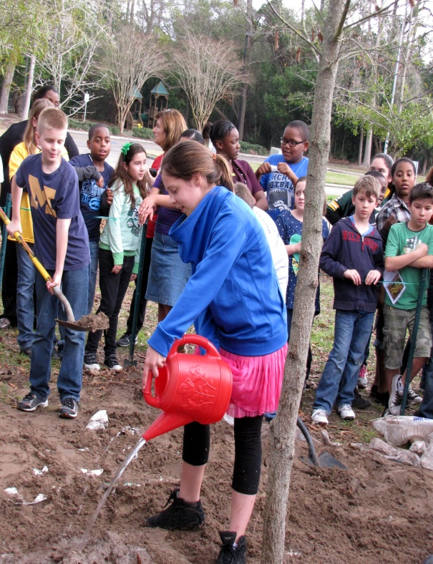
Arbor day
Tree Planting
5th Graders donate
an Oak tree to the school and plant it.
Students raise
money to buy the tree.

Slide 5
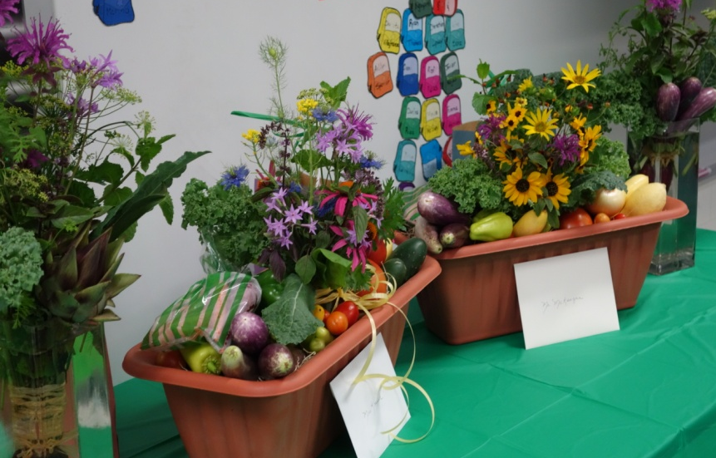
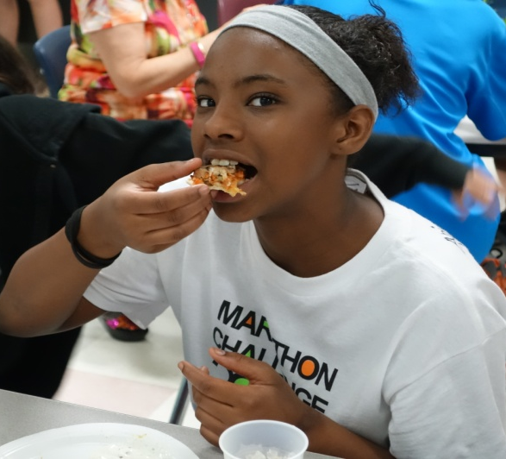
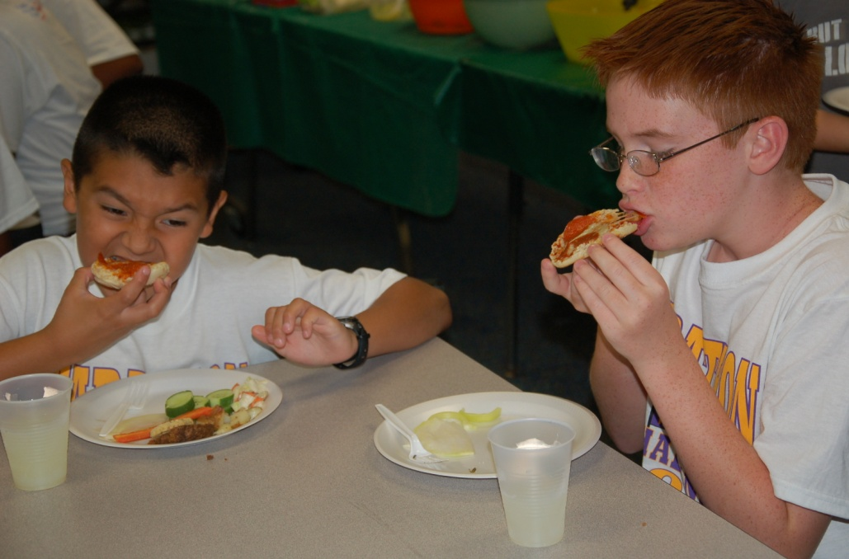
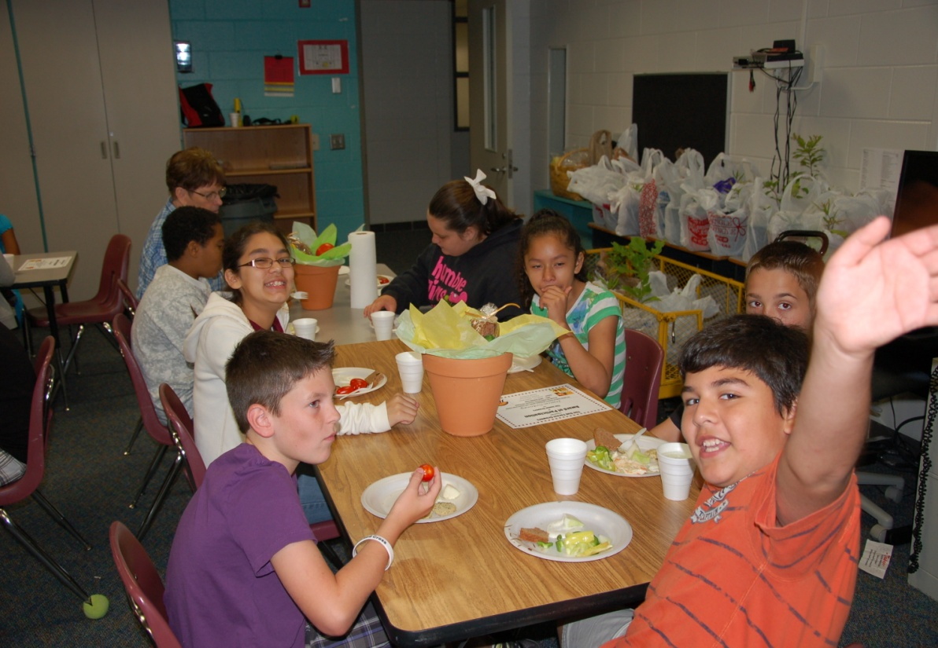
Harvest celebration

Slide 6
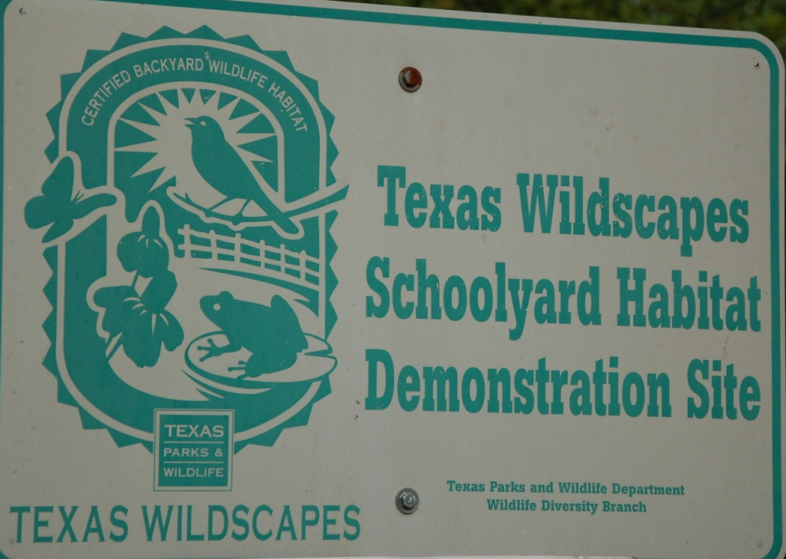
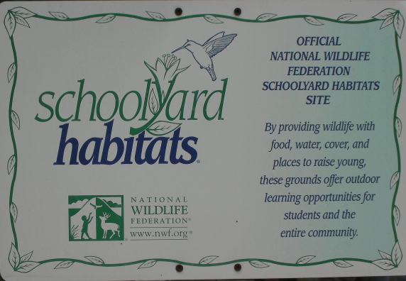
Our campus is part of:

Slide 7
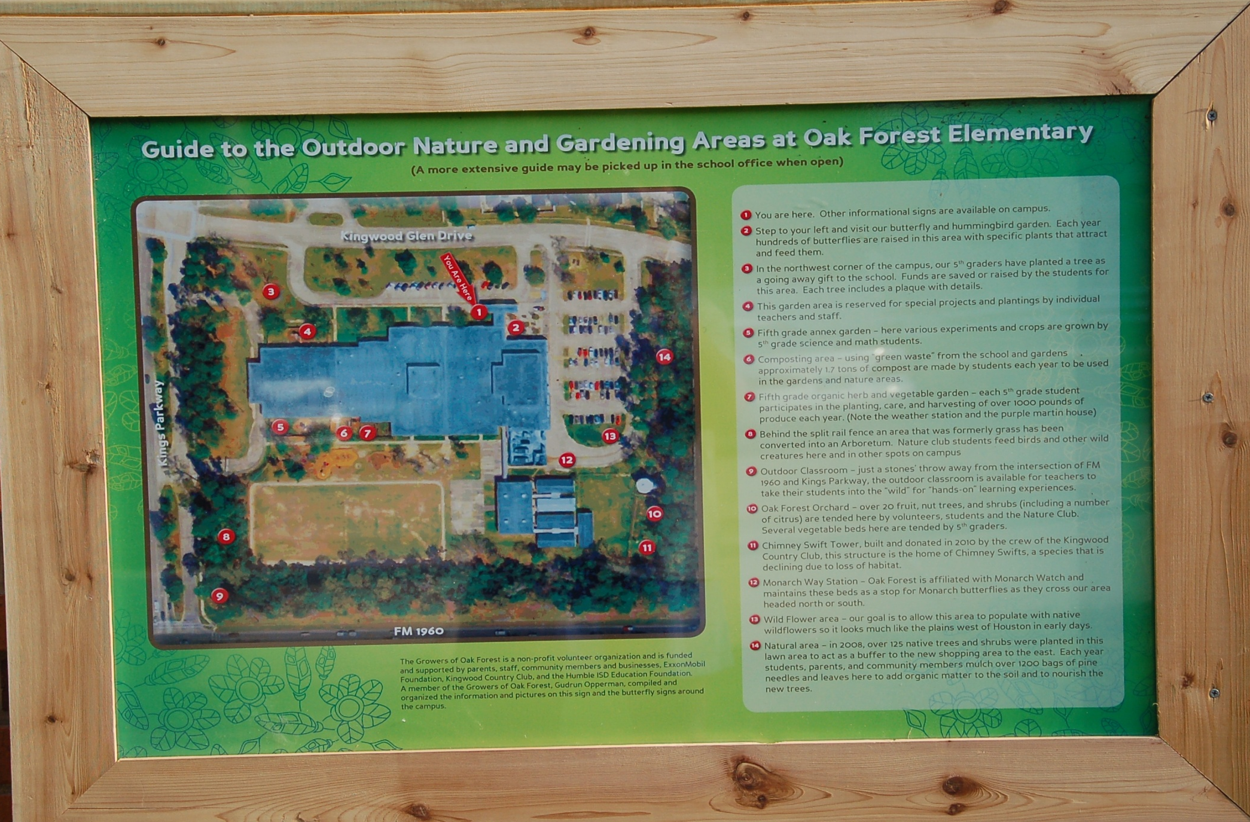
Take a tour of OFE campus

Slide 8
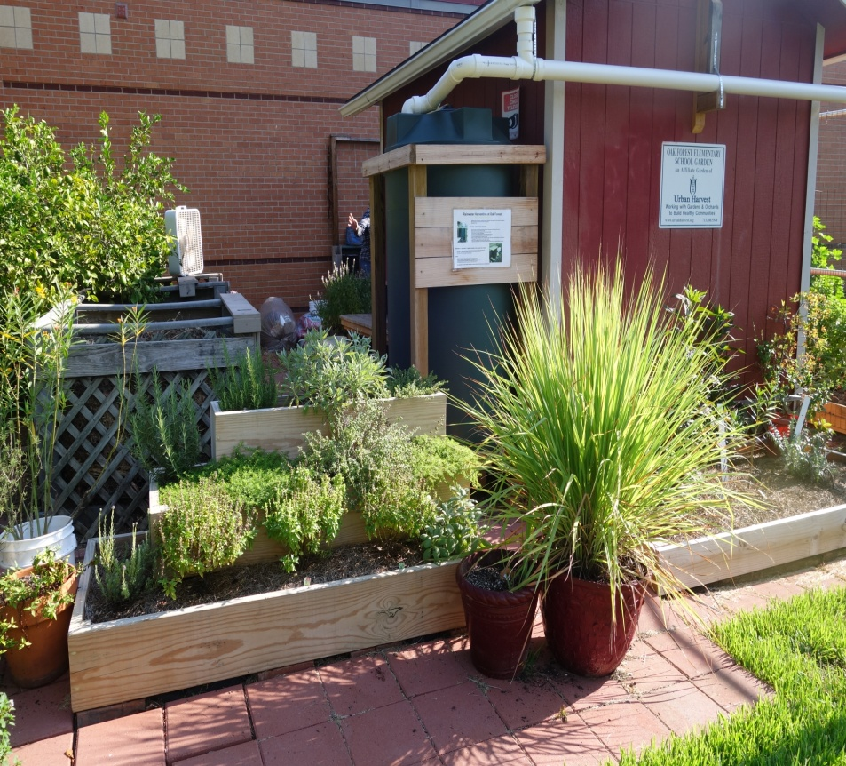
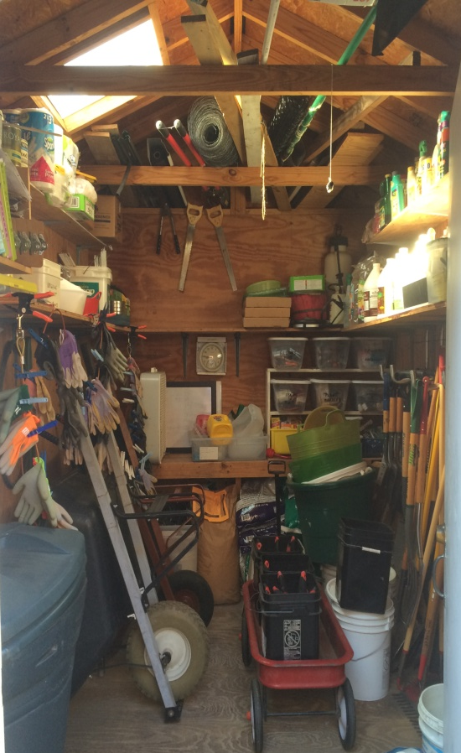
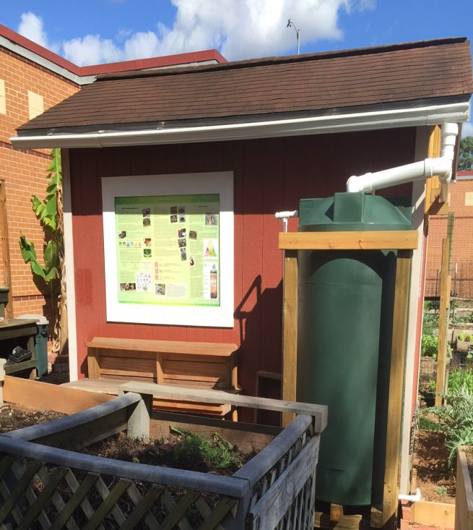
Welcome to the 5th grade garden
The Little Red Shed
With Rainwater
Tank

Slide 9
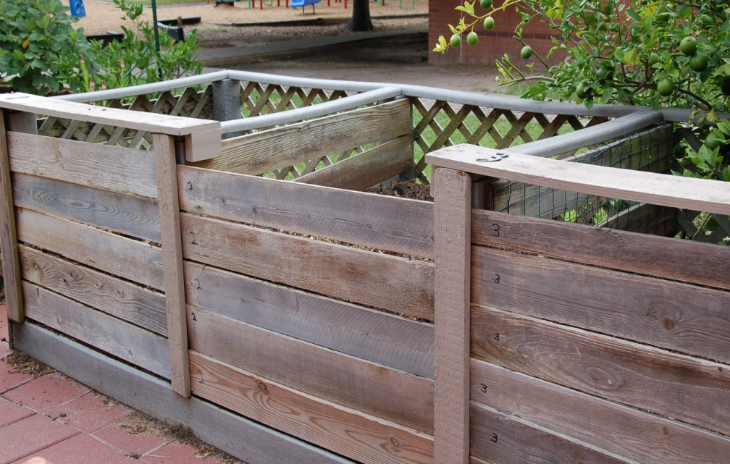
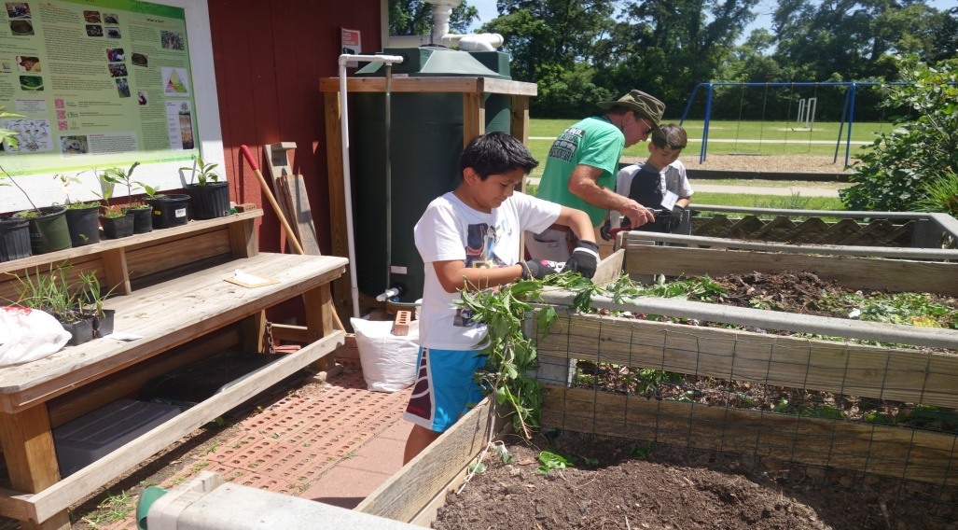
Compost Area
This area is an important part of our garden. We make compost here from dead plant material. We then use the finished compost in the garden to feed new plants.

Slide 10
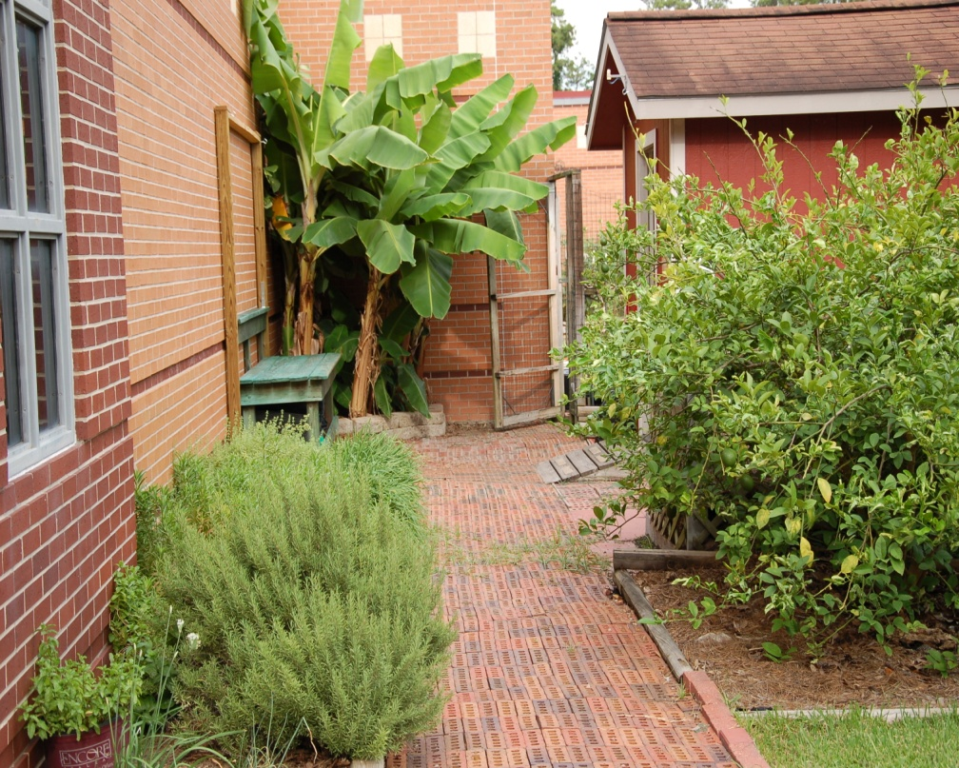
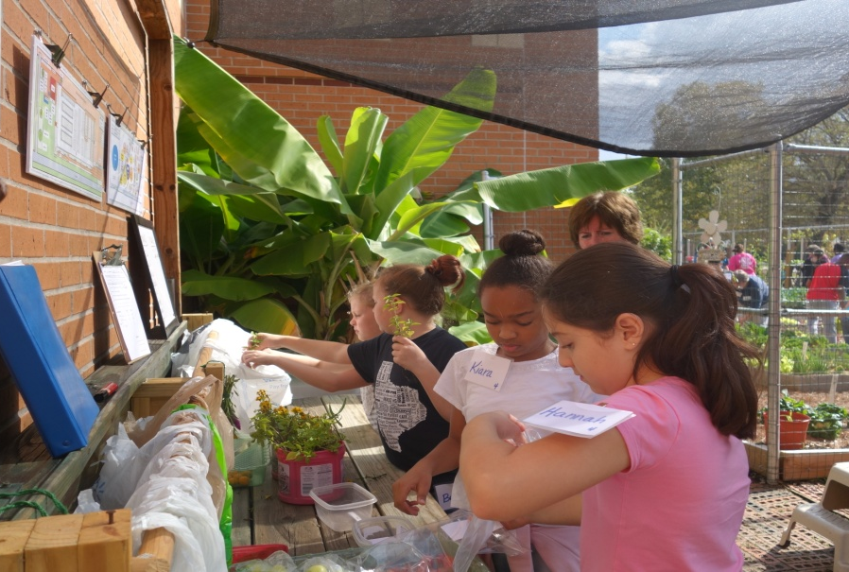
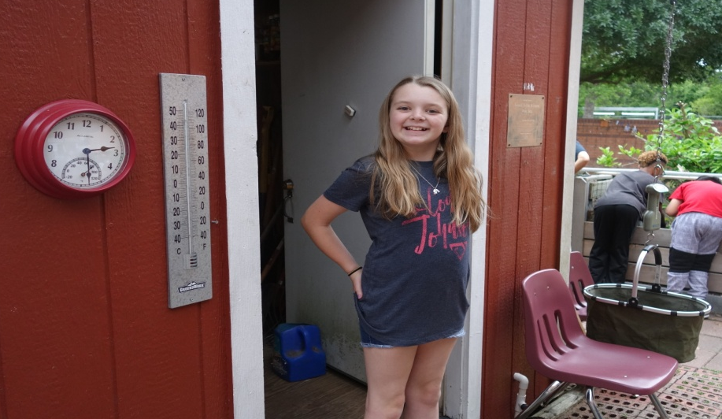
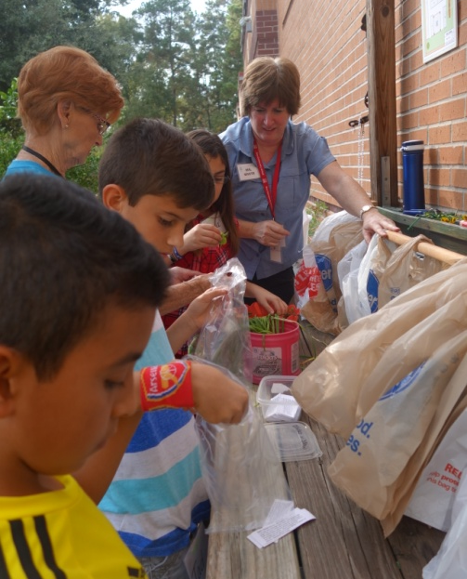
Around the shed

Slide 11
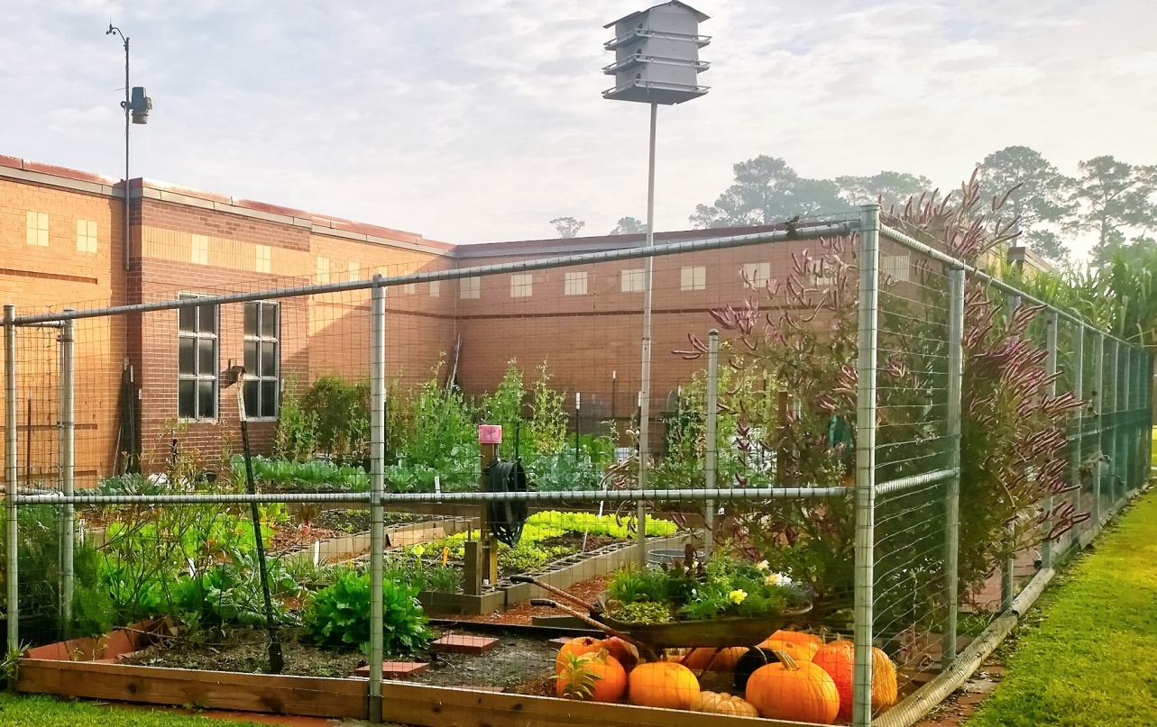
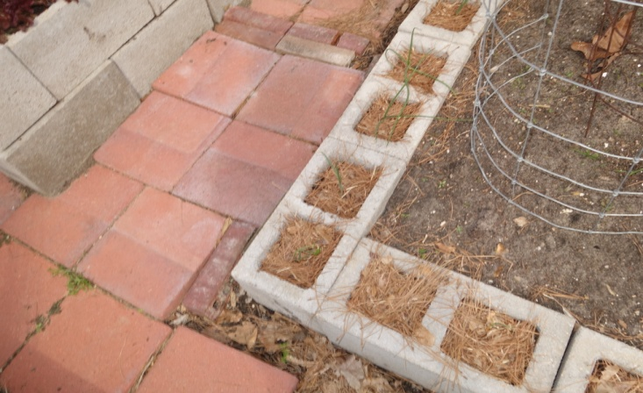
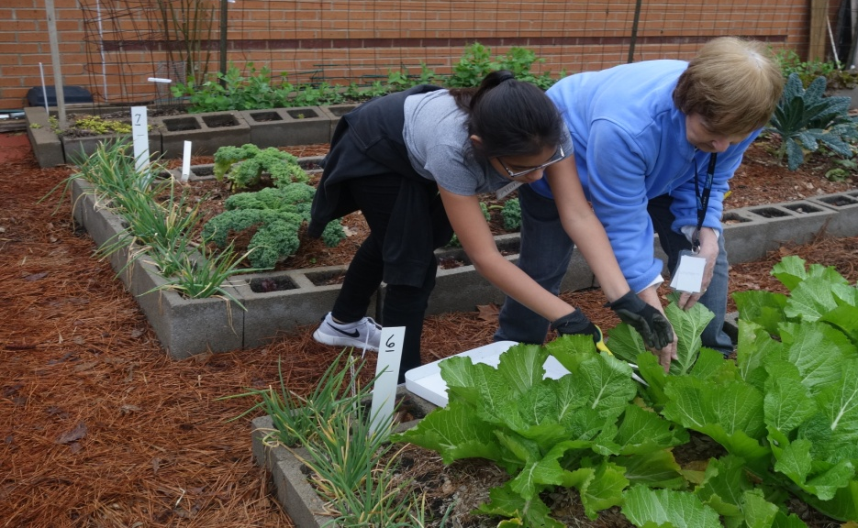
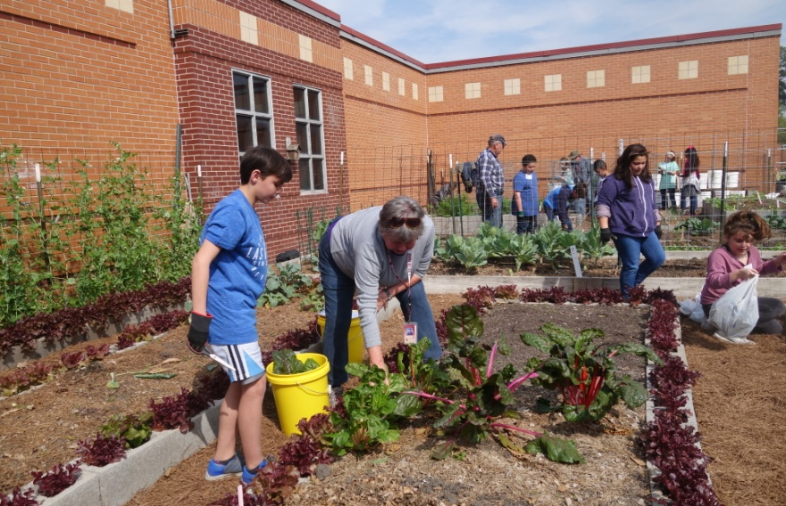
Know your way around the garden!

Slide 12
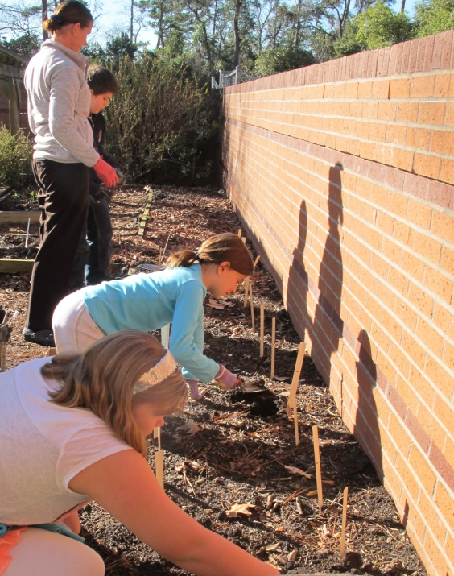
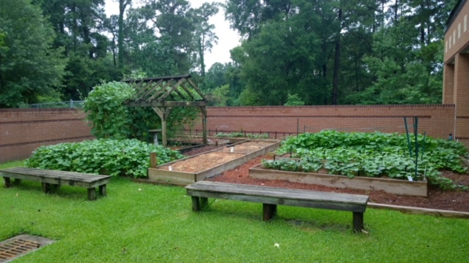
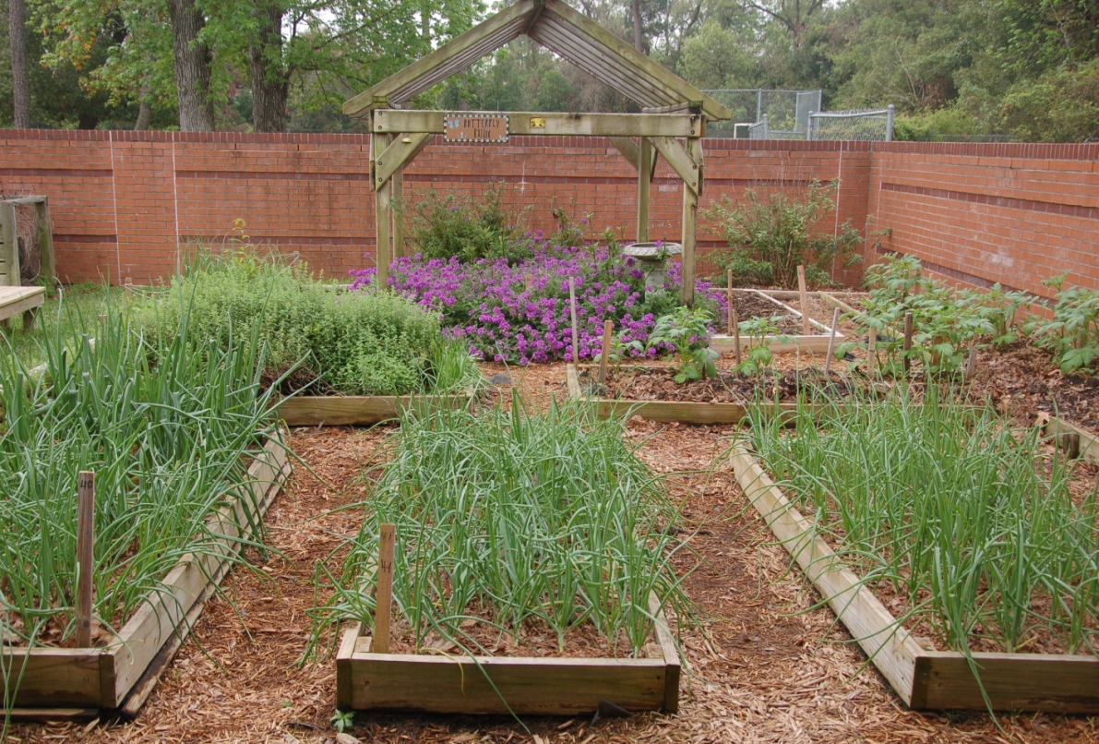
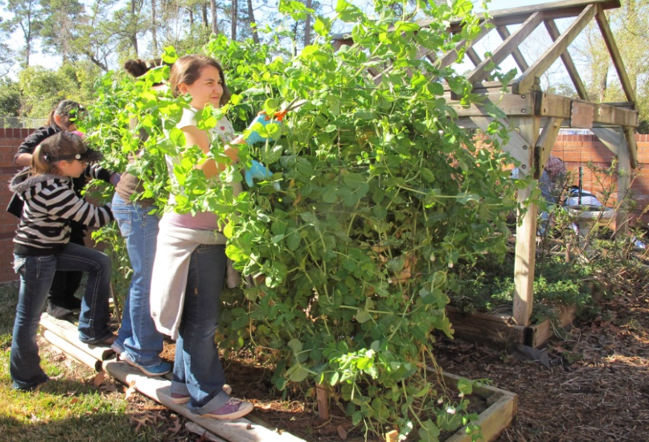
The Annex Garden

Slide 13
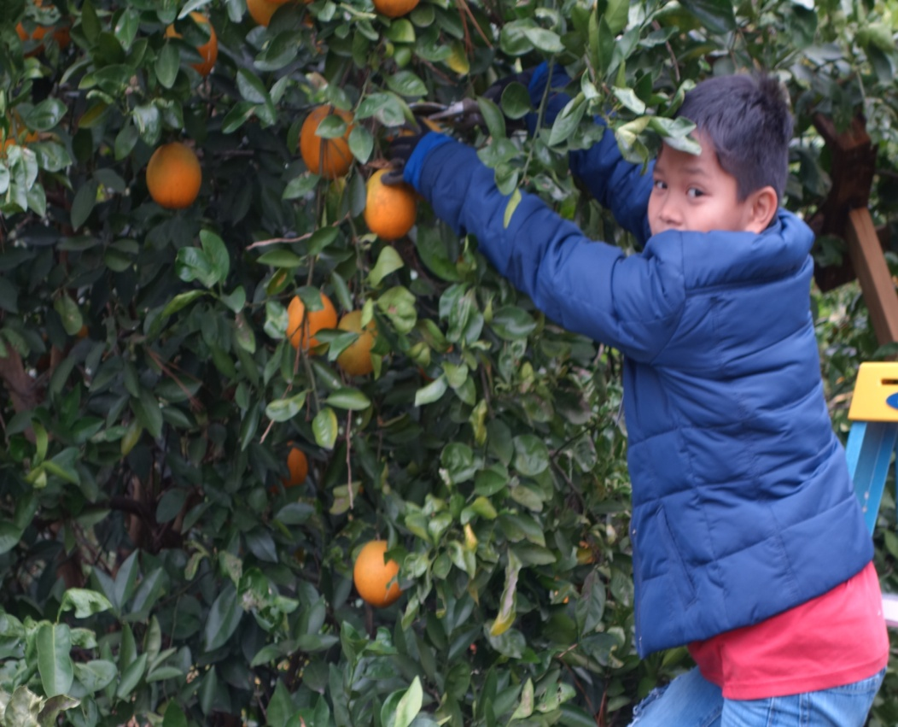
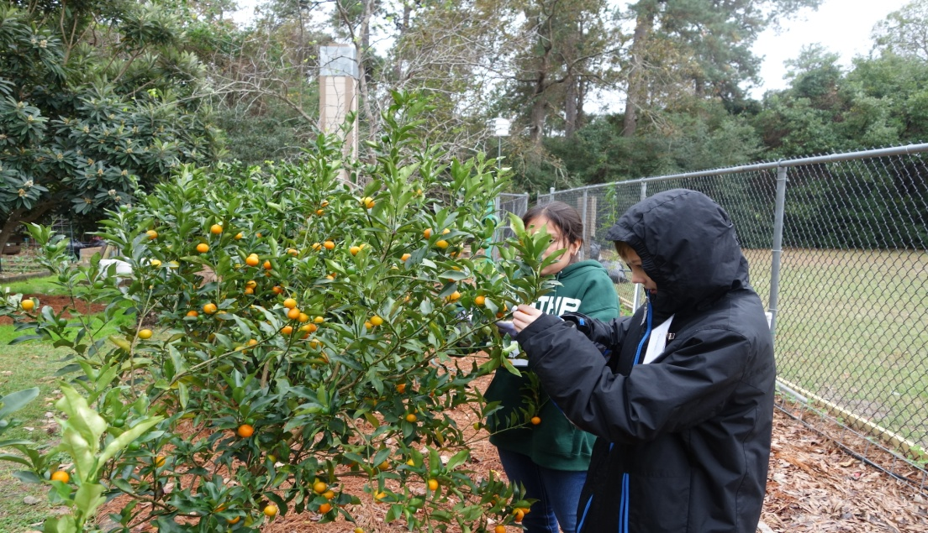
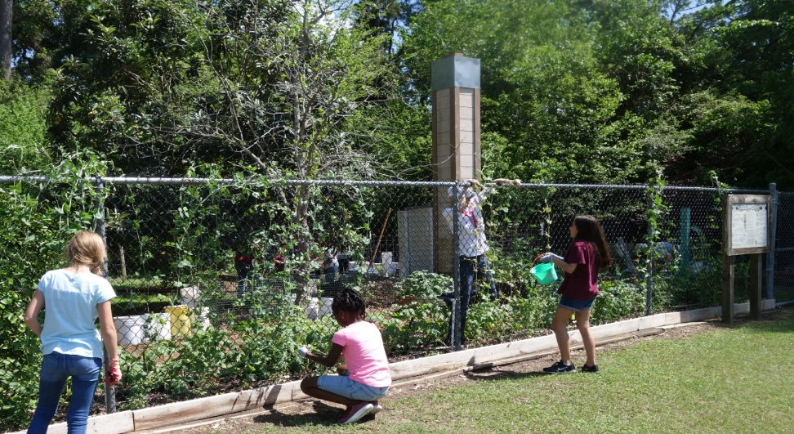
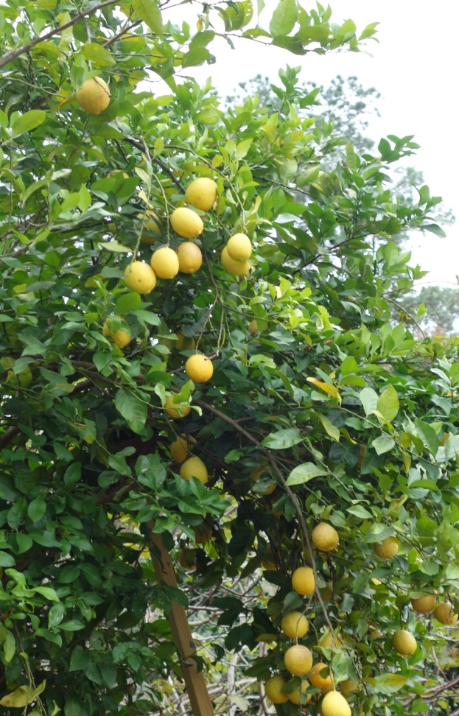
The orchard
Fruit trees, vegetable beds, Chimney Swift tower, Purple Martin birdhouses, birdfeeders and birdbath along with many native plants are found here.

Slide 14
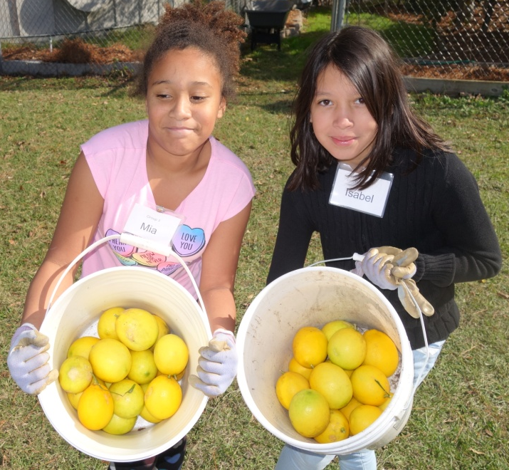
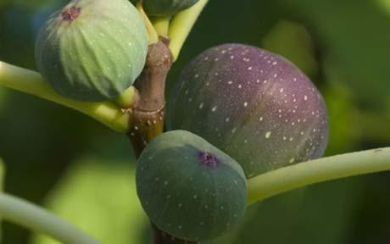
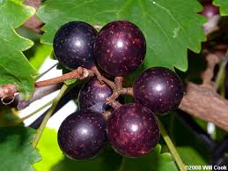
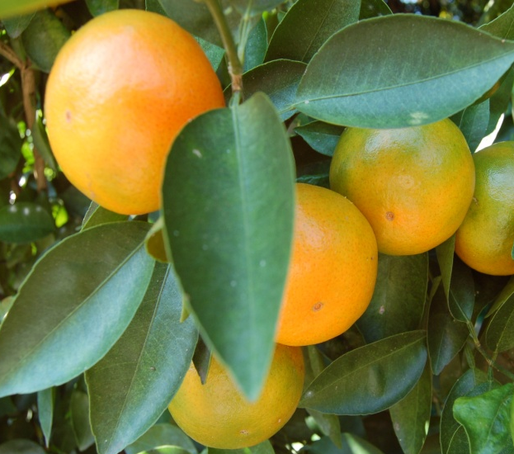
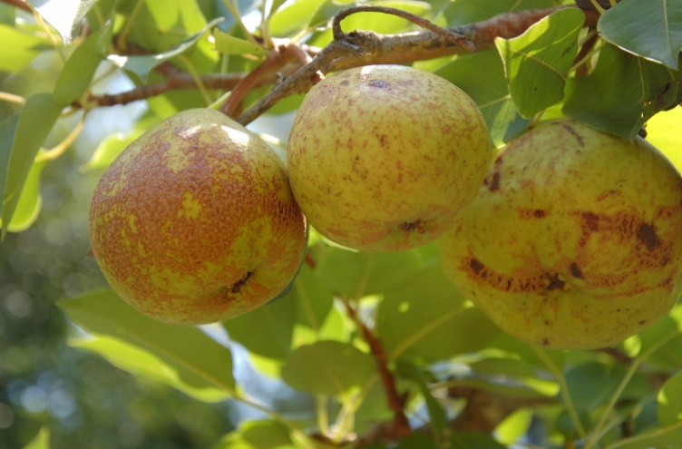
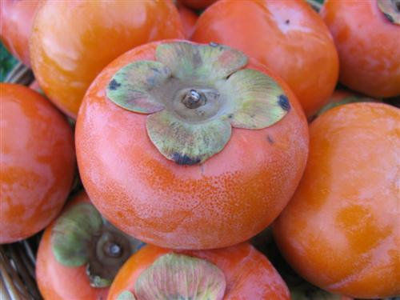
Citrus and other Fruit
Grapes
Figs
Lemons
Pears
Oranges
Persimmons

Slide 15
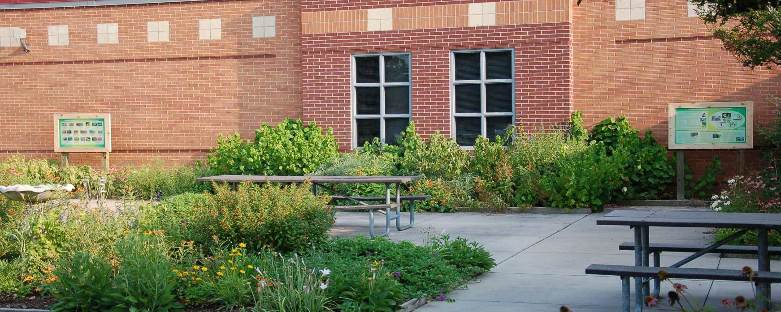
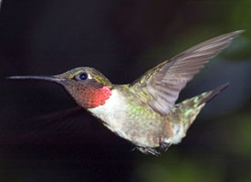
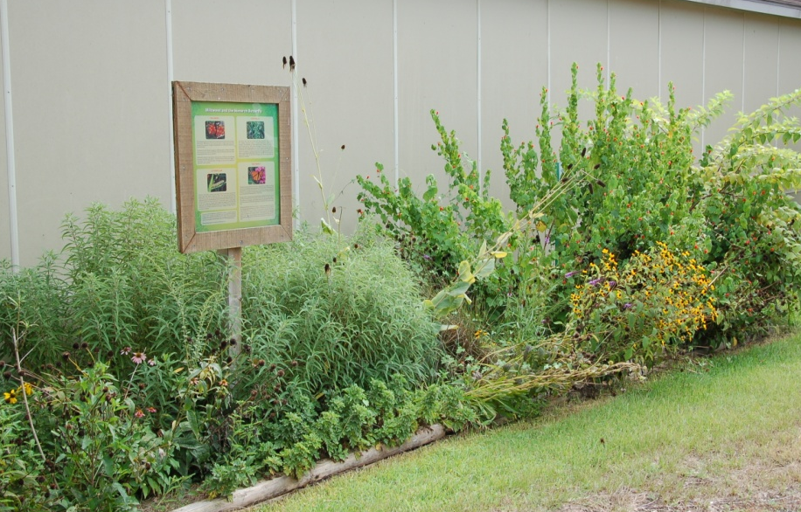
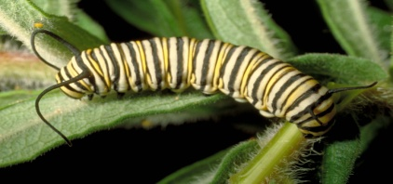
Butterfly and hummingbird gardens

Slide 16
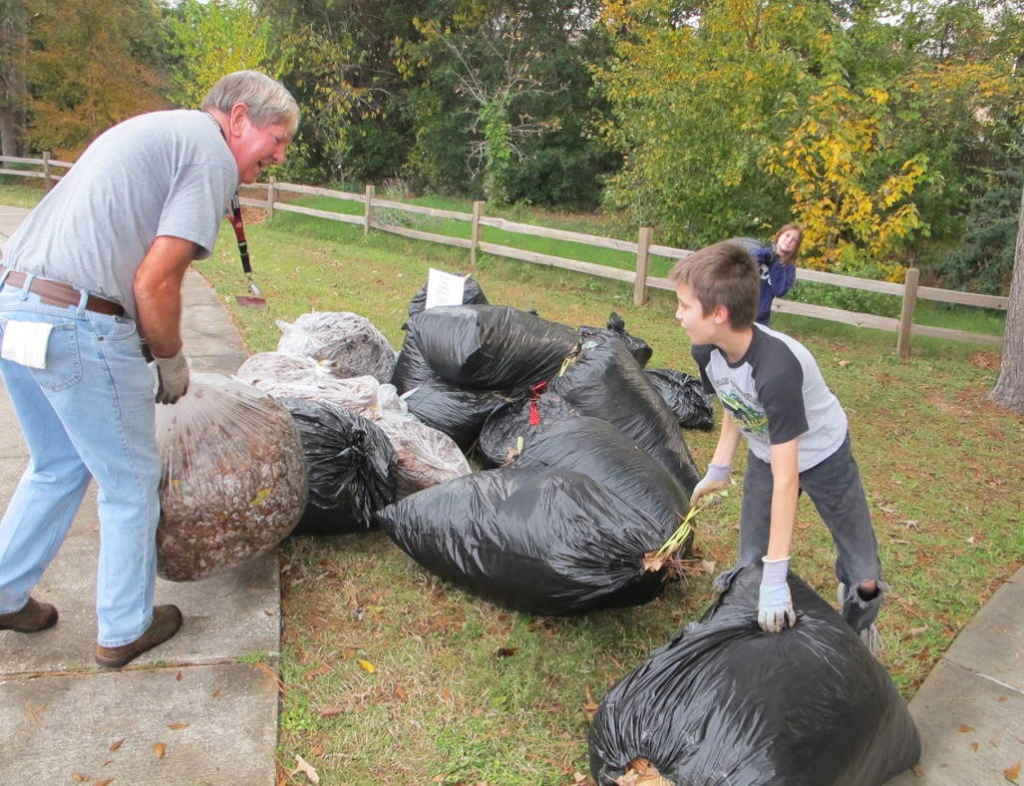
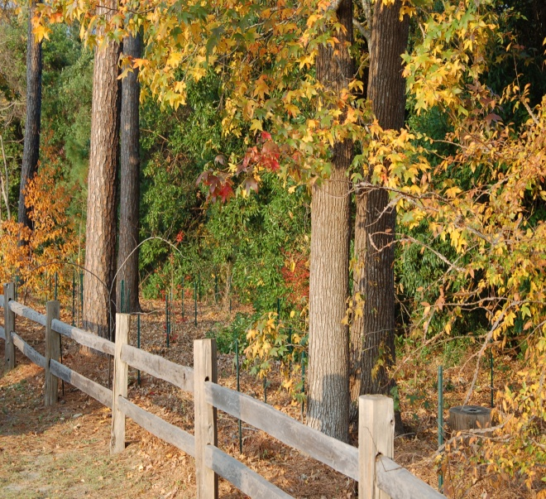
The East Side natural area
It’s a buffer for the school from the shopping center
Lots of native trees and shrubs
Home to lots of birds and creatures
Paper Retriever is located here
Leaf drop-off area

Slide 17
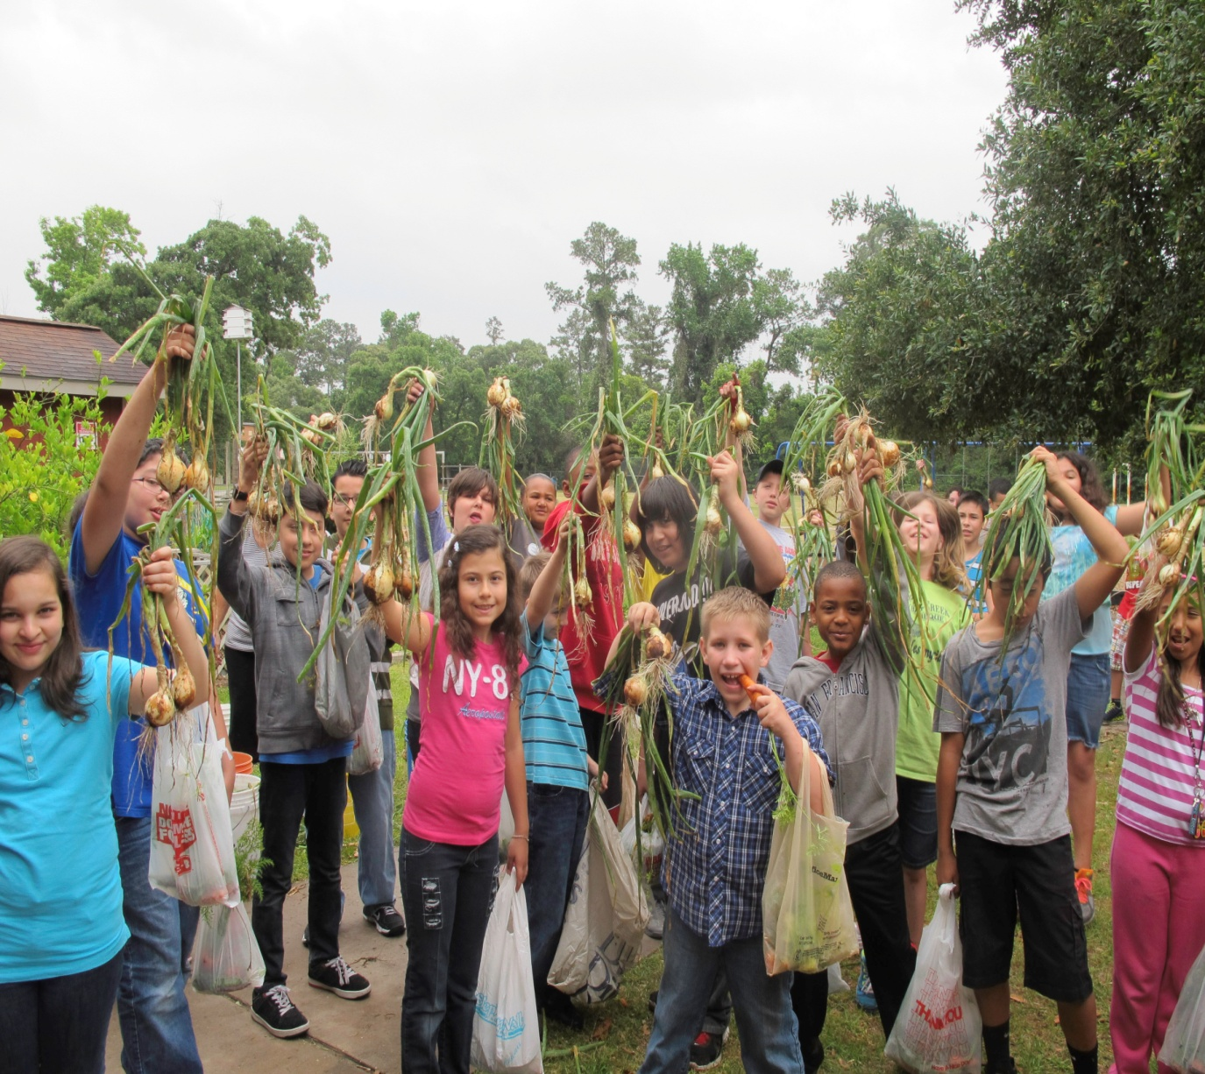
5th grade gardening is great!
Grow knowledge, cooperation and produce!
Rules for good gardening:
Listen to instructions
Learn
Respect others
Cooperate
Help your classmates
Reap the harvest
Be safe!!
Have fun!

Slide 18
In the Home and the Classroom!
OFEGrowers.org – a Resources at your command
Teaching and Reference manual-
A place you can go to any time to review and a place filled with go to information (e.g. a reference book)
Planting chart
Power point lessons
List of other Resources
This slide needs to be viewed as part of the slide show and performs best when waiting until the narration is complete so that utilizing the arrows will not conflict with the presentation.

