Slide 1
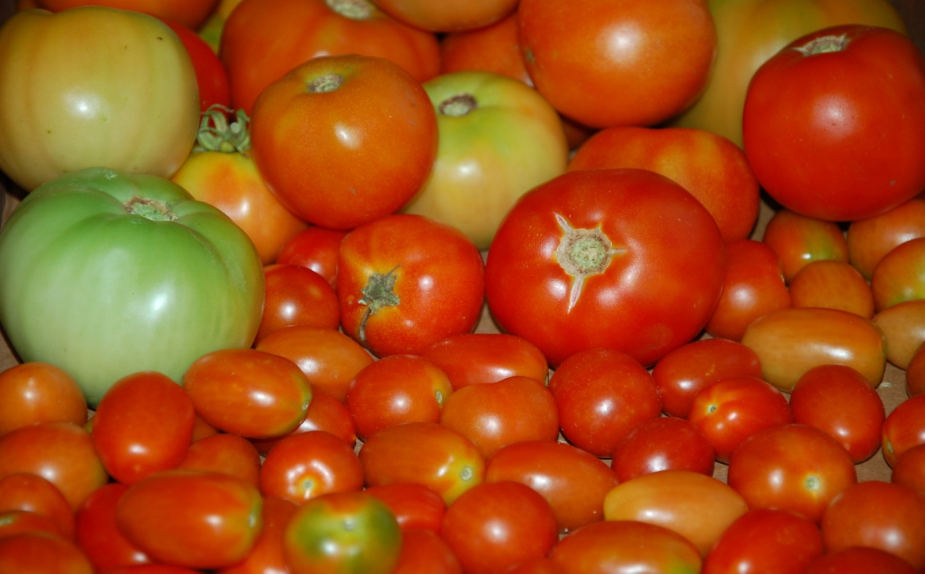
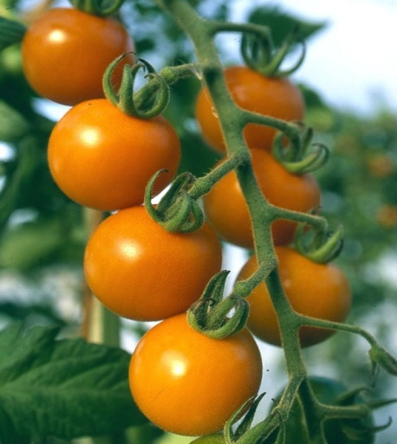
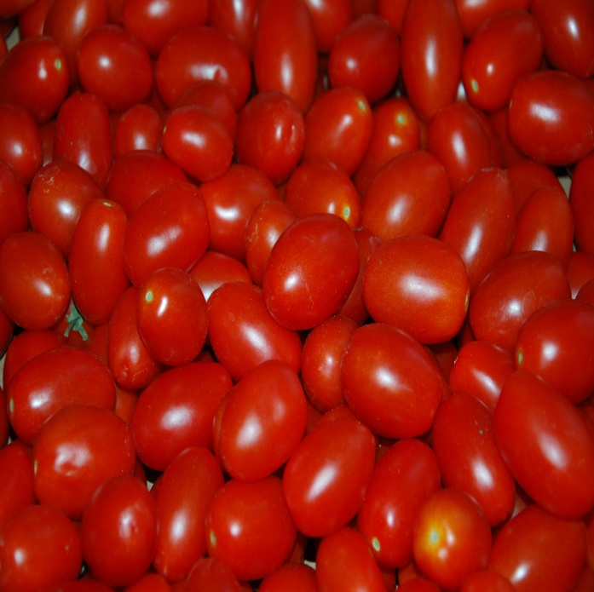
Tomato
Fruit or Vegetable?

Slide 2
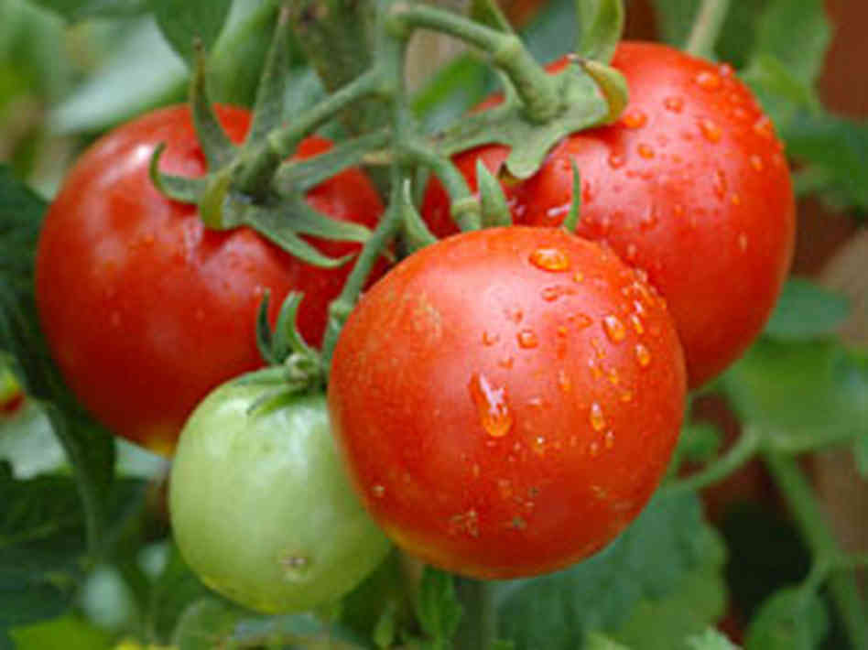
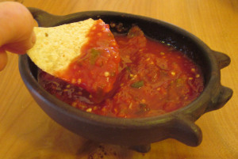
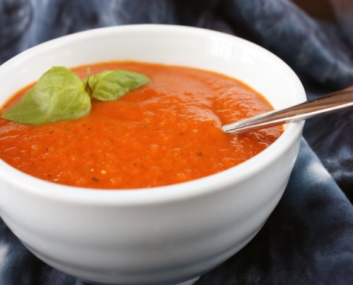
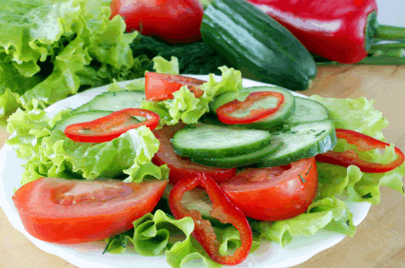
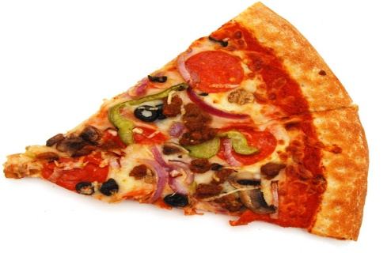
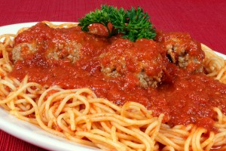
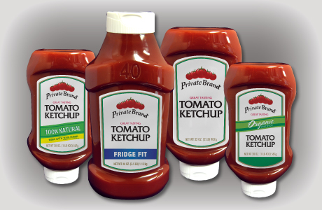
Tomato – King of the Garden!
=
Most popular plant grown in vegetable gardens.
Tomatoes are in some of our favorite foods.

Slide 3
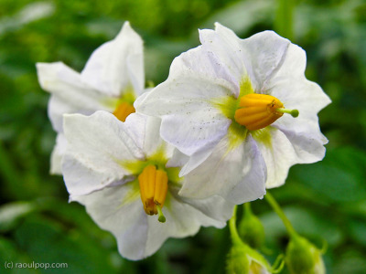
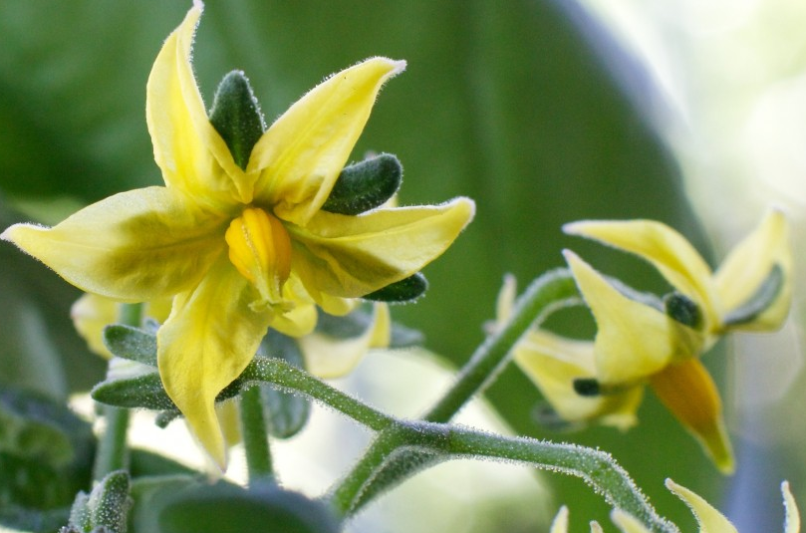
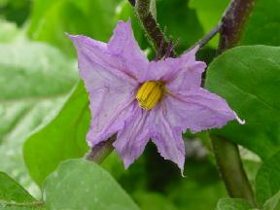
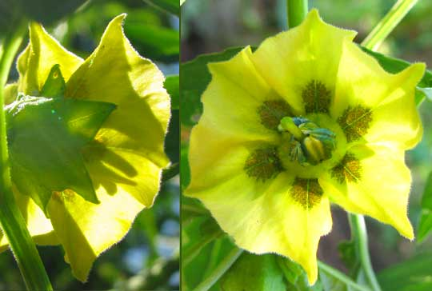
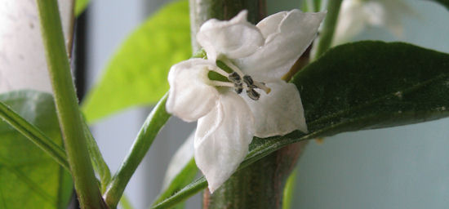
Tomatoes
Tomato flowers
Eggplant flower
Potato flowers
Tomatillo flower
Are part of the Nightshade or Solanaceae Family
Pepper flower

Slide 4
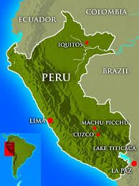
Origin of Tomatoes
Found growing wild in fields in Peru, Ecuador, & Chile

Slide 5
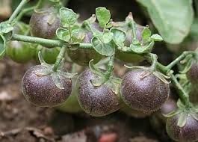
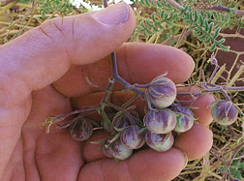
The Original Wild Tomato

Slide 6
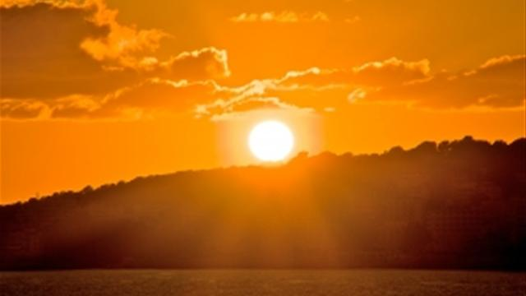
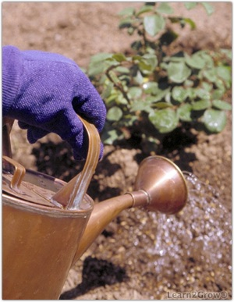
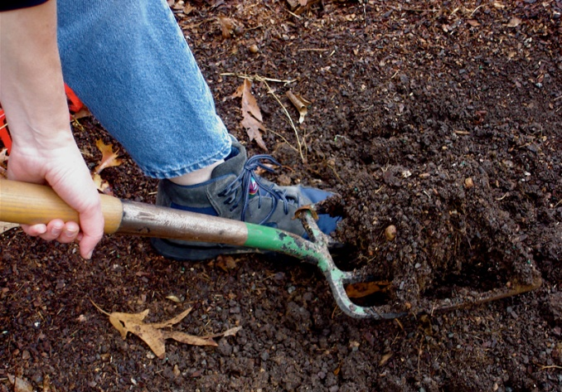
Tomatoes need:
At least 8 hours
Good soil with compost
Lots of sunlight
Consistent water
Good fertilizer
Regular watering
Good Soil

Slide 7
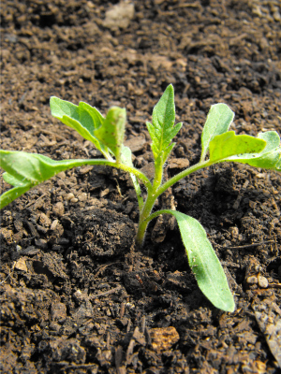
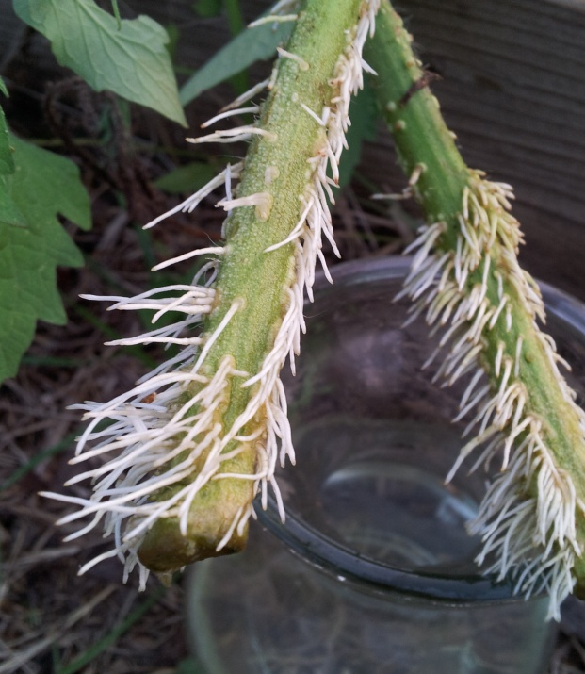
Planting Tomatoes
Plant early - around March 1
Fruit will not set if night temperatures are above 70 degrees or if day temperatures are above 90 degrees.
Plant transplant deep, to where leaves start
Roots will sprout along the stem.

Slide 8
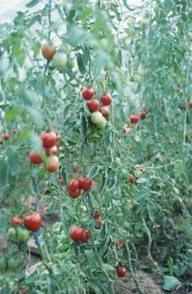
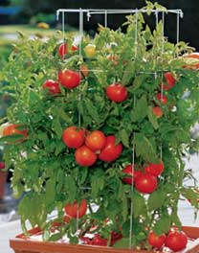
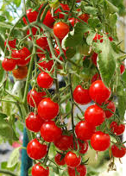
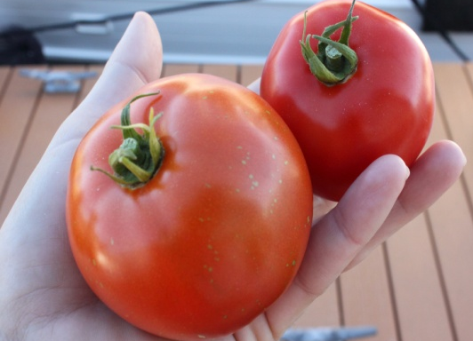
Two Types of Tomatoes
Indeterminate
Continue to grow during the growing season
Are vines
Usually have
small fruits
Determinate
Will mature and ripen its fruit all around the same time
Are usually bush types with large fruit

Slide 9
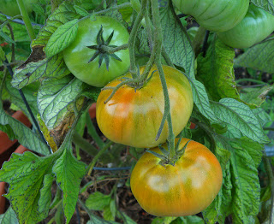
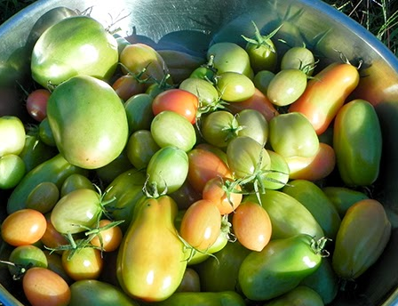
Harvesting Tomatoes
Harvest when just starting to turn color
Keep on kitchen counter until ripe
Do not keep in refrigerator

Slide 10
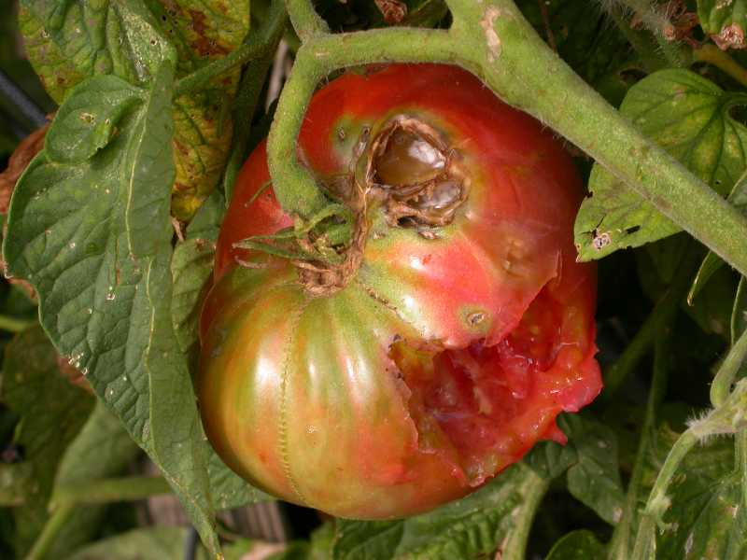
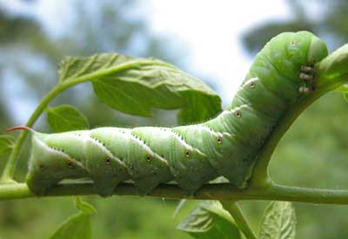
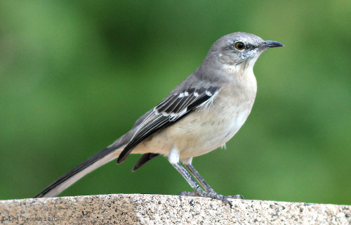
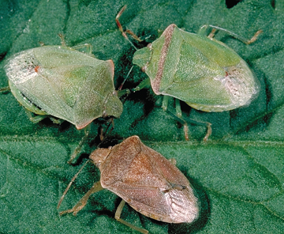
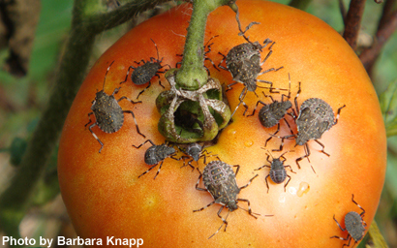
Some Tomato Pests
Tomato Hornworm
Stinkbugs

Slide 11
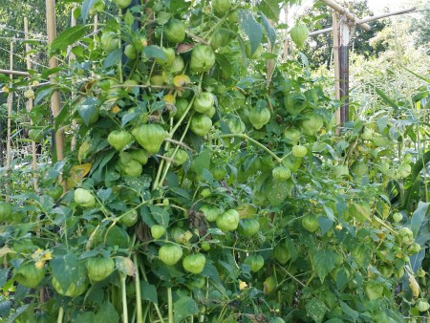
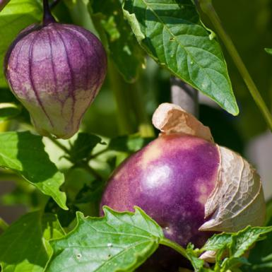
Tomatillos
Need same conditions as tomatoes
Take up a lot of room
Two plants are needed for cross pollination to get fruit
Are ripe when papery husk splits from fruit

Slide 12
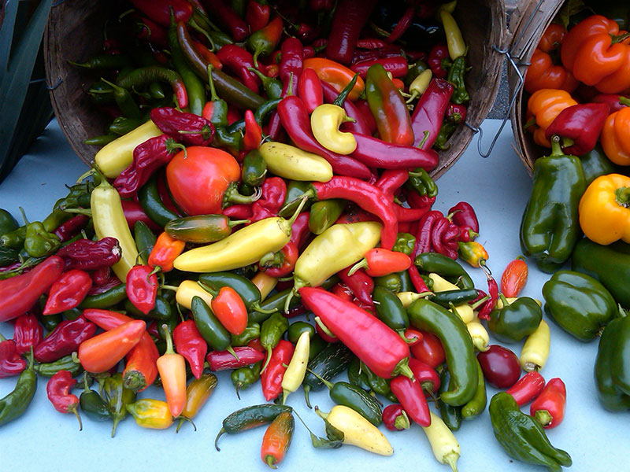
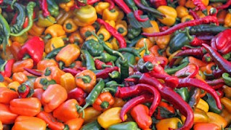
Peppers
More fruits in the Solanaceae or Nightshade Family

Slide 13
History of peppers or chiles
Originated south of the Amazon area
Peppers were used over 9000 years ago in Mexico
Our wild pepper is called Chile piquin or chiltepin
Columbus brought pepper seeds to Europe
Most peppers grown by people are Capsicum annuum types

Slide 14
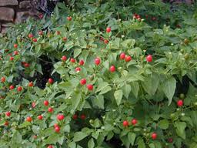
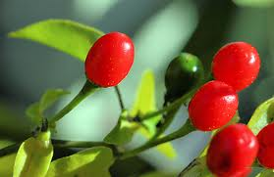
Chiltepin – chile pequin - Birdseye
Birds spread the seed all over South and Central America as well as southern North America

Slide 15
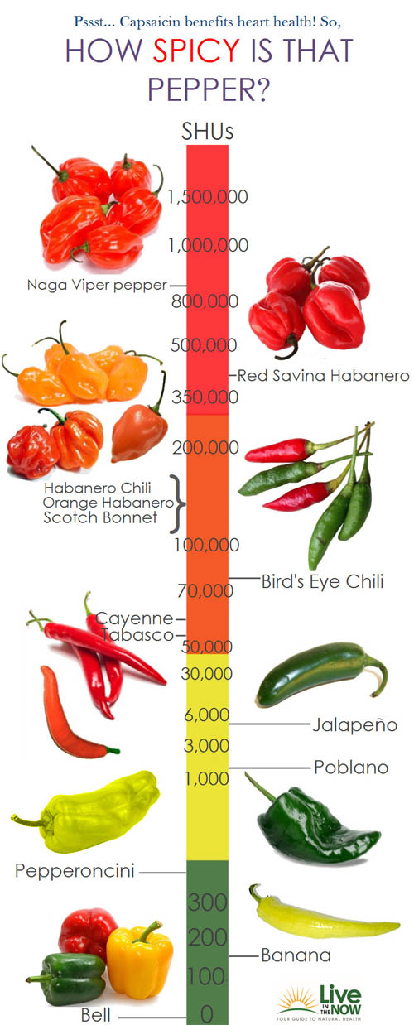
Hot peppers
Spicy peppers have capsaicin
Capsaicin can even blister
skin
Spiciness is measured in Scoville Units - –the higher the number the hotter the taste

Slide 16
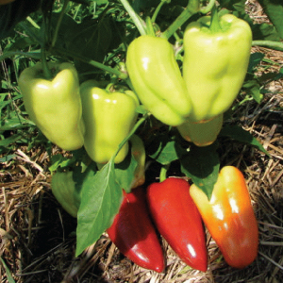
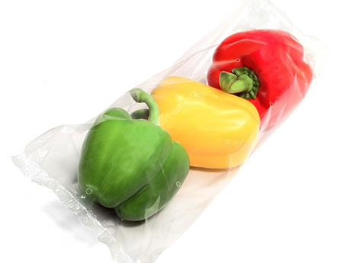
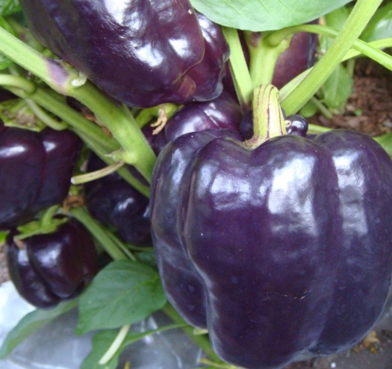
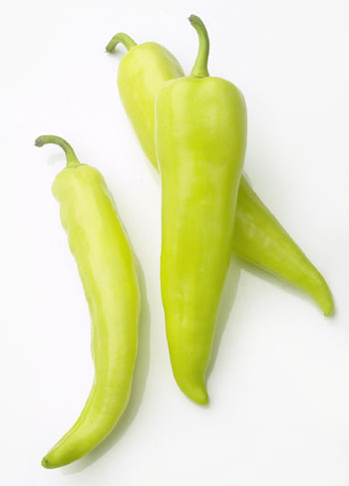
Bell peppers – sweet peppers
Have no capsaicin
All start out green and mature to red
Gypsy Pepper
Chocolate Bell Banana Pepper

Slide 17
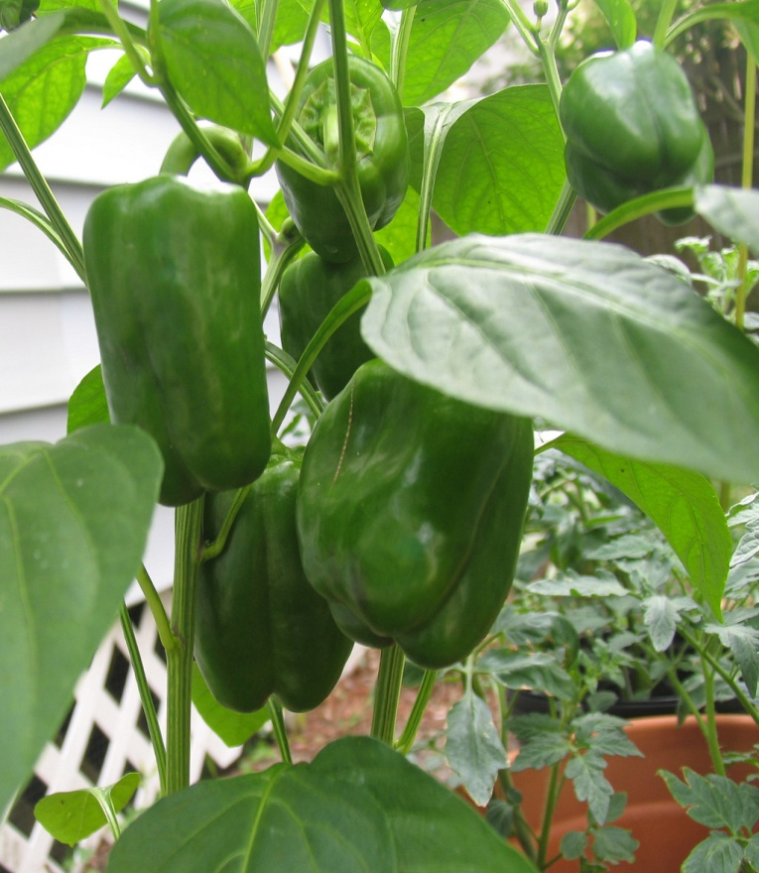
Peppers need:
Warm temperatures
Lots of sun
Lots of good organic fertilizer (not too much Nitrogen)
Even watering
Some support

Slide 18
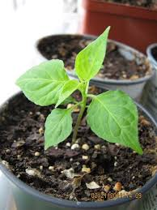
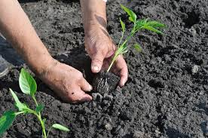
Planting peppers
Dig hole slightly larger than the pot
Mix fertilizer and compost in the hole
Plant the transplants level with the soil
Mulch around the plants
Water plant

Slide 19
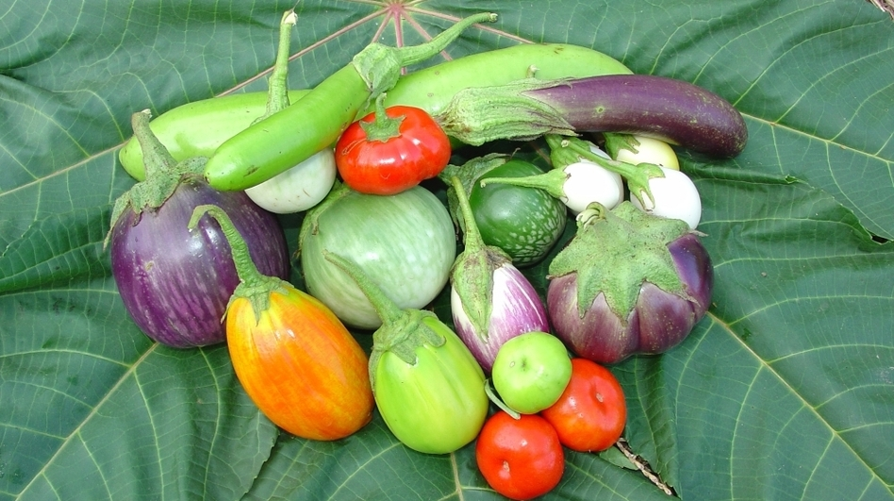
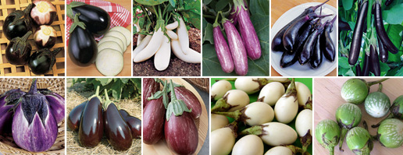
Eggplants – Solanaceae family
Originated in India
Were grown in China
Spread to the Middle East

Slide 20
Eggplants
Need same growing conditions as tomatoes and peppers
Planted same time as peppers
Love warm weather
Are harvested when they are a mature size
Do not store well, so use soon after harvest
Bruise easily

Slide 21
Pollinating Nightshade plants

