Slide 1
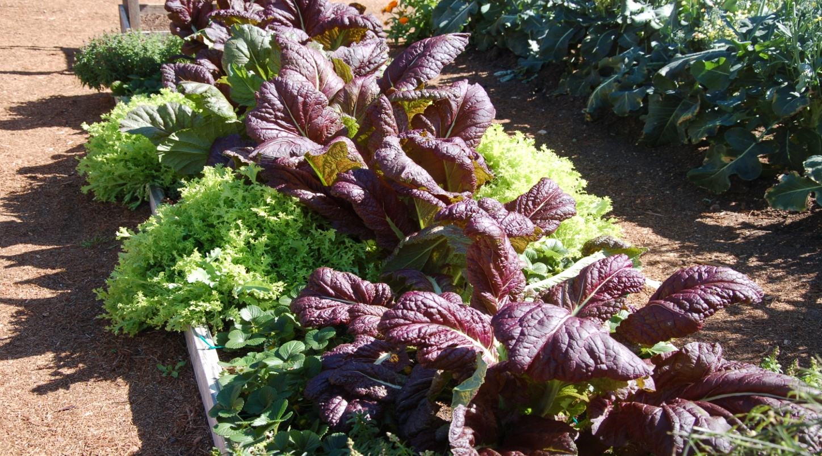
Leafy Greens
Easy to grow and fun to eat! They are pretty, too!
Many leafy greens that we grow are ‘cool season’ crops.

Slide 2
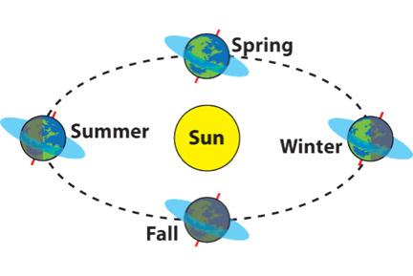
About seasons
Earth has seasons because its axis is tilted. Earth’s axis is always pointed in the same direction, so different parts of earth get the sun’s direct rays throughout the year.

Slide 3
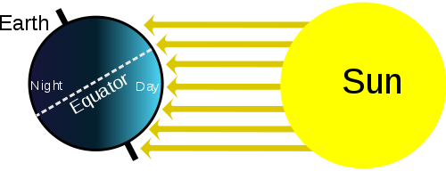
Seasons, continued
During winter, the Northern Hemisphere leans away from the sun, there are fewer daylight hours, and the sun hits us at an angle; this makes it appear lower in the sky. There is less heating because the angled sun's rays are “spread out” rather than direct.

Slide 4
Cool Season plants
During our cool/winter season in Houston –
1. Temperatures are cooler
2. Days get shorter
3. There is less sunlight
Plants need sunlight for photosynthesis.
Why then, can we grow some plants here in the winter?
As the days get shorter, will plants grow more slowly?

Slide 5
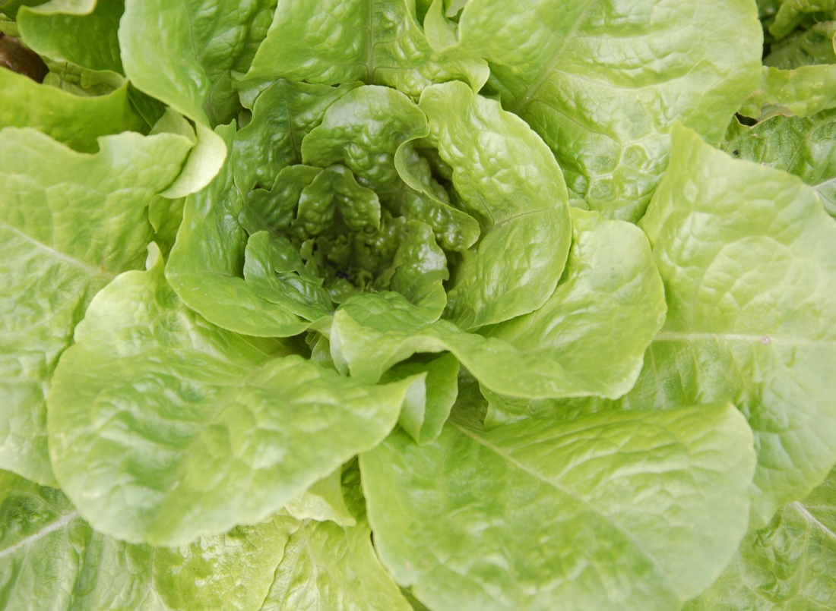
Let us eat lettuce!
Do you know that leaf lettuce has a whole bunch of nutrients? So be sure to eat some of our wonderful lettuces.
Green Butterhead Lettuce

Slide 6
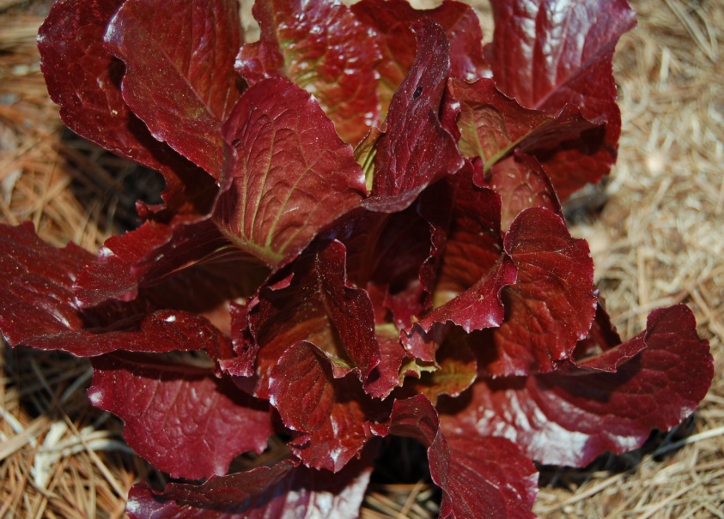
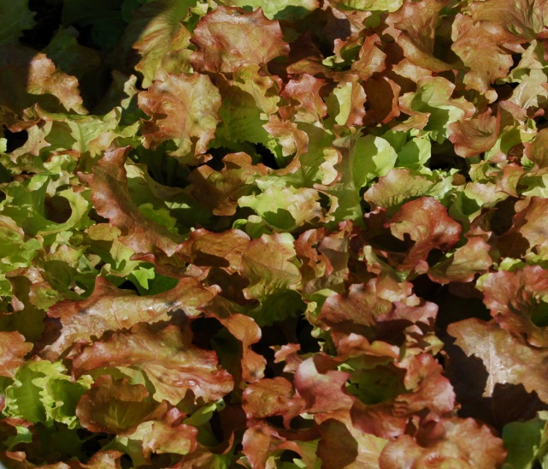
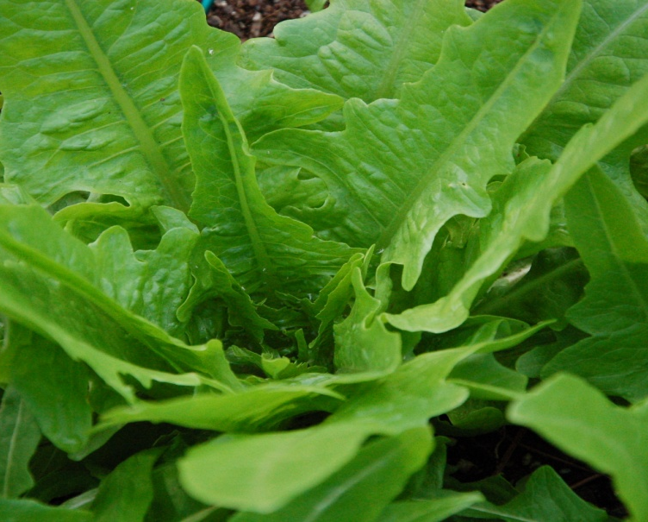
Lettuce can be pretty, too!
Darker leaf color means more nutrients!

Slide 7
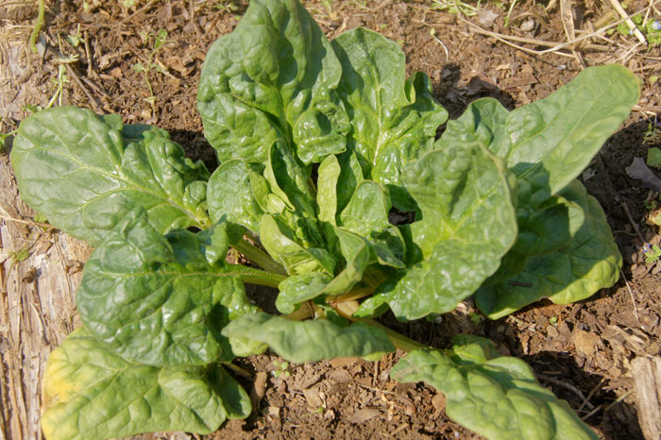
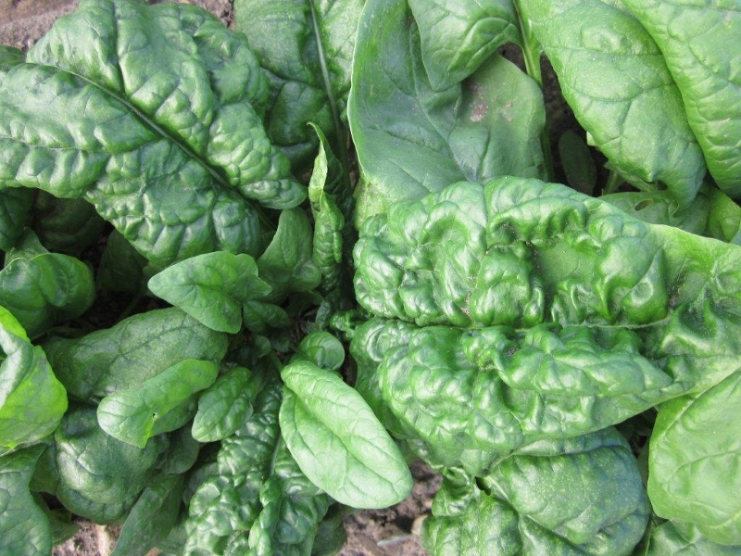
Spinach
Popeye was onto something good!
Monstreuex de Viroflay
Bloomsdale Long Standing

Slide 8
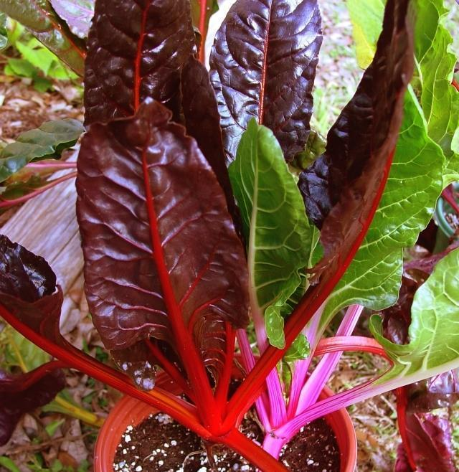
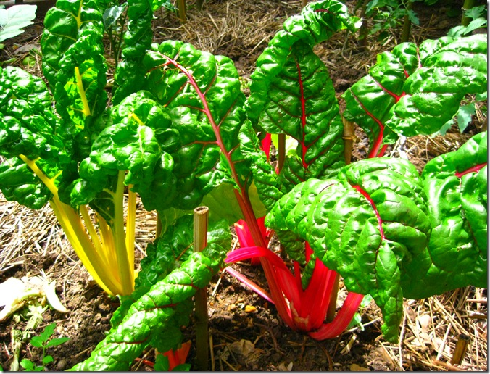
Swiss Chard
It’s pretty and good for you. It is a relative of spinach and beets. They are all in the Amaranthaceae Family.

Slide 9
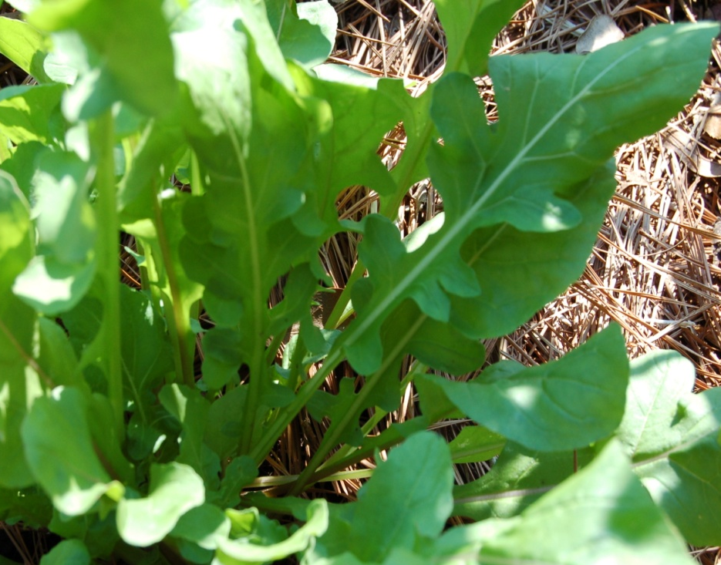
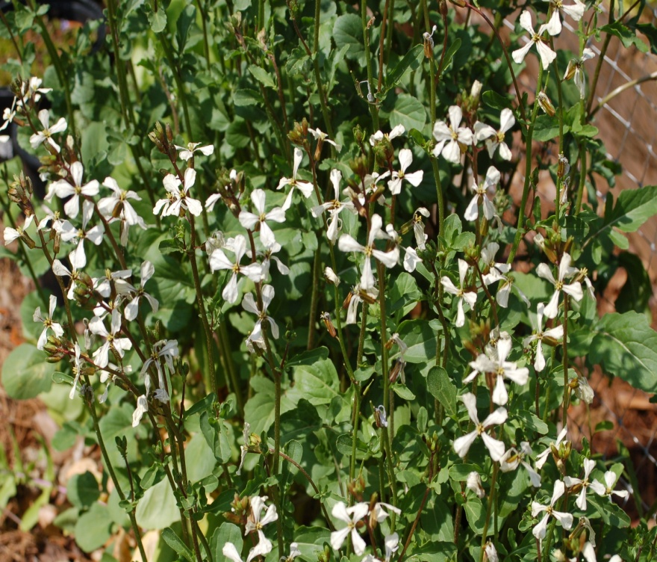
Arugula
Belongs to the Brassicaceae Family
Flowers of Arugula. They look like all the flowers in the same family – like a cross.

Slide 10
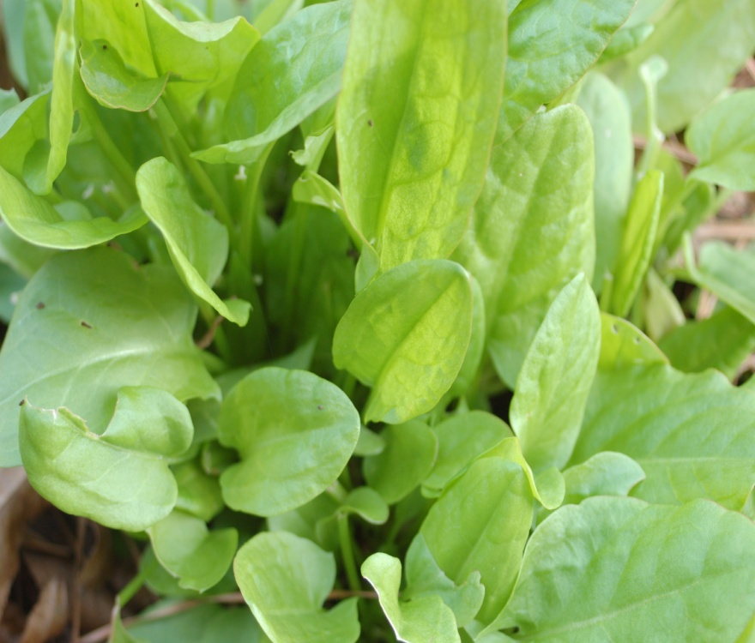
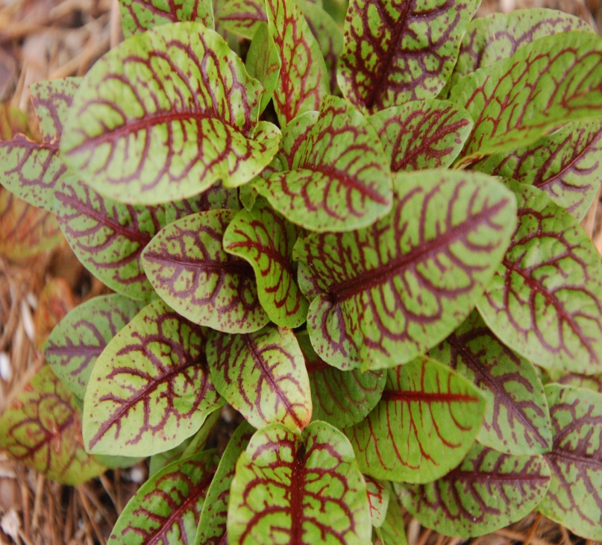
French Sorrel
French Sorrel
Red Sorrel
It is an unusual leafy green that tastes sour and is great eaten raw or cooked into a sauce. What makes it taste sour?

Slide 11
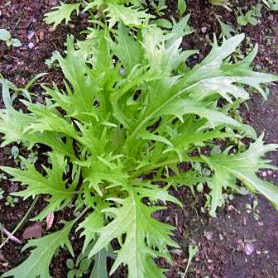
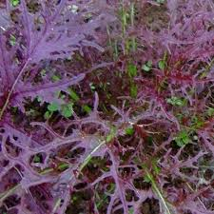
Mizuna (Spider Mustard)
It has a mild peppery flavor that is slightly spicy
Cool season crop
Used raw in salads or cooked with meats

Slide 12
Safety lesson for today

Slide 13
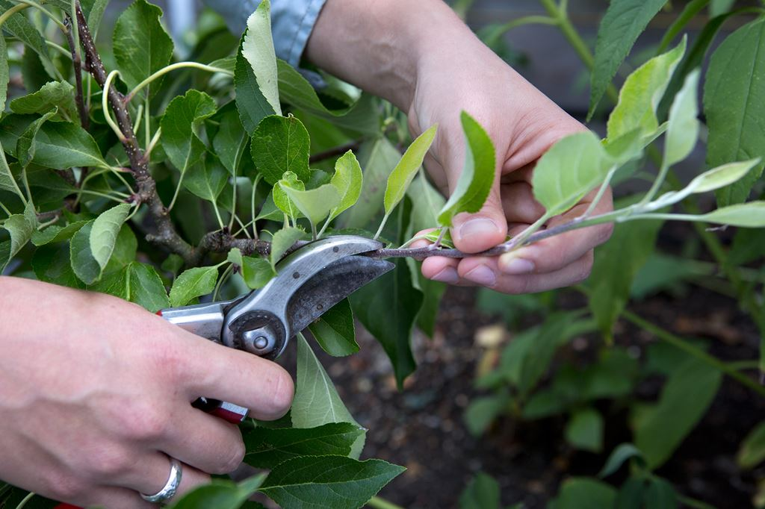
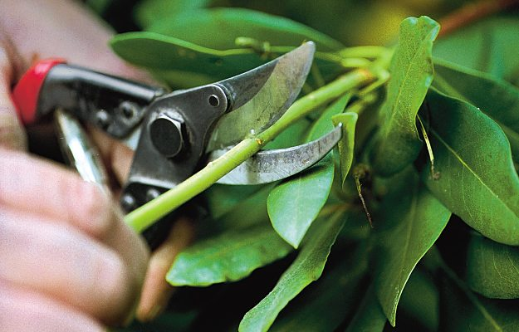
Tool safety - Pruners
Use pruners properly.
Where is the cutting blade?
Where are your fingers?
Check before you cut!

Slide 14
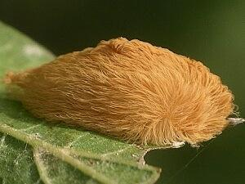
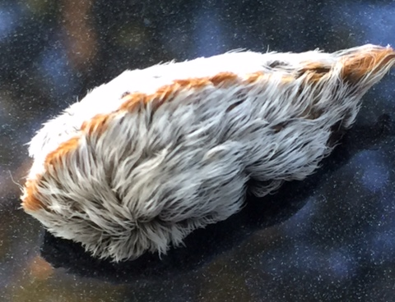
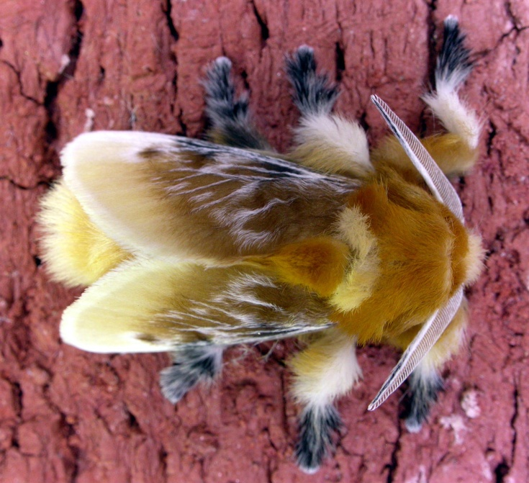
Insect safety – the flannel moth
Asp (Puss Caterpillar)– the larva of the flannel moth
Touching it can cause severe pain and
blisters.

