Slide 1
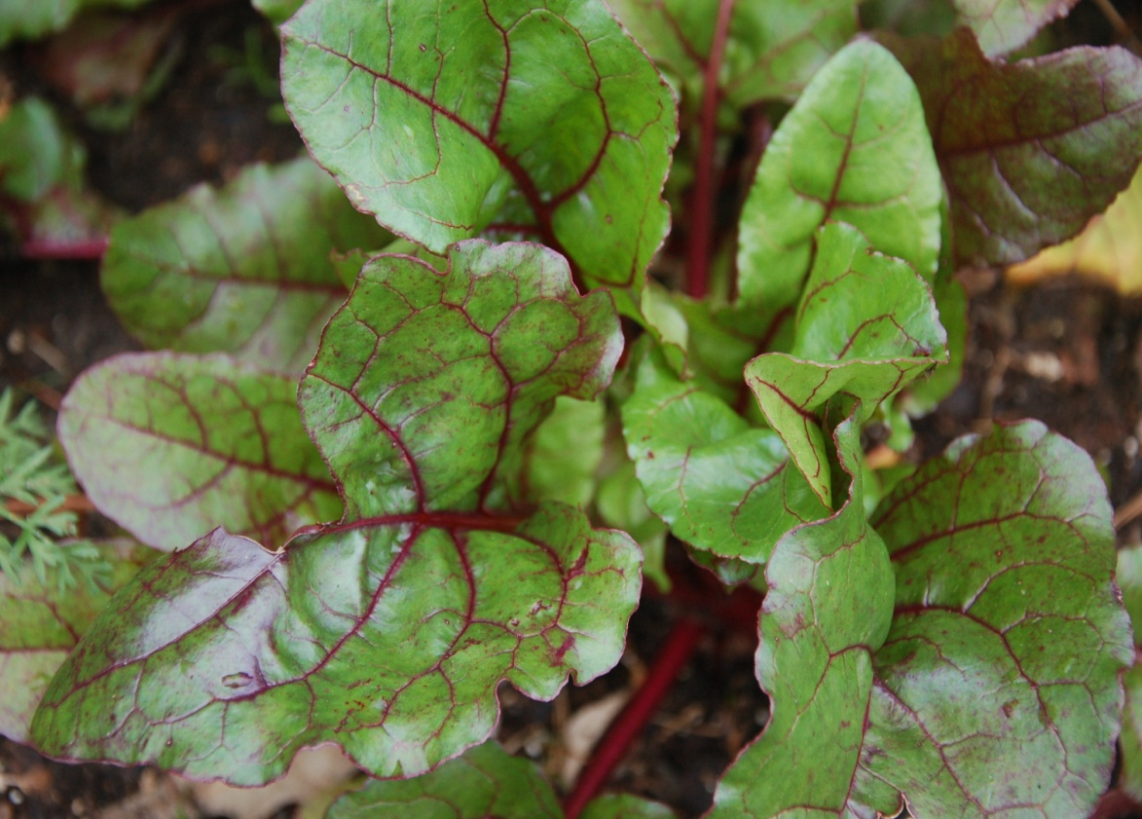
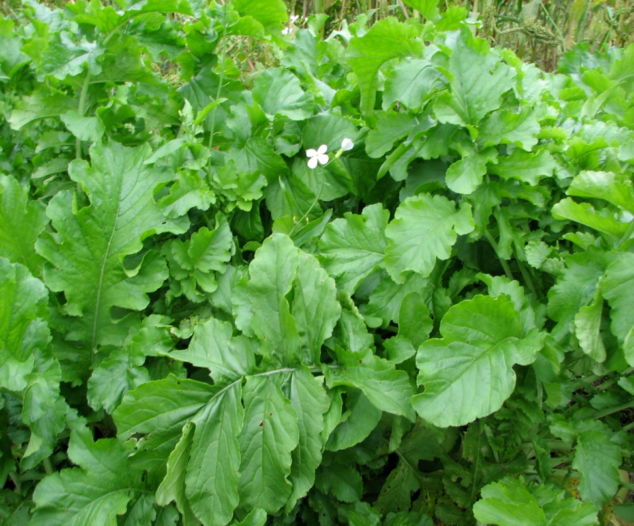
Root Crops
What are root crops?

Slide 2
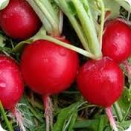
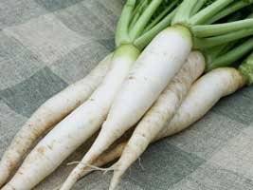
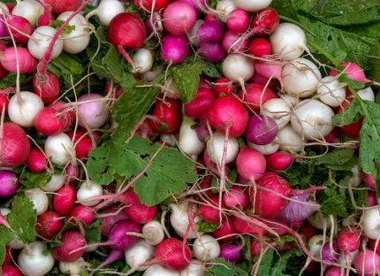
Radishes are fun to grow!
Cherry Belle White Icicle Early Scarlet Globe
Easter Egg Watermelon French Breakfast

Slide 3
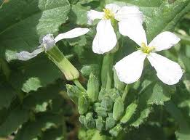
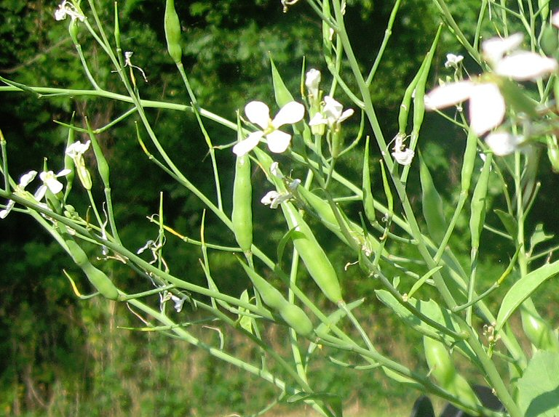
To What Family do Radishes Belong?
They belong to the
‘Brassicaceae’ or Brassica family.
What other plants are in this family ?
What shape are the flowers?
Seed pods on radishes…
They taste good!

Slide 4
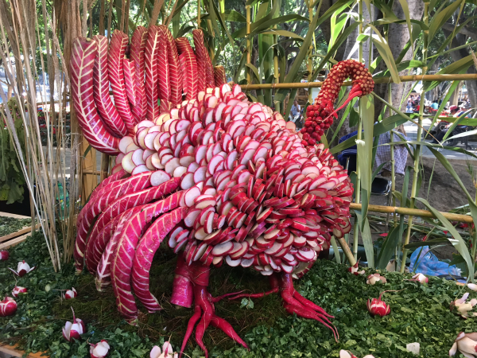
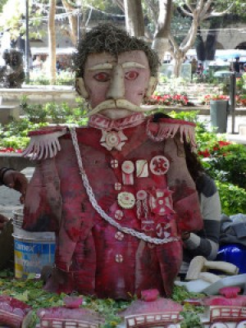
NIGHT OF THE RADISHES
ANNUAL EVENT STARTED MANY YEARS AGO. HELD ON DECEMBER 23RD IN OAXACO, MEXICO
ON THE TOWN PLAZA WHERE THEY CARVE OVERSIZED RADISHES
INTO VARIOUS FIGURES TO ATTRACT SHOPPERS,

Slide 5
What makes radishes spicy?
The spicy taste is in their skin
The ‘zing’ is in their skin
When you bite into a radish, the chemical in the skin is released and mixed with another one that makes it taste spicy.
What part of the radish has the most nutrients?
That spicy chemical is the same as in arugula, horseradish, leafy mustard, turnips and wasabi.

Slide 6
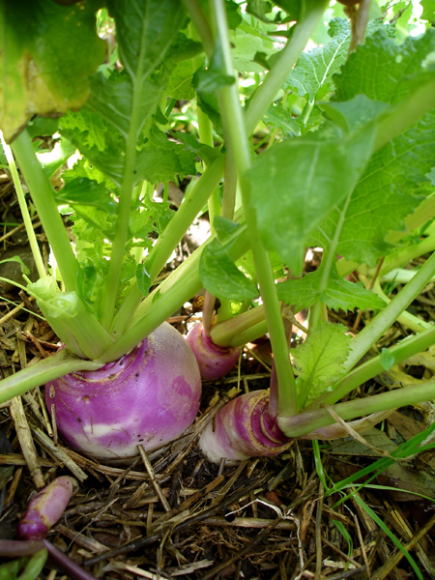
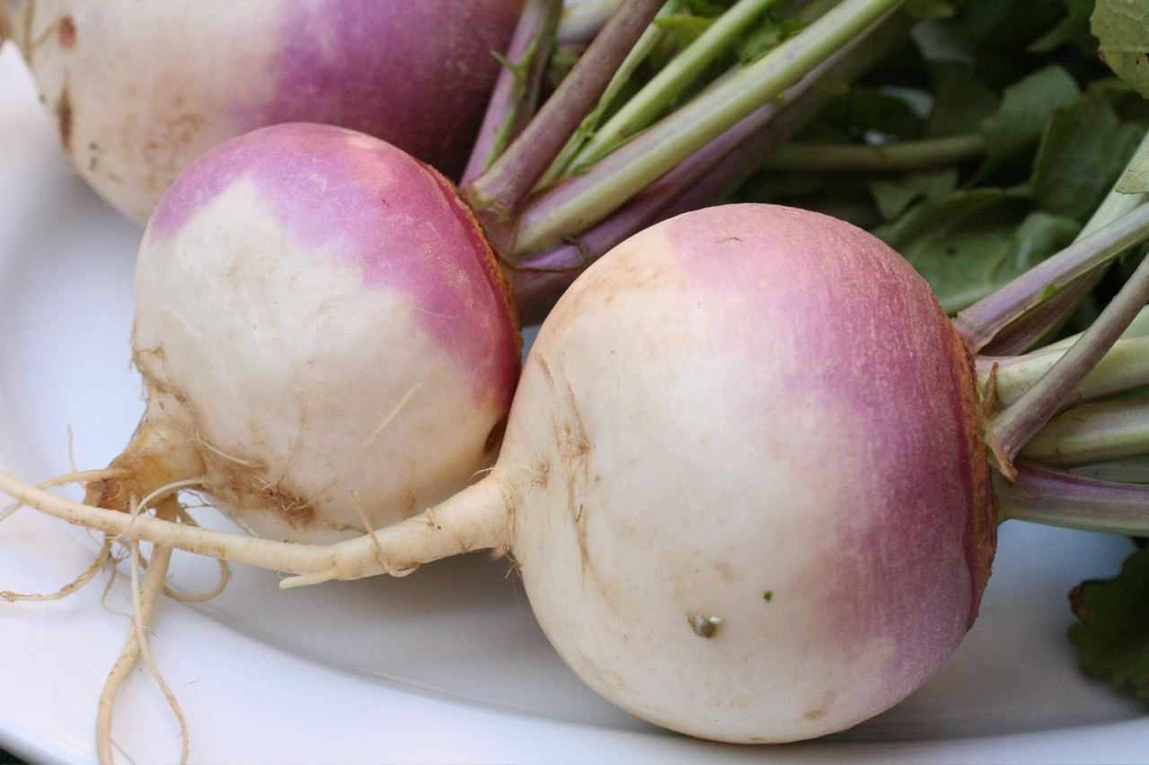
Turnips – another brassicaceae
We can eat the leaves and the roots!
What is wrong with these plants?

Slide 7
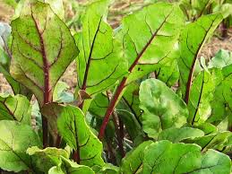
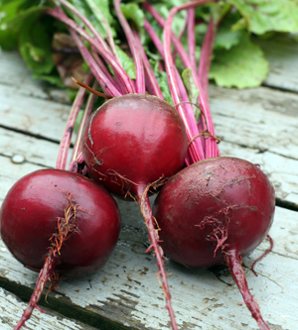
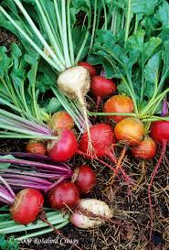
Beets – another amaranthaceae
Leaves are tasty & nutritious
‘Detroit Wonder’ ‘Rainbow’

Slide 8
CHIOGGIE BEET
“CANDY CANE” Beet Named after a fishing town in the province of Venice

Slide 9
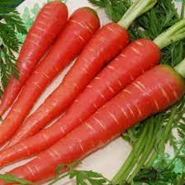
CArrots
We grow Danvers Half Long, Scarlet Nantes, and Cosmic Purple types.
Danvers Half Long
Scarlet Nantes
You have to love that Lycopene!

Slide 10
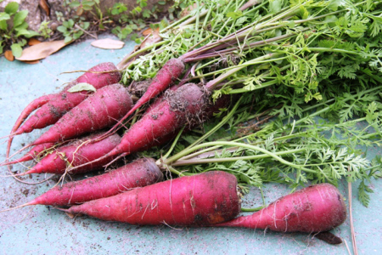
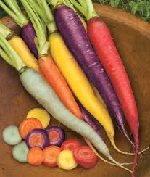
Are all carrots orange?
‘Cosmic Purple’ (but we call these, ‘Aggie’ carrots)
‘Kaleidoscope Mix’

Slide 11
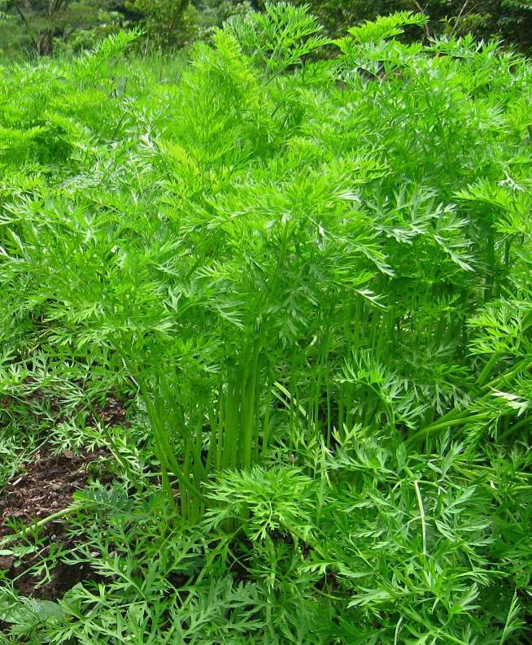
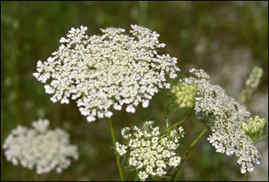
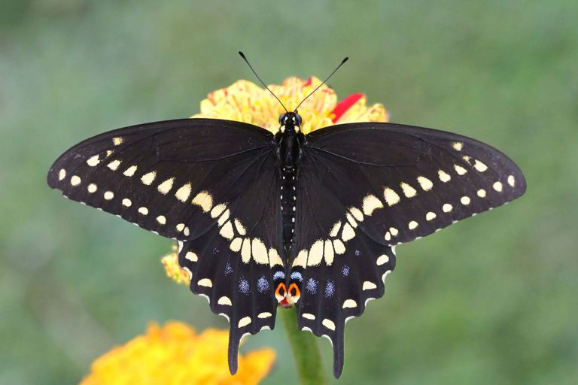
CArrots
Carrot leaves feed Black Swallowtail Butterfly larvae & flowers attract many other pollinators.
Belong to the family Apiaceae or Umbelliferae

