Slide 1
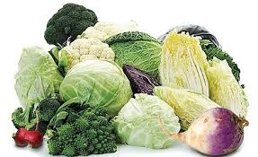
The Cole Crops
Cole crops are cool!
They are in the Brassicaceae family They are all in the Genus Brassica
Hence we call cole crops, Brassicas
(are you confused yet?)
So why are they called Cole Crops?
All cole crops are relatives of cabbage.
The Latin word for cabbage is ‘caulis’. Can you hear the word cole in that?

Slide 2
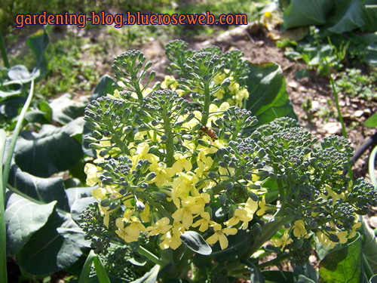
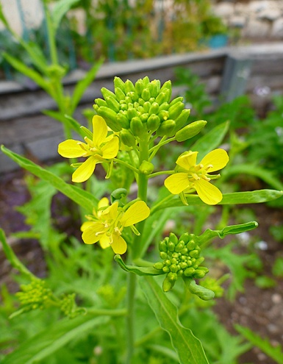
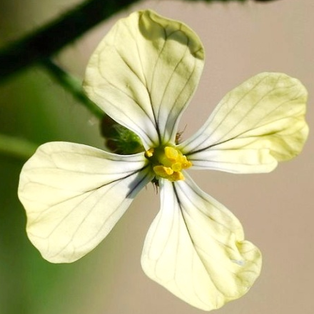
What do all Brassicaceae plants share?
Arugula Broccoli
Kale
Cauliflower

Slide 3
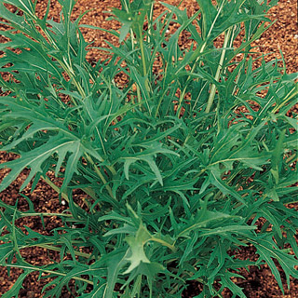
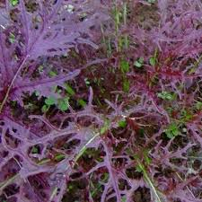
Some Asian Cole Crops
Bok Choy
Chinese Cabbage
Mizuna

Slide 4
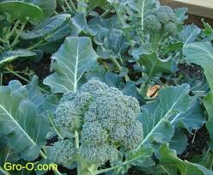
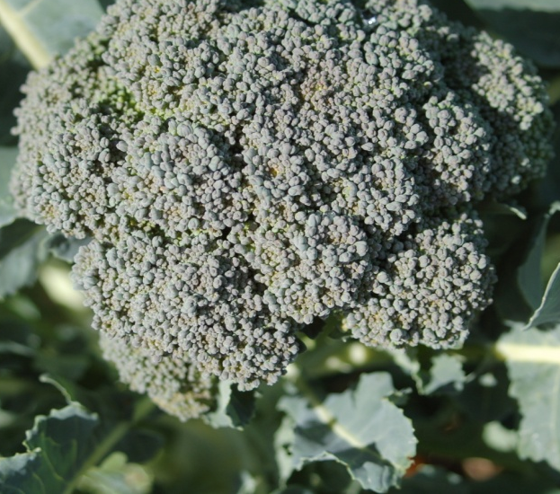
Broccoli
What part of the broccoli plant do we eat?

Slide 5
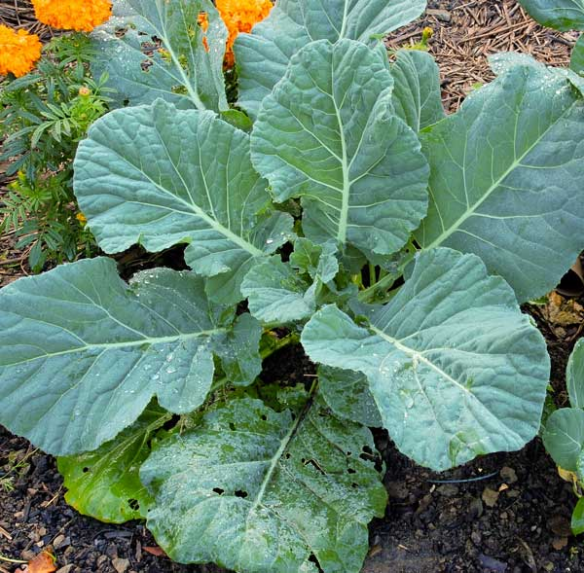
From Brussels to Georgia
Brussels Sprouts
Collards
The Collard that we usually grow is called ‘Georgia Southern’.
Grown for its edible buds. They taste milder than cabbage.
We don’t
grow them
here.

Slide 6
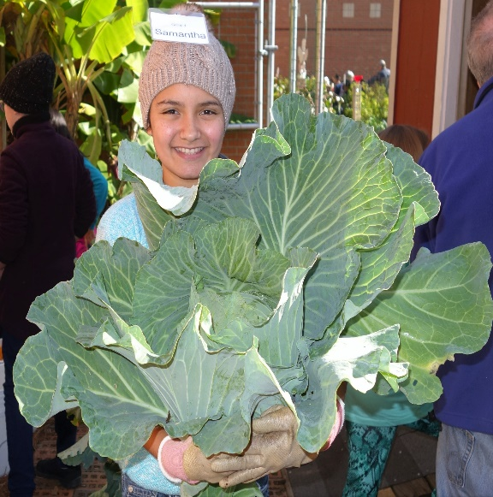
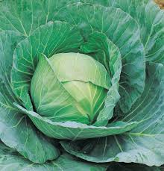
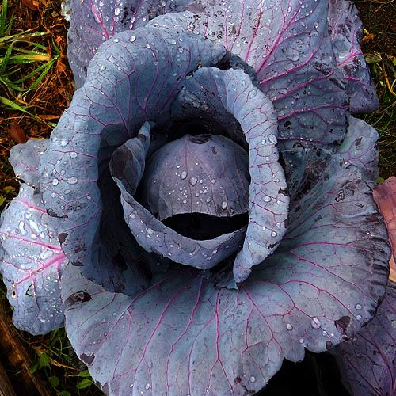
Cabbage
‘Giant’ Cabbage
Green and Red Cabbage

Slide 7
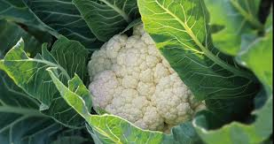
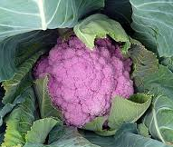
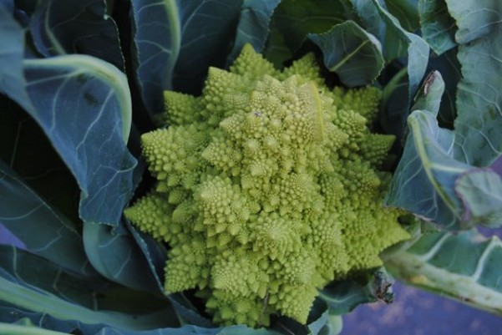
Cauliflower
‘Snowball’
‘Cheddar’
‘Graffiti’
‘Romanesco’

Slide 8
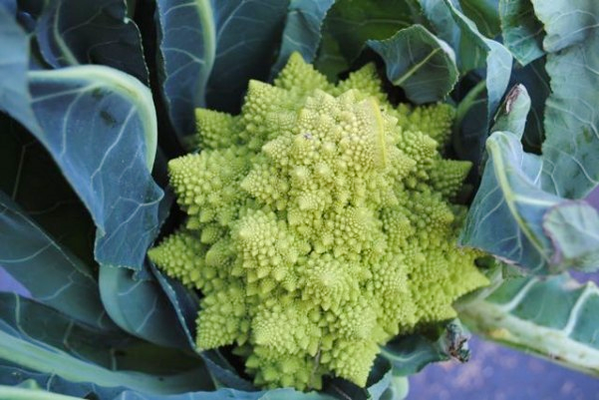
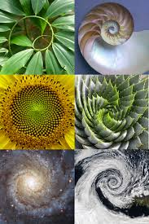
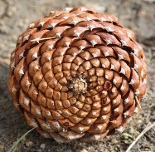
Fibonacci Sequence
Fibonacci was an Italian mathematician.
He discovered a mathematical sequence
that can be found in nature.
The sequence that he discovered starts like this: 0, 1, 1, 2, 3, 5, 8, 13………………..to infinity.
Do you see the pattern in this sequence?
Can you give the next few numbers in the sequence? _______________________________
Look for the numbers in this sequence in flowers and other things in Nature.
Romanesco cauliflower shows this sequence.
Can you think of other things that show this?

Slide 9
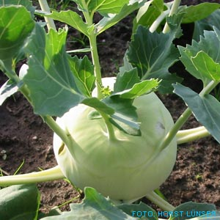
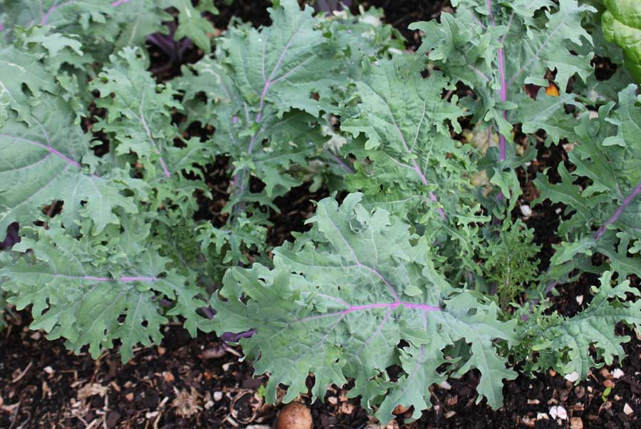
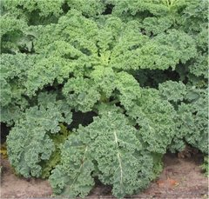
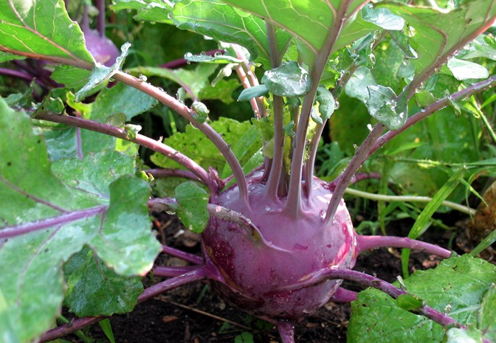
Kale Kohlrabi
‘ Tuscan’ ‘Redbor’
‘ Blue Russian’ ‘Curly Green’

Slide 10
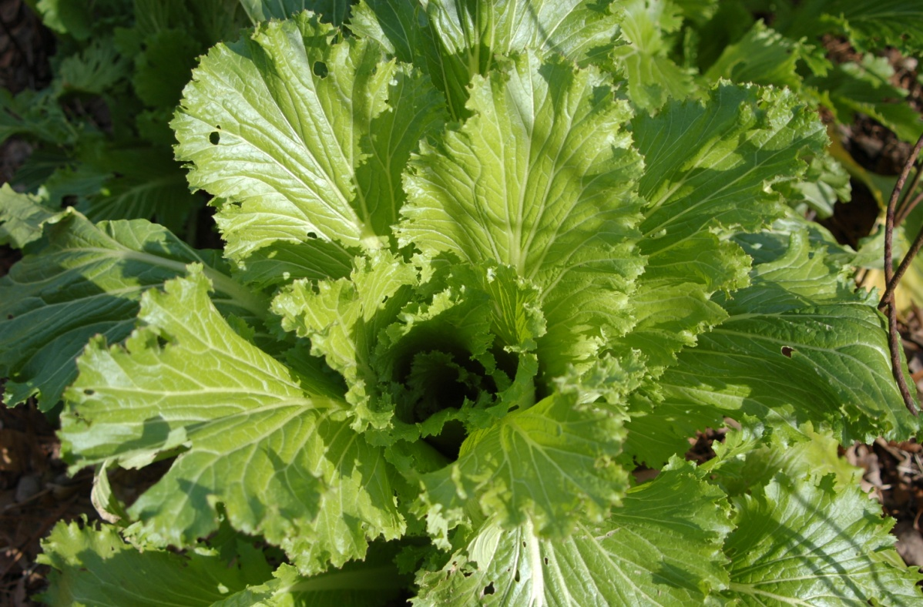
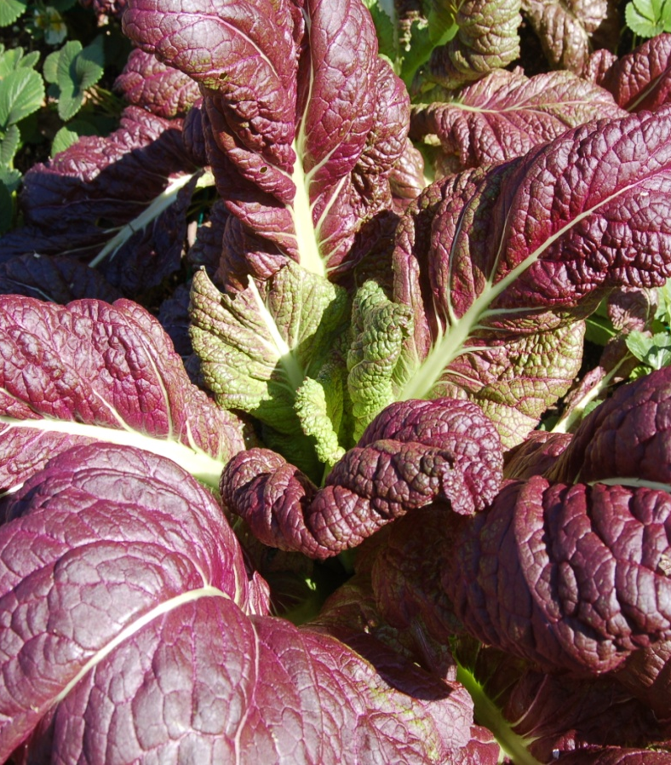
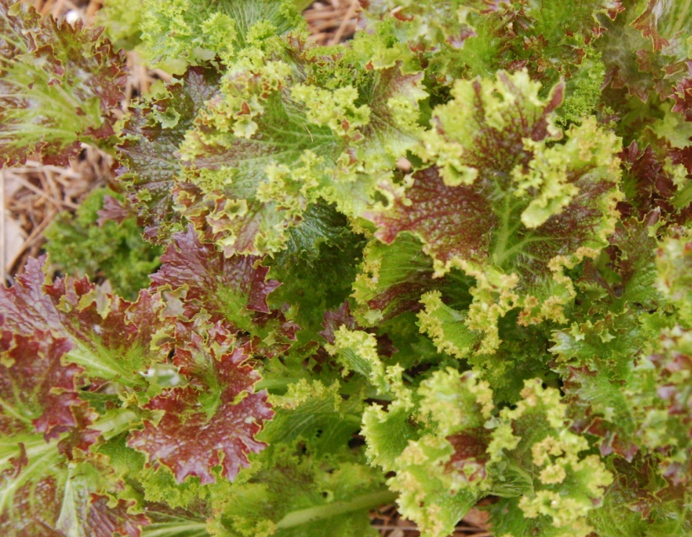
MUSTARD GREENS
Does mustard come from these plants?
‘Green’
‘Curly’
‘Osaka Purple’

Slide 12
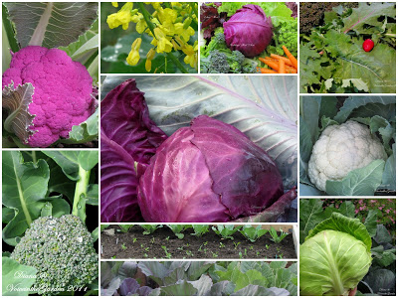
EAT YOUR BRASSICAS
They are ‘Health foods’!
They have lots of FIBER, CALCIUM Vitamin C and the leafy parts have lots of Vitamin a.
Collards, Kale & Brussels Sprouts have more protein than milk!

Slide 13
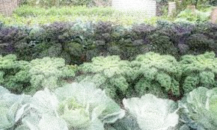
Can you answer these questions?
1. To what family do the cole crops belong? ______________________________________
2. During what months are cole crops planted here? ______________________________________
3. What vitamins do you get when you eat cole crops? ____________________________
4. Name your two favorite cole crops?__________
_________
4. In what cole crop can your readily see the Fibonacci sequence? ______________________________

