Slide 1
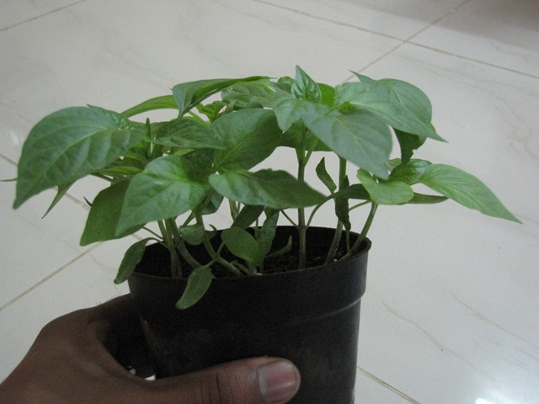
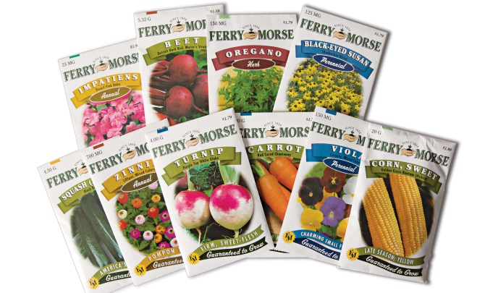

From Seed to Transplant
How to plant them….

Slide 2
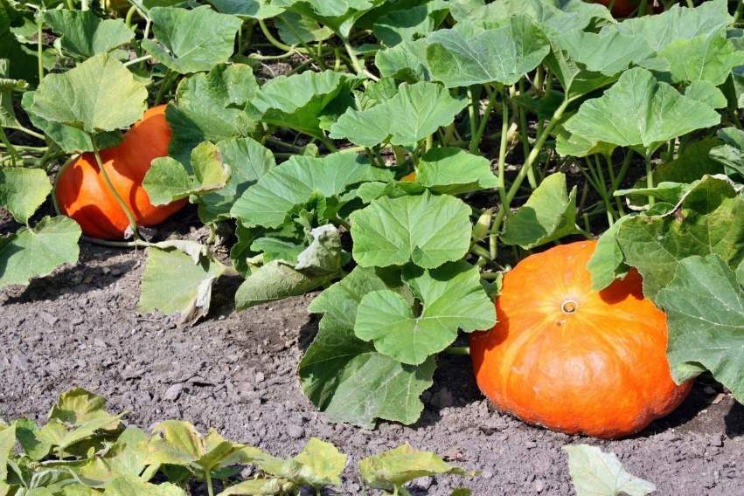
A Few Seed Jokes
Want to hear a gruesome joke?
A farmer planted a pumpkin seed. He watered it and cared for it very well. Soon it grew some, and grew some more, and grew some more…..

Slide 3

What do you call cute seeds?
Awwwwwwwmonds!
What type of flower seeds did King Tut plant?
Chrysanthemummies!

Slide 4
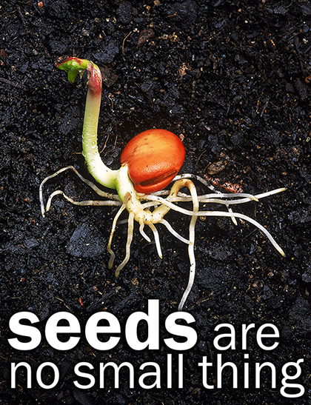
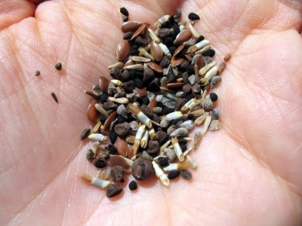
Seeds come in different sizes & shapes
Seeds contain all the material that a plant needs to reproduce itself.

Slide 5
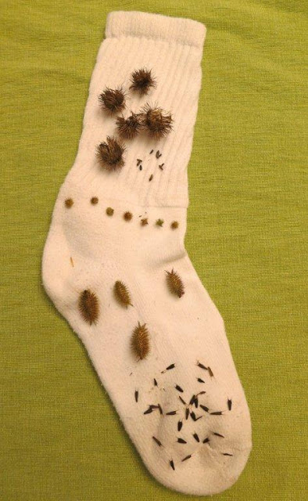
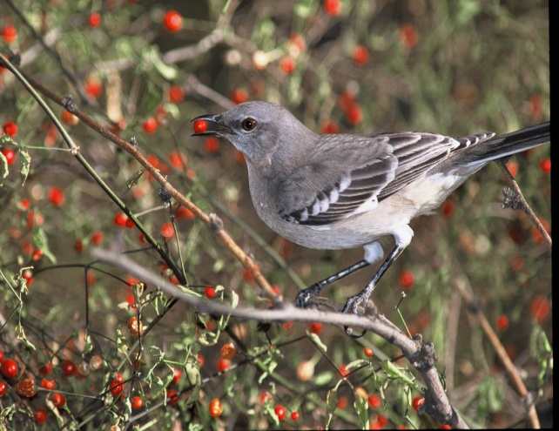
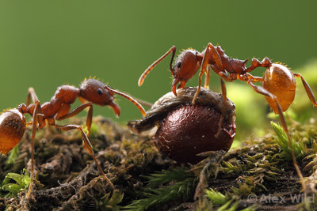
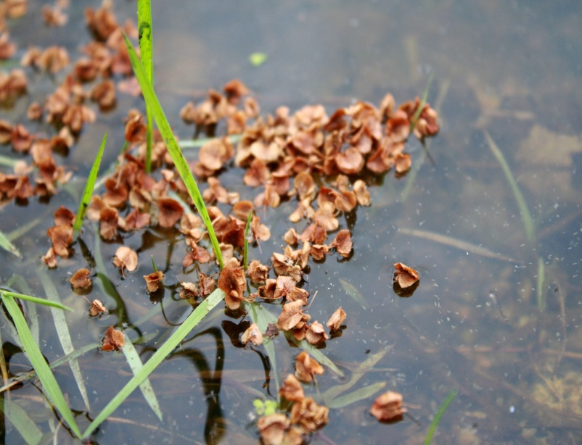
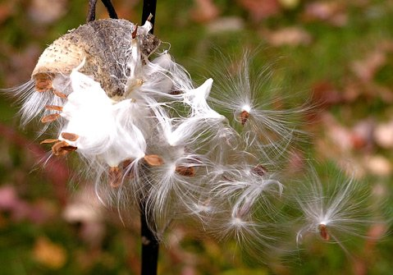
How are seeds spread?

Slide 6
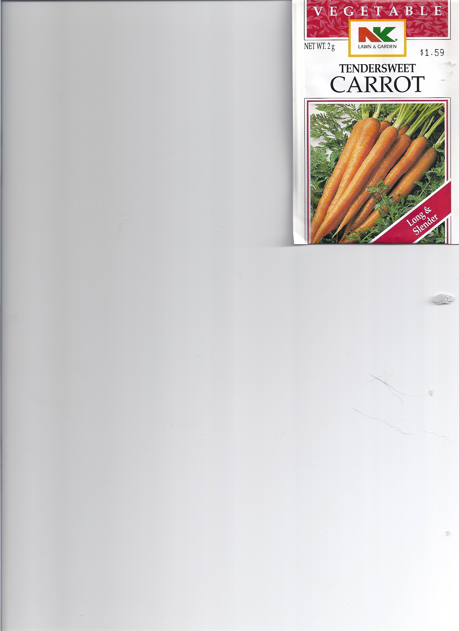
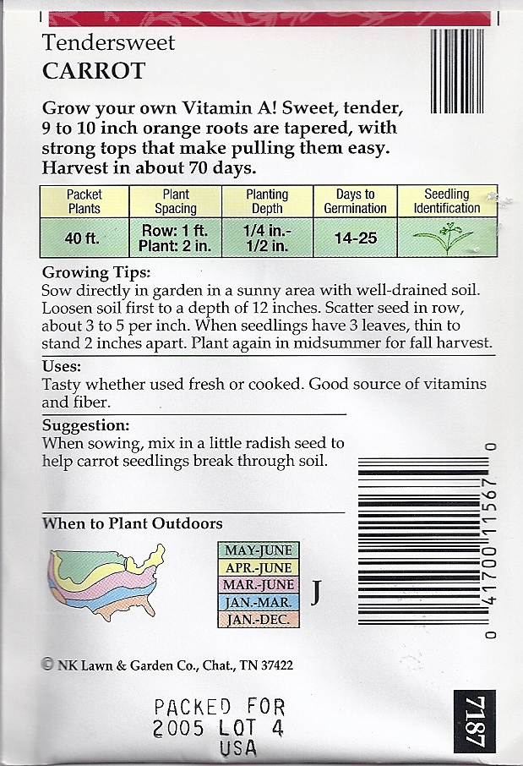
Seed packet information

Slide 7
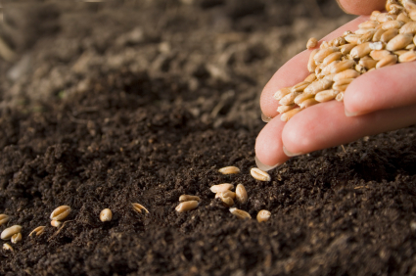
Planting seeds properly
Prepare soil
Spread fertilizer & mix into soil with a rake
Read & follow seed packet directions
Cover seeds with fine compost
Gently water in the newly planted seeds
Mark the row with
name of plant

Slide 8
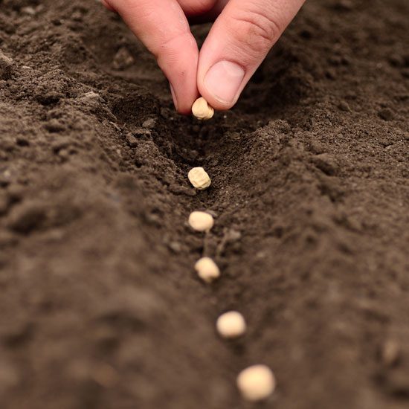
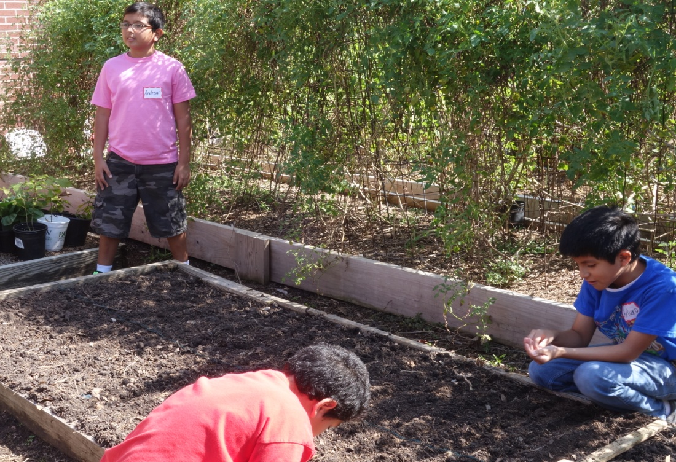
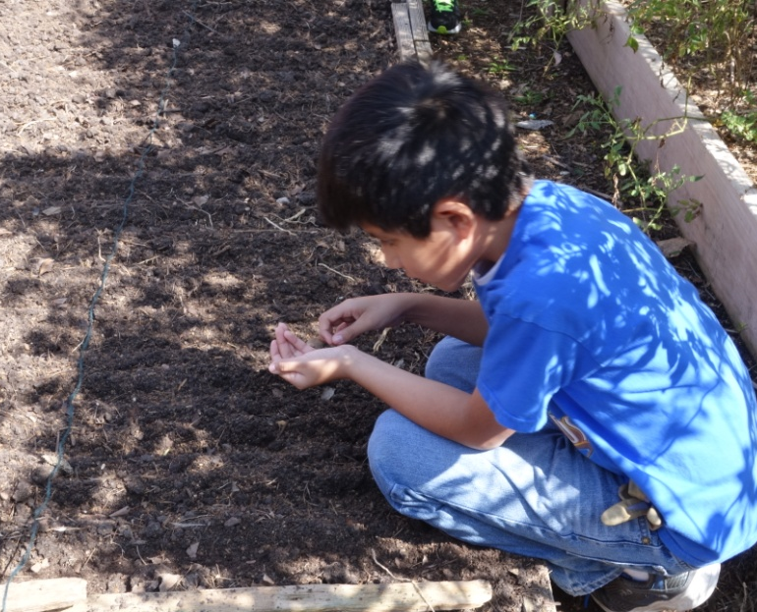
How we plant seeds

Slide 9
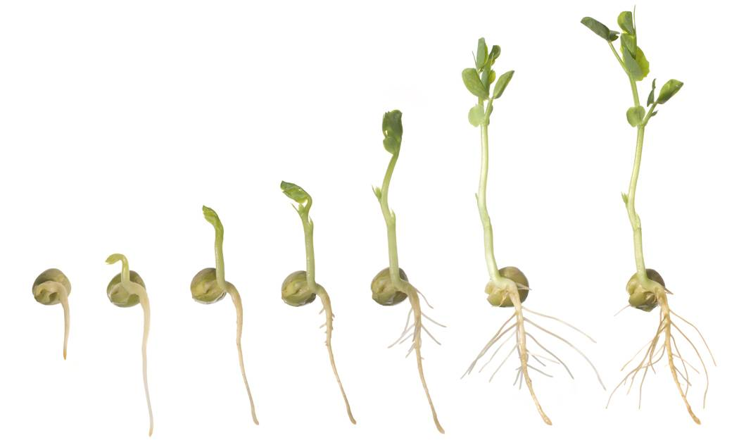
Germination or sprouting of a seed

Slide 10
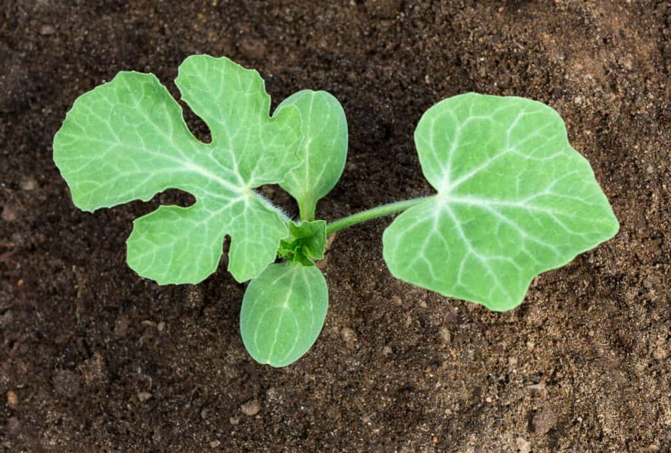
Cotyledons (seed leaves) & true leaves

Slide 11
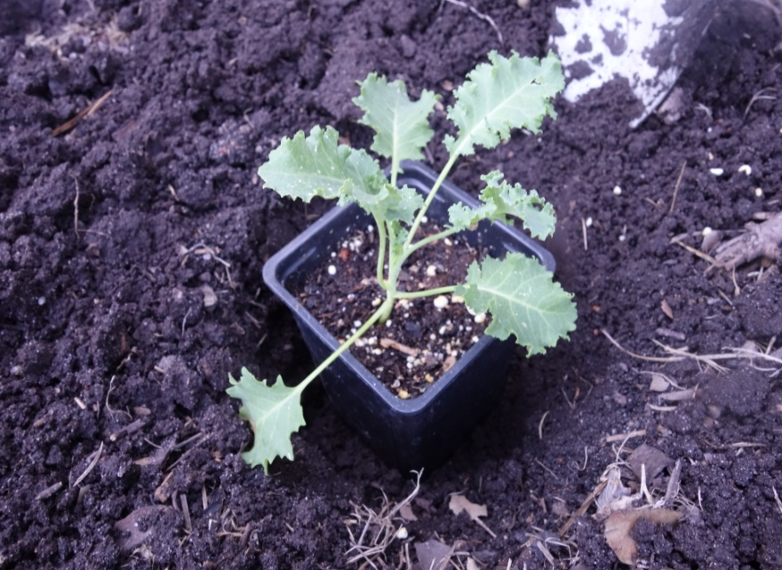
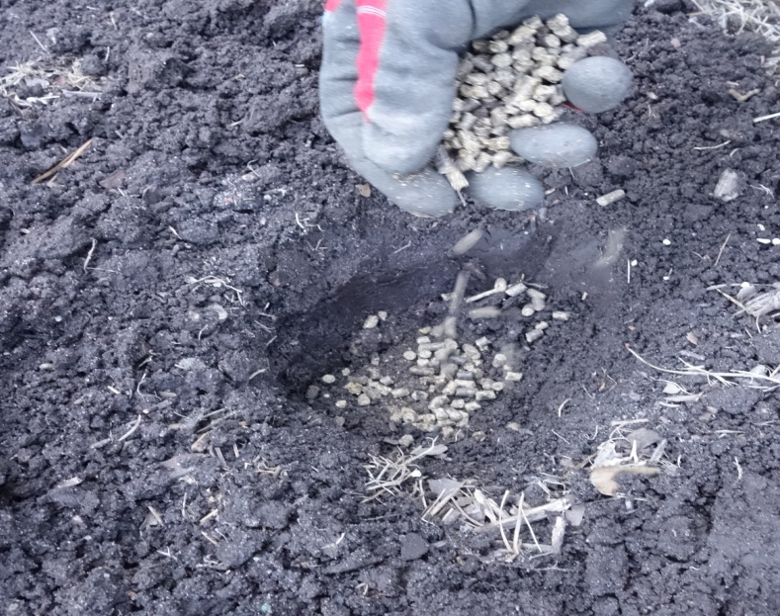
Transplanting a seedling from a pot
Prepare soil
Dig a hole slightly larger than the pot
Add compost and fertilizer to hole & mix

Slide 12
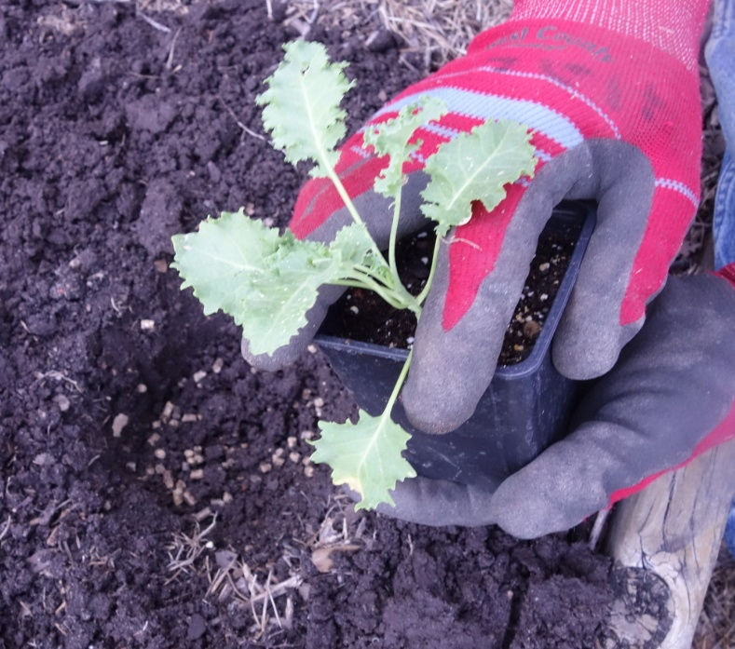
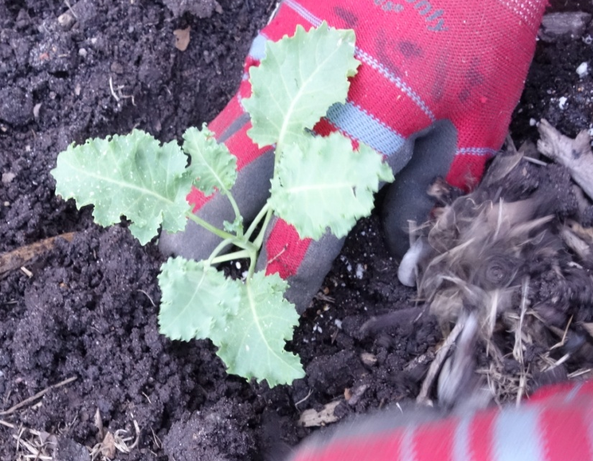
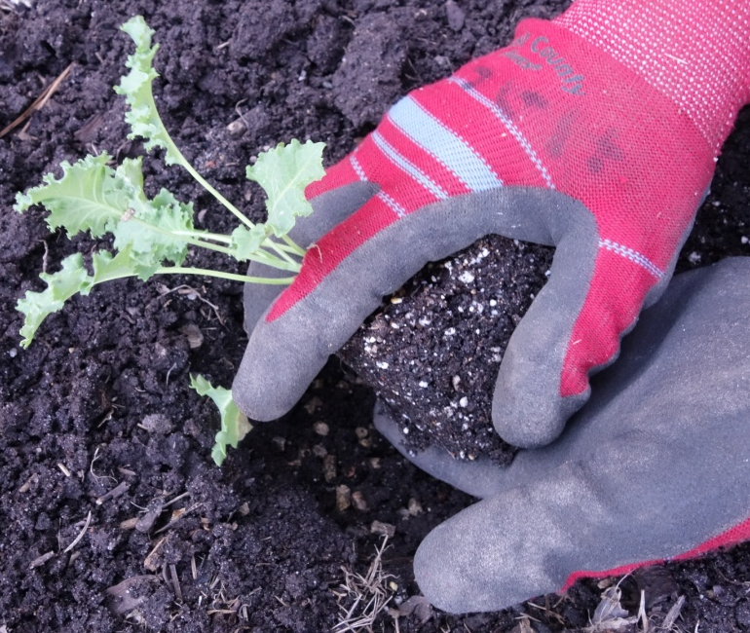
transplanting
Remove plant from pot
Place root ball into hole

Slide 13
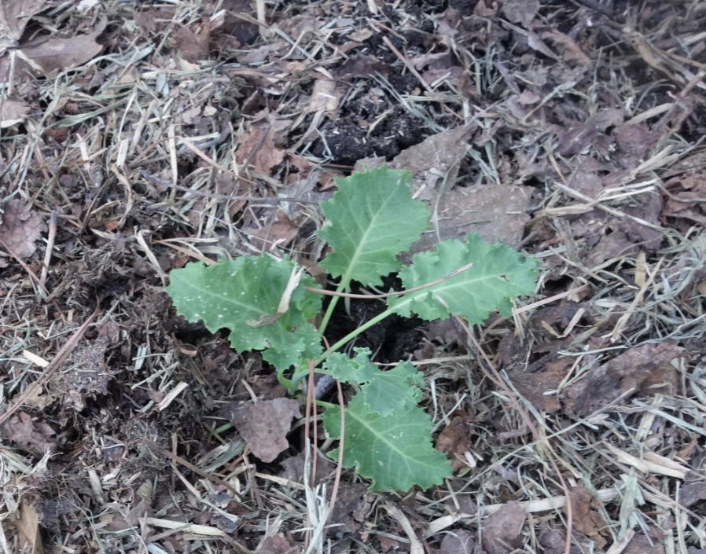
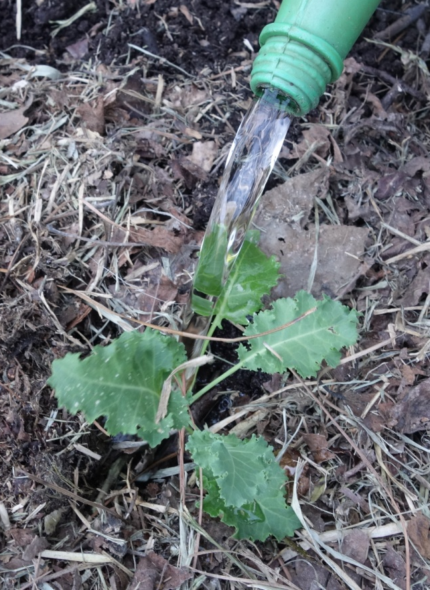
transplanting
Fill soil around the roots
Mulch and water

Slide 14
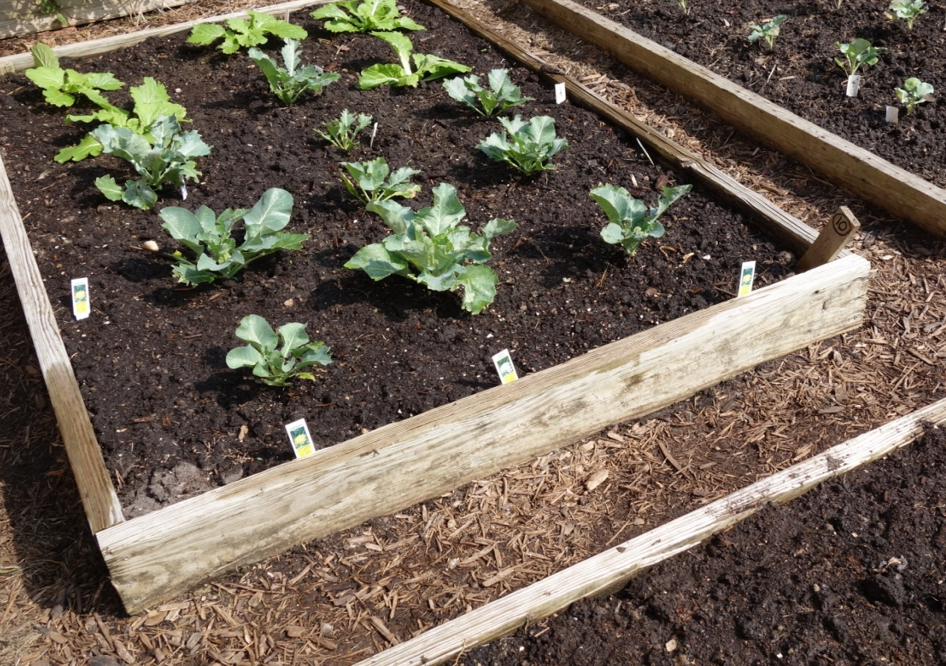
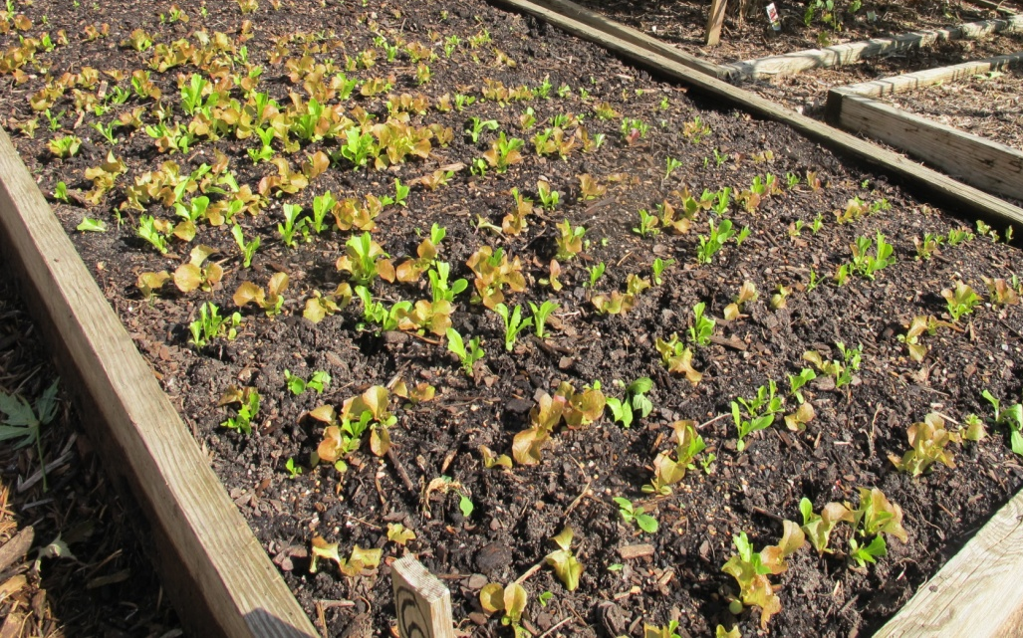
Off and growing!

