Slide 1
Mr. Opperman
or
Mr. Compost
or
Mr. Recycler
I love making compost

Slide 2
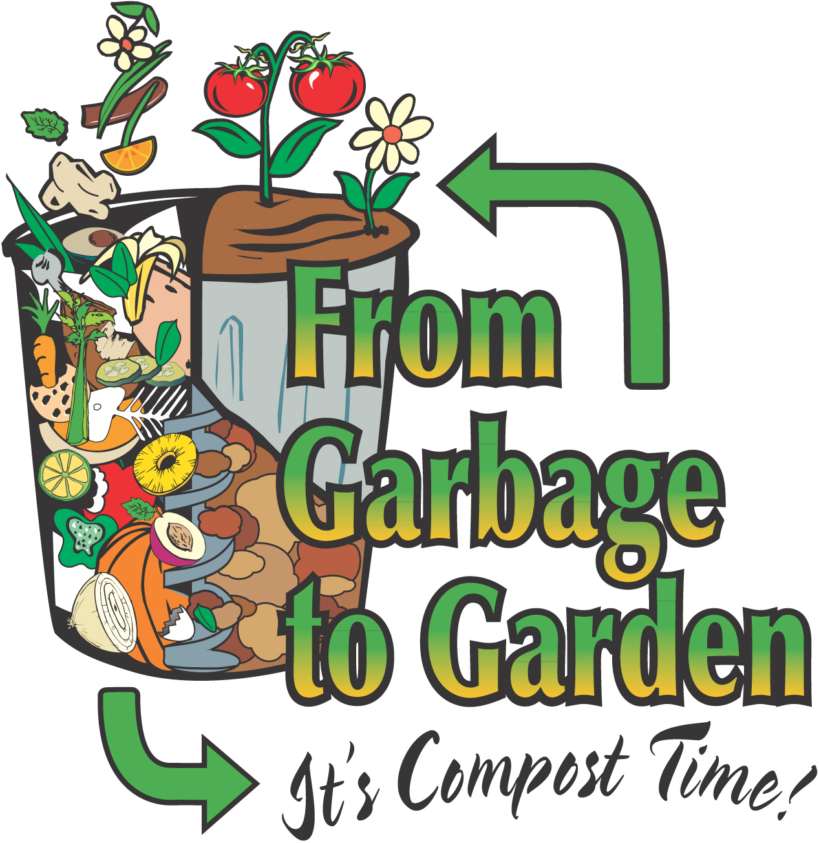

Slide 3
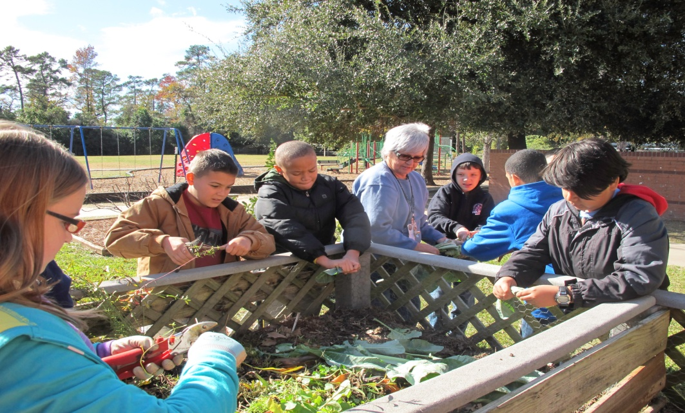
Composting is EZ
How we compost at the Oak Forest Gardens

Slide 4
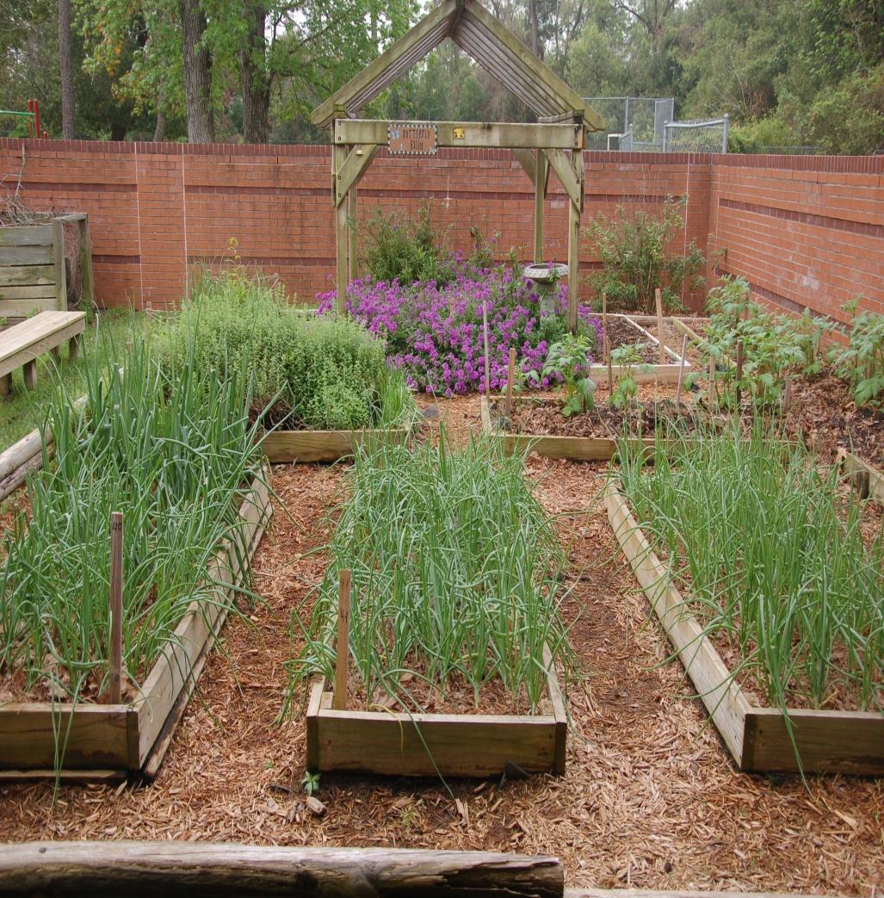
Composting is fun!
It's also easy.
Let's learn about
how we make
compost and how
we use it to grow
beautiful gardens.

Slide 5
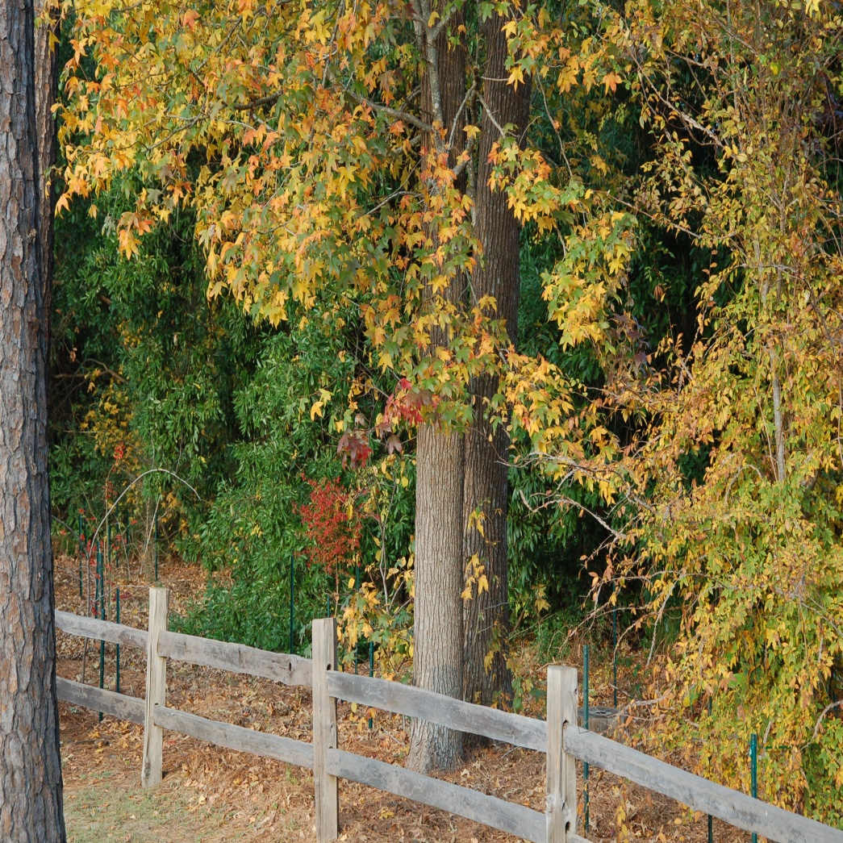
The Forest Floor
Nature recycles leaves
and plants.
In a forest, leaves fall
forming mulch that
protects the soil.
Over time they
decompose into nutrients that feed plants in the forest.

Slide 6
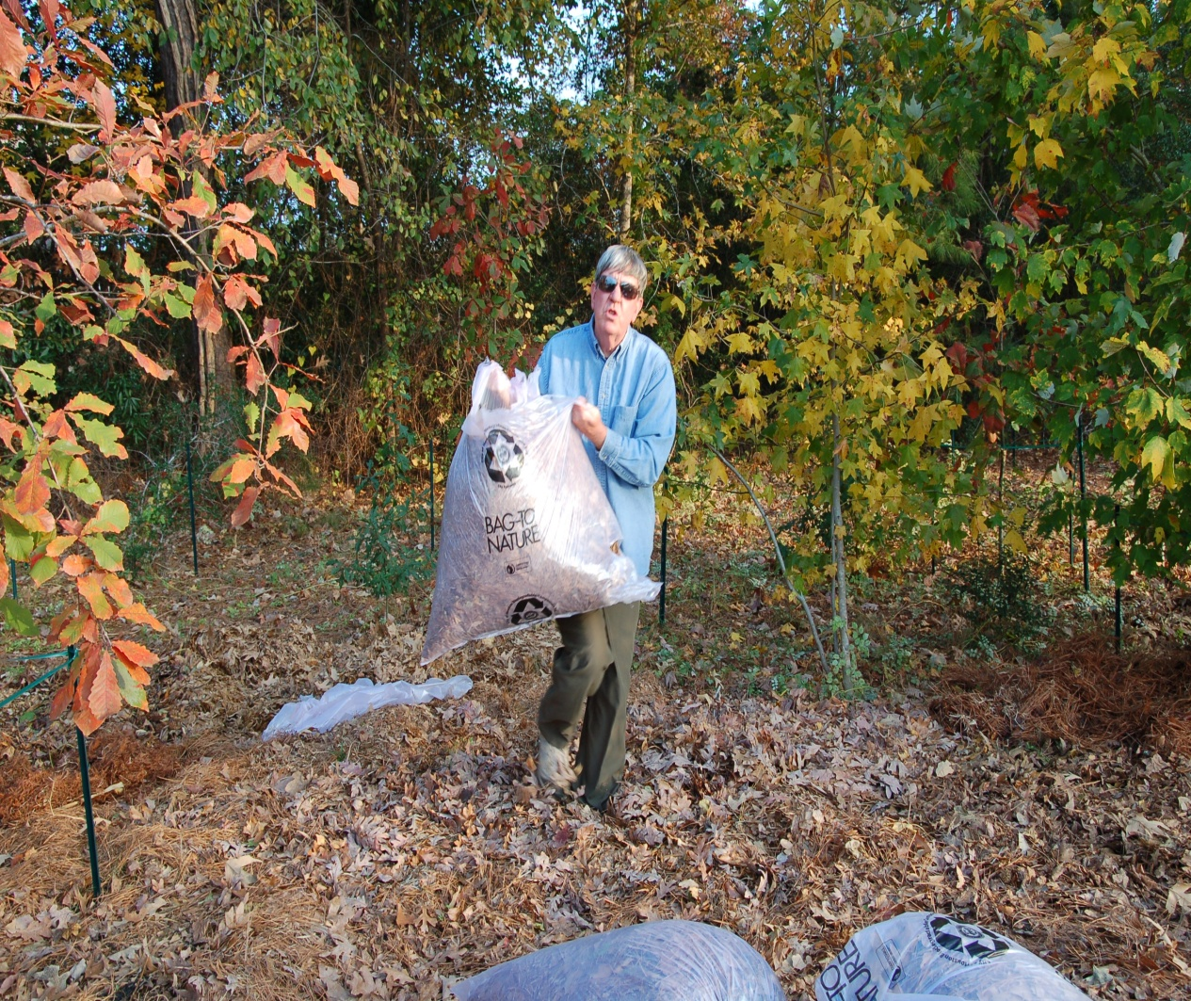
Composting in Place
Leaves layered on ground will eventually compost in place.
Will become part of soil over time.
This is nutrition for trees and part of the natural nitrogen cycle.

Slide 7
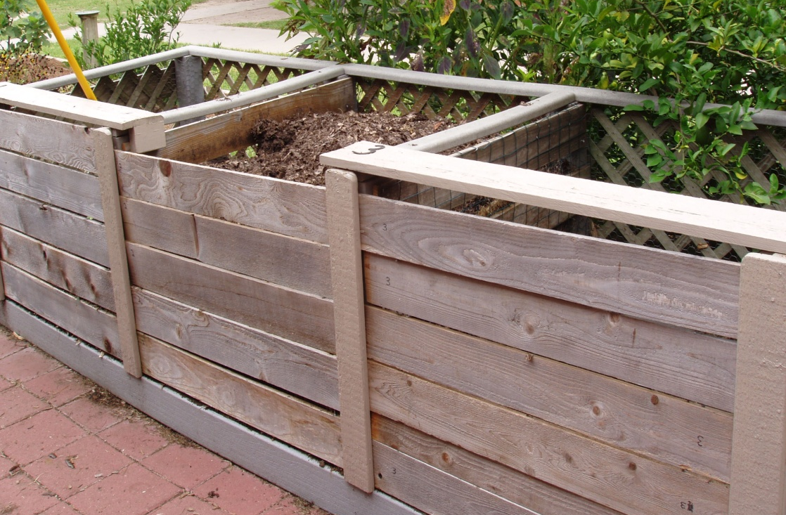
Composting in Bins
Everything organic eventually composts.
The bins speed up the process .
To help it along we cut everything into tiny pieces.

Slide 8
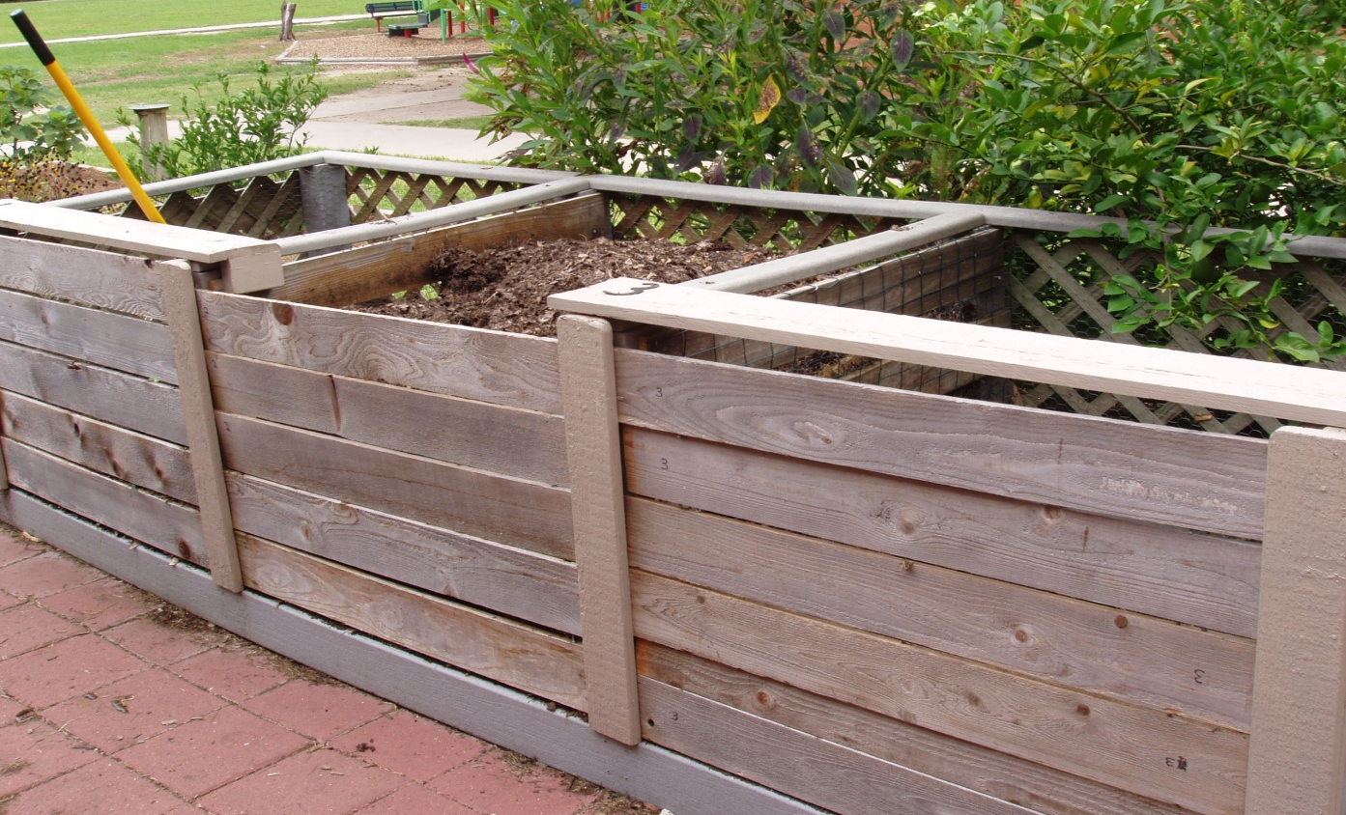
The Compost Bins
Bin # 1 Bin # 2 Bin # 3
Raw materials Partially decomposed Finished compost

Slide 9
Compost happens!
Three bin compost system
Five necessary ingredients for success…
Green matter = nitrogen
Brown matter = carbon
Water
Air
Microbes

Slide 10
Compost Recipe
The micro and macro organisms
that recycle leaves and other plant
parts need a mix of brown stuff and green stuff on which to munch.
Like you, they also need air and water to live and work.
Mix all this together and in time you will have compost!

Slide 11
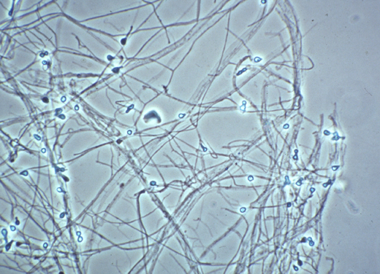
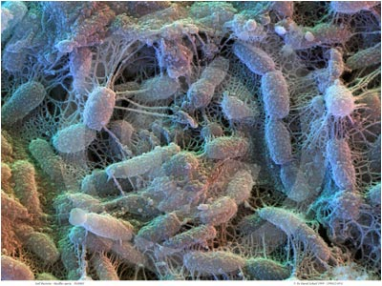
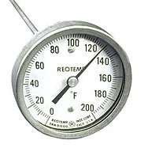
Microorganisms Work Hard
---Bacteria and microscopic fungi
---Billions in the compost pile
---Their hard work causes the pile to heat up

Slide 12
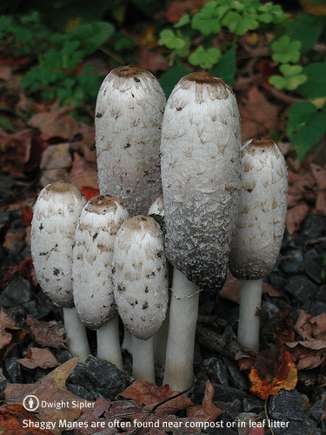
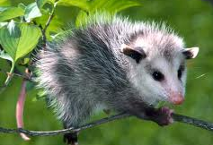
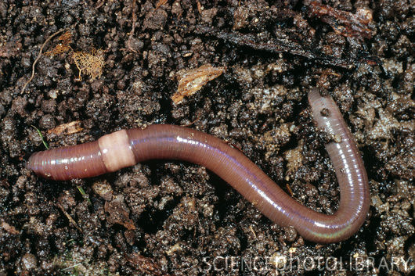
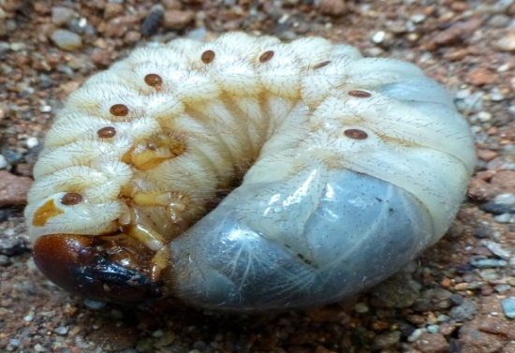
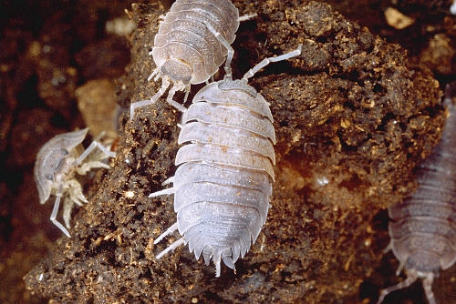
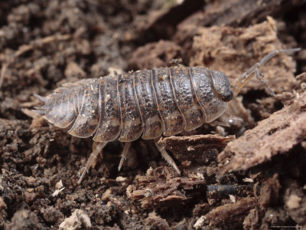
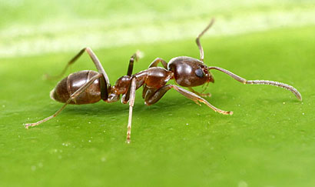
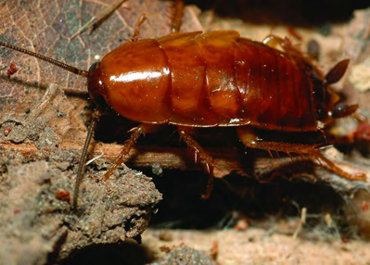
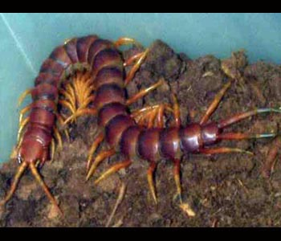
Other Decomposers
Macro- organisms

Slide 13
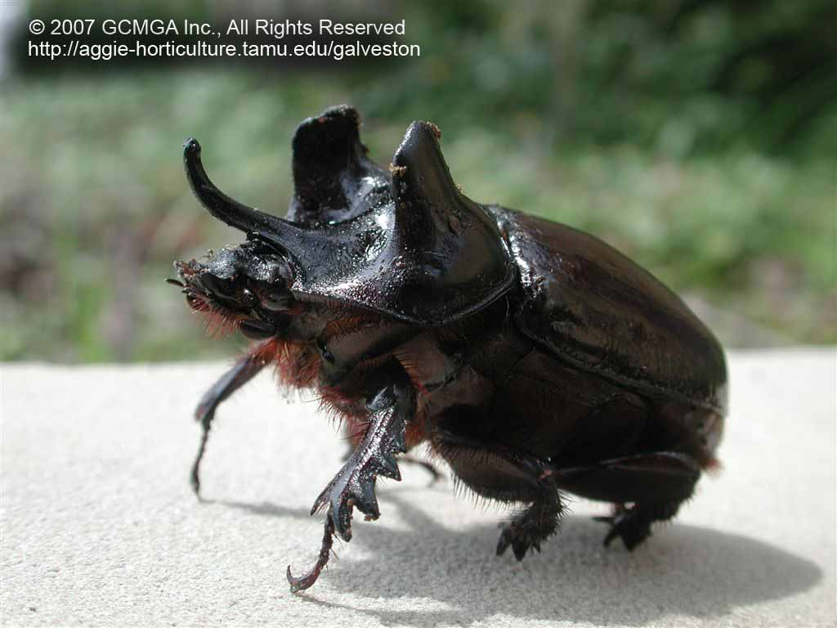
Extraordinary Decomposers
Good Guys!
Larval
Stage of Elephant Beetle
The Larvae are Eating Machines!

Slide 14
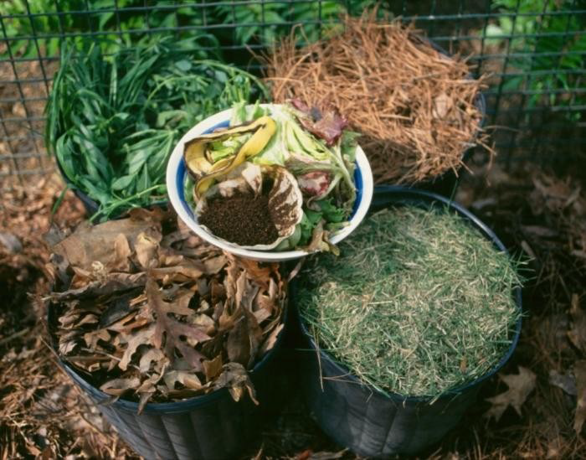
Brown stuff is dead, dried plant parts like leaves and pine needles. Brown stuff is high in the element carbon.
Green stuff is fresh, living parts like grass clippings, kitchen vegetable scraps,
weeds and other plants. Green stuff is high in the element nitrogen.

Slide 15
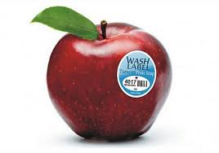
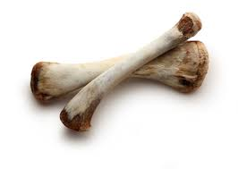
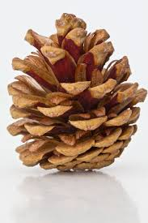
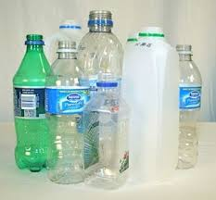
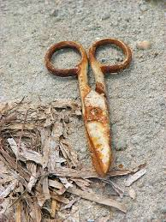
Not in OUR Compost:
Plastics
Meat or Dairy Products
Pet Wastes
Large Plant Parts,
Like tree limbs, big roots or stems, pine cones
Concrete or stones
Metal objects, including our tools!

Slide 16
Layer Ingredients: ~ 6 inches
Start with the brown stuff.
Add a layer of grass clippings.
Add a shovelful of soil or compost.
Each layer must be moist. (rain or add)
Repeat each of the layers until the bin
is full.
Use the compost tool to inject air and mix it up.

Slide 17
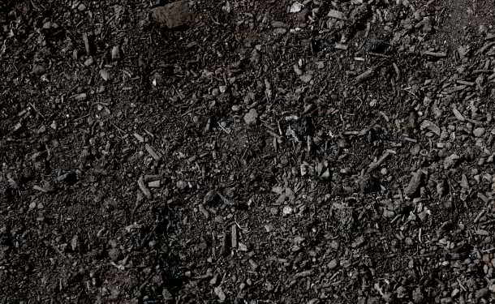
Humus is the end result of composting
It can be added to planting beds as:
Mulch
Planting mix
Fertilizer
It can be used to make Compost Tea!

Slide 18
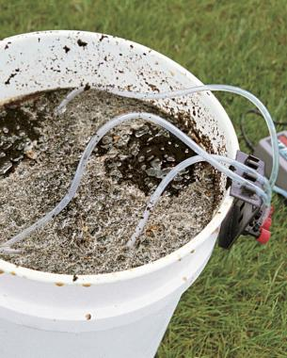
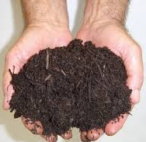
It’s Not Coffee – It’s Tea -Compost Tea that is!
Vitamins for Plants!
Well brewed compost tea is rich in microorganisms that are really beneficial to plant growth and plant health.

Slide 19
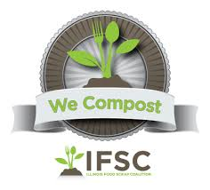
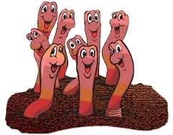
Compost is ‘Black Gold’!
Making compost –
Saves lots of waste from going to the landfill
Is good for the environment
Is the best fertilizer for all plants
Is good for the soil
Is good for creatures
Makes healthy plants and healthy gardeners

Slide 20
Making Compost is important for our gardens but:
Making it safely is even more important!

Slide 21
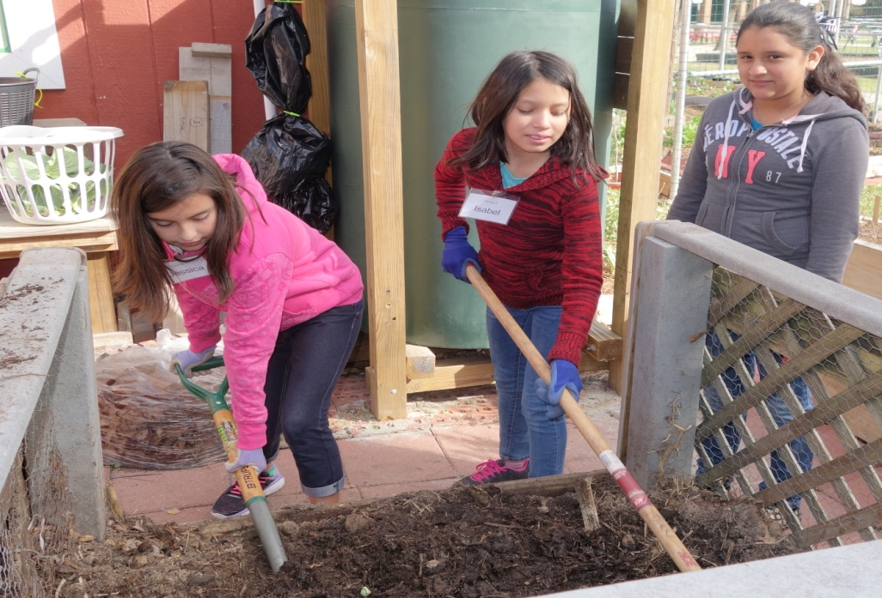
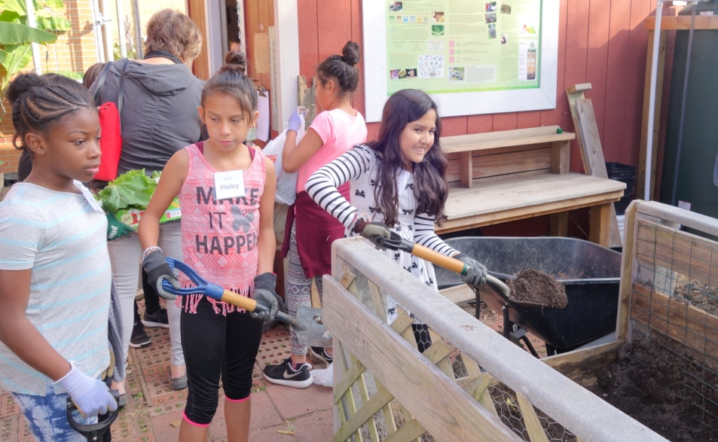
Safety in the Garden- The Compost Area
Be aware of people working around you!

Slide 22
Use Tools Properly
Keep fingers away from sharp blades
Wear gloves

Slide 23
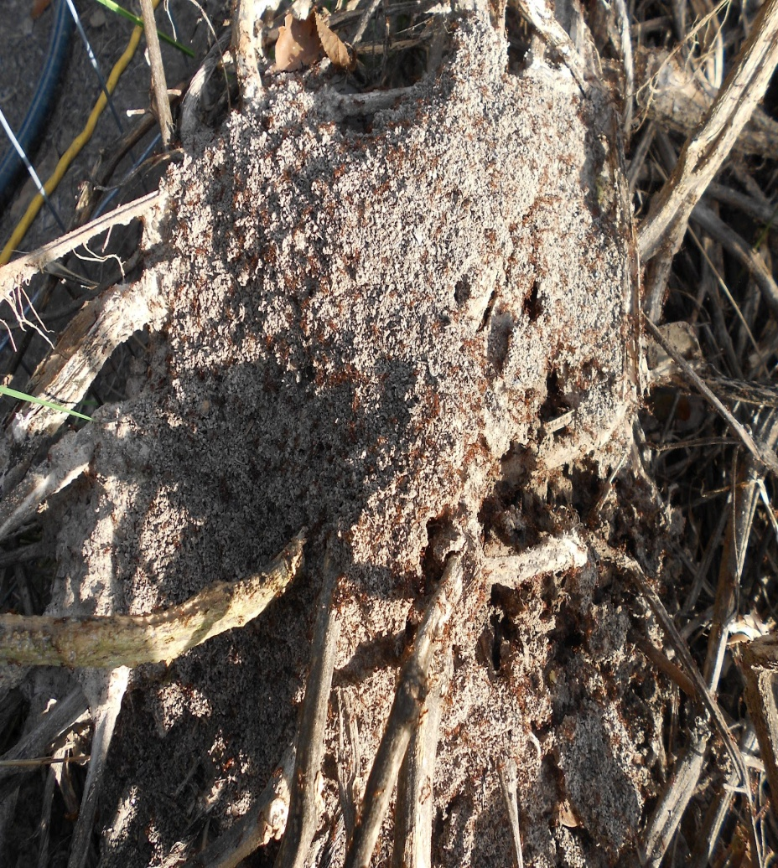
Look Out for Potential Problems
Fire ants in compost pile
Don’t disturb them
Tell an adult
No other critters in the compost will hurt you, so please do not scream when you find a decomposer there

Slide 24
Enjoy yourself in the gardens and compost areas this year and please be safe!

