Slide 1
Know the signs – follow the clues

Slide 2
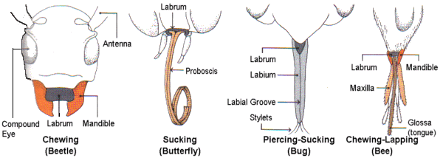
Three types of insect mouthparts

Slide 3
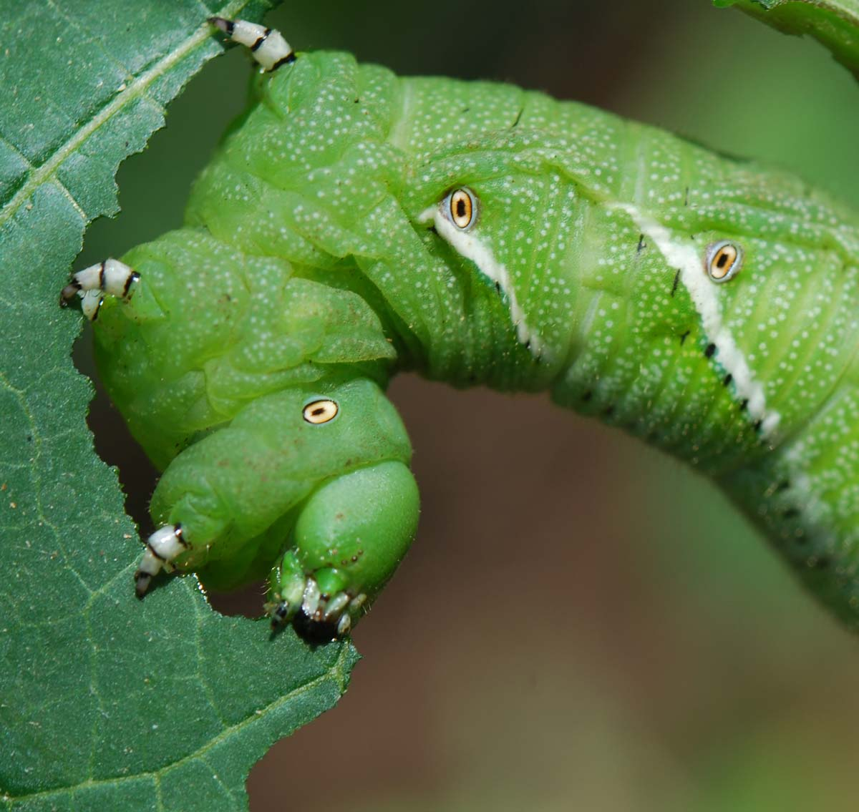
Chewing mouthpart

Slide 4
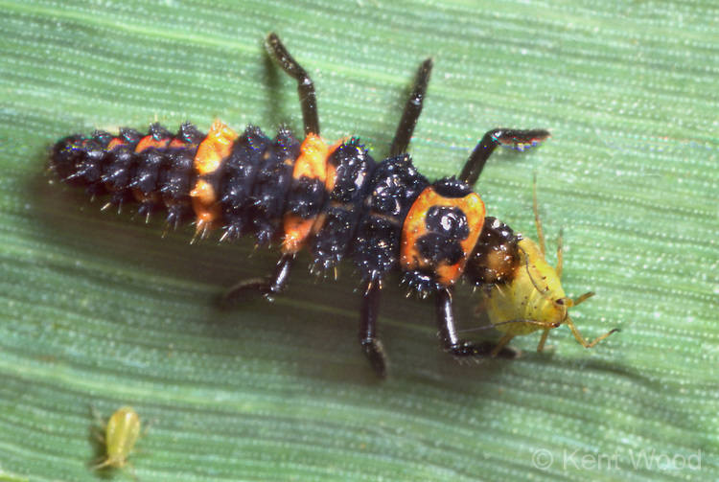
Lady Beetle feeding
Adult Lady Beetle
Lady Beetle larva

Slide 5
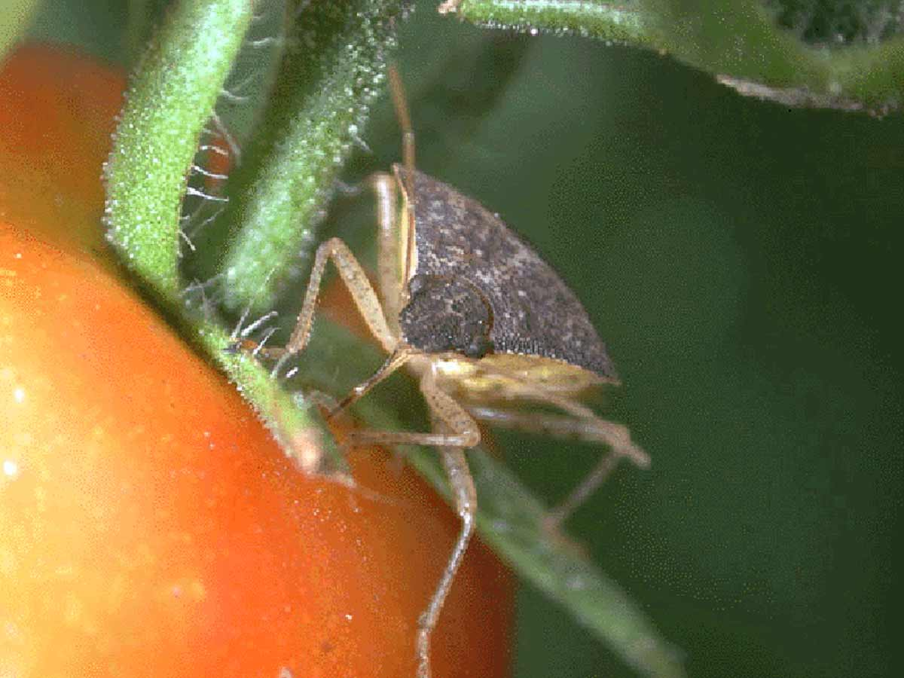
Sucking mouthpart

Slide 6
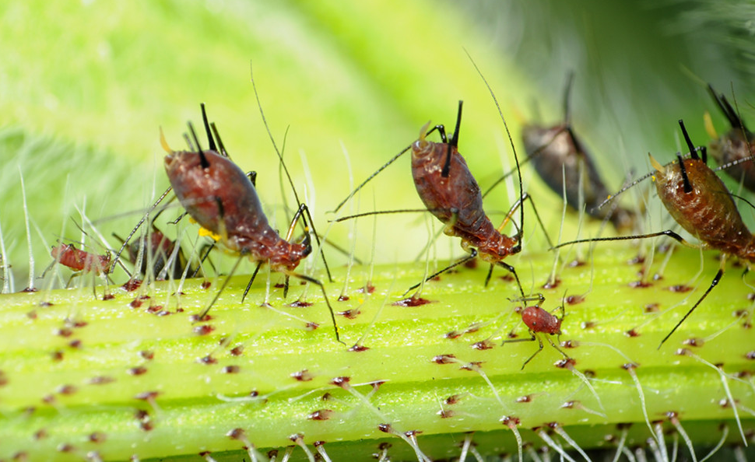
Aphids feeding

Slide 7
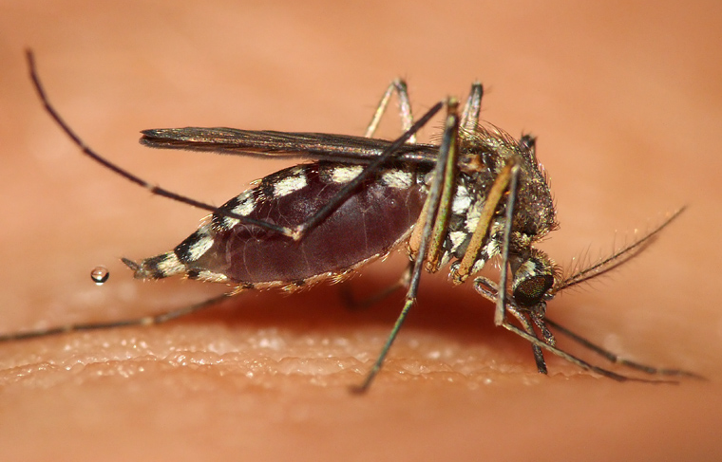
Mosquito feeding

Slide 8
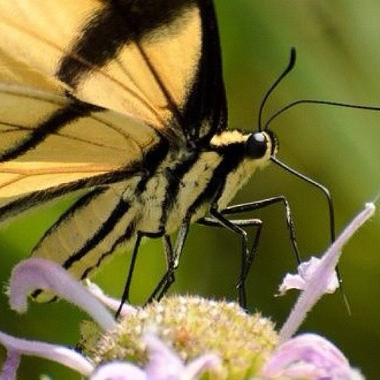
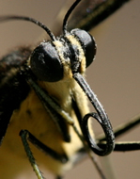
Siphoning mouthpart

Slide 9
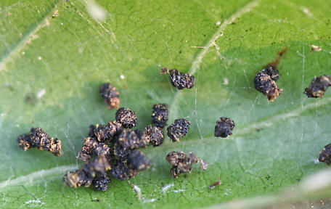
Who did this?
Frass
Holes

Slide 10
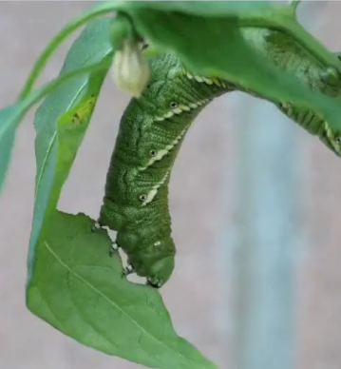
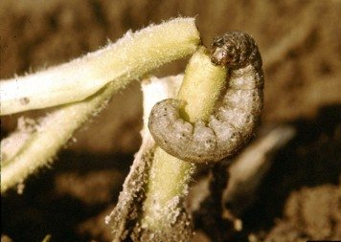
Caterpillars

Slide 11
Who did this?
Skeletonized Leaf

Slide 12
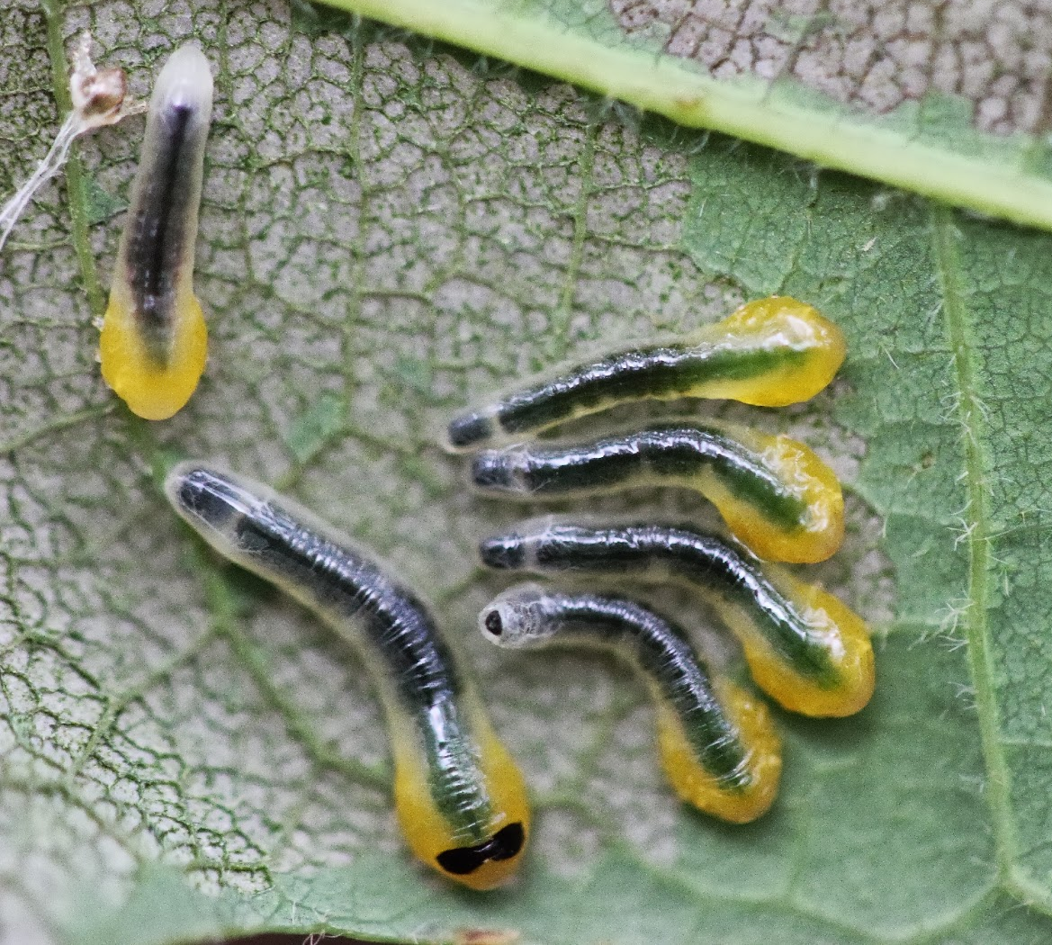
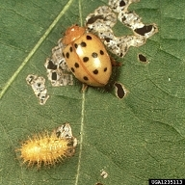
Caterpillars and beetles
Oak Sawfly Larvae – (one cool dude) Mexican Bean Beetle

Slide 13
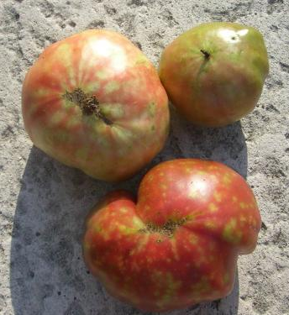
Who did this?

Slide 14
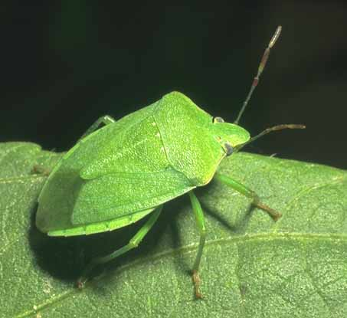
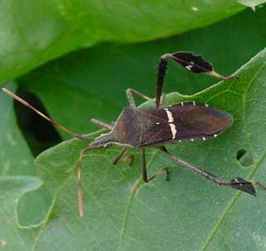
Stink Bugs
Green Stinkbug
Brown Stinkbug Leaf-footed Stinkbug

Slide 15
Who did this?

Slide 16
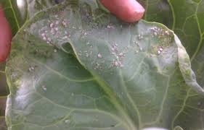
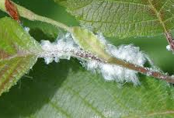
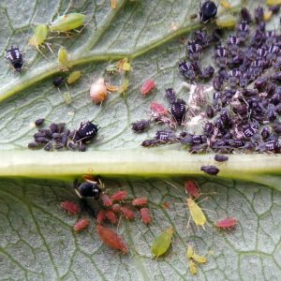
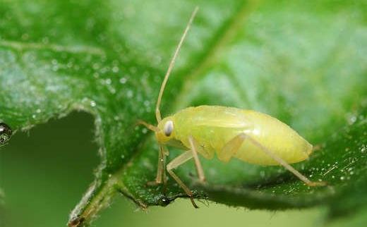
Aphids
Aphids are tiny and come in many colors.
There is even a white wooly aphid. Aphids use their piercing mouthpart to suck plant juices.

Slide 17
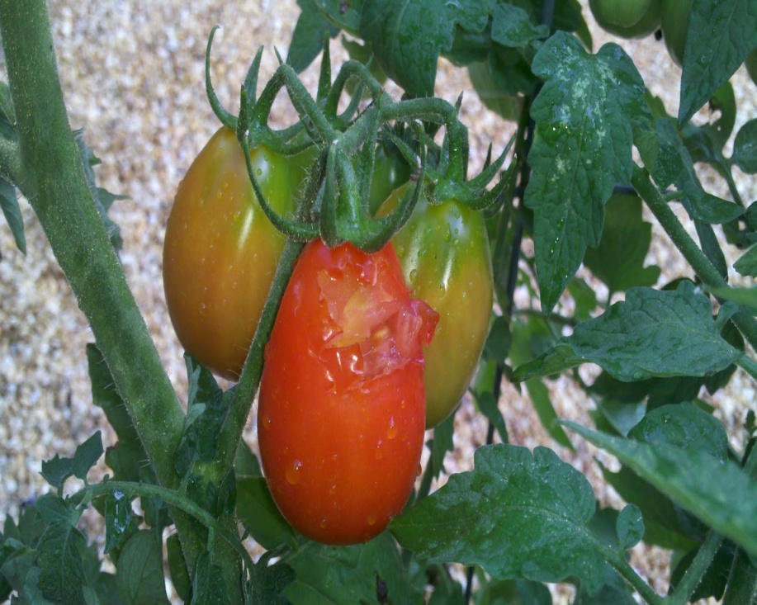
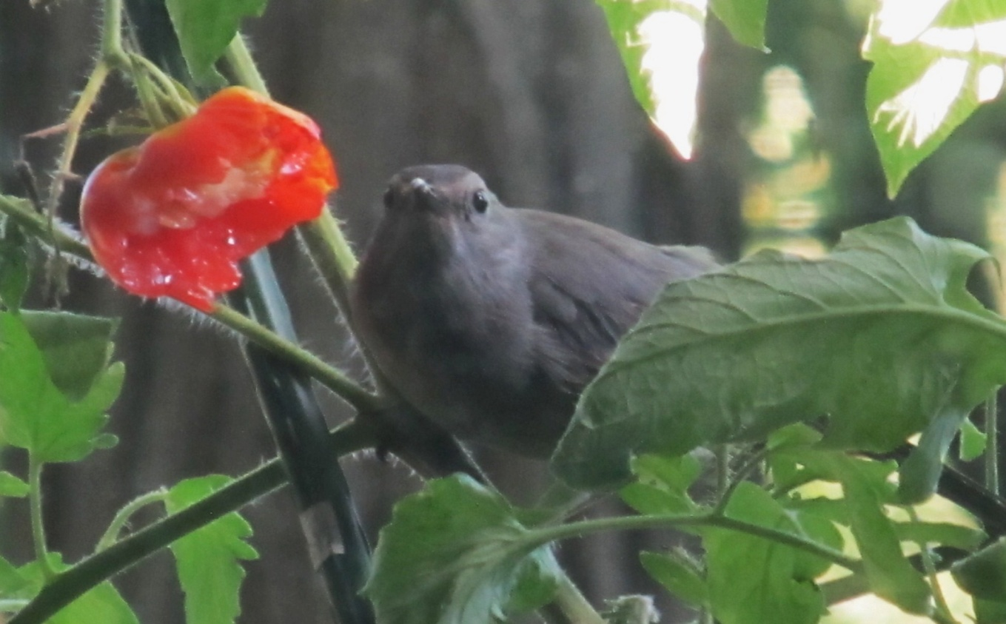
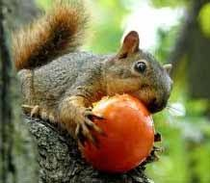
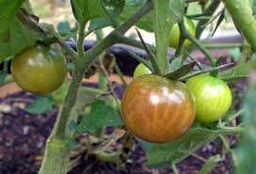
More plant damage suspects
To avoid birds eating our tomatoes we pick them early before they turn really red.

Slide 18
Keep your eyes open!

Slide 19
Pests
What is a pest? How should we treat them?
Herbicide = plant killer (cide = to kill)
Insecticide = insect killer
Pesticide = pest killer
Or
IPM = Integrated Pest Management
IPM uses the fact that many pests also have pests. We use these to get rid of our pests without using harmful chemicals

Slide 20
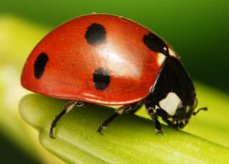
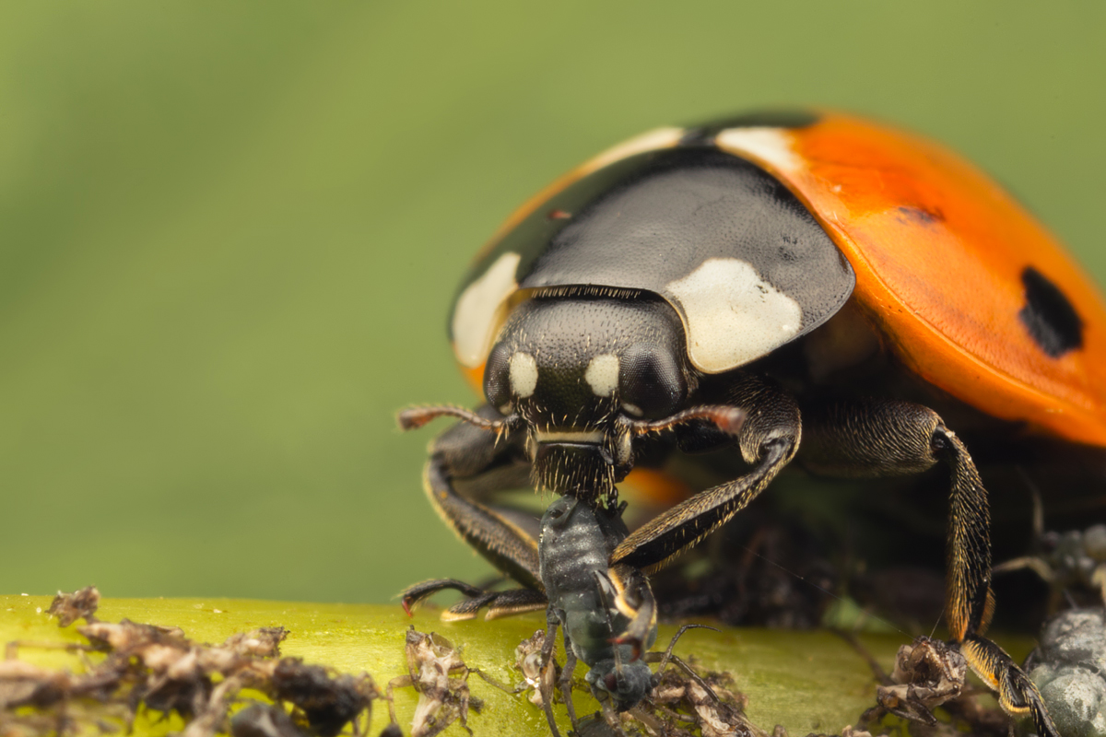
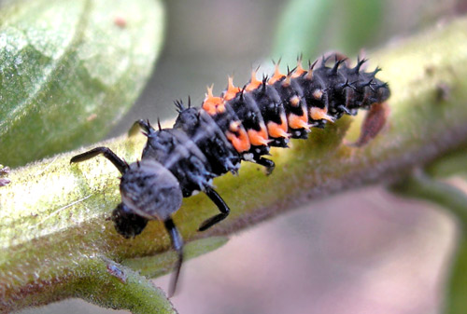
beneficial insects
Lady beetle
Lady beetle larva

Slide 21
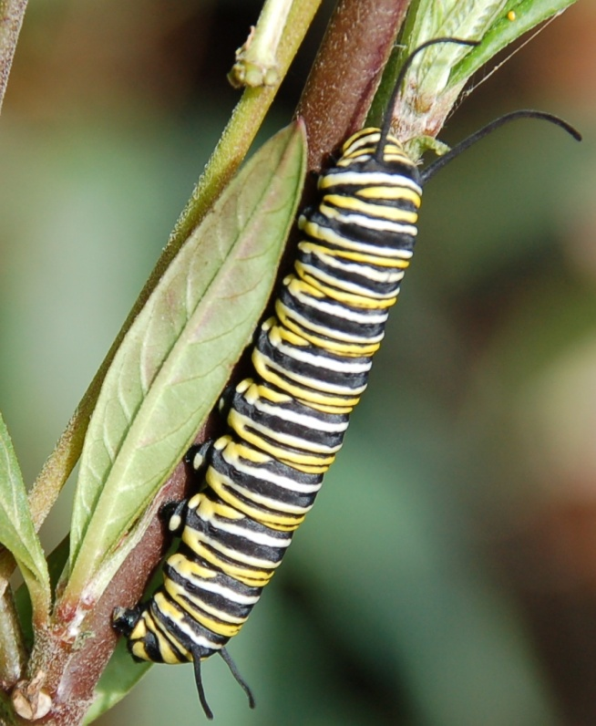
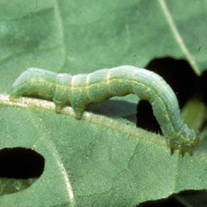
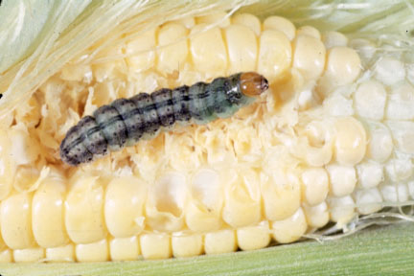
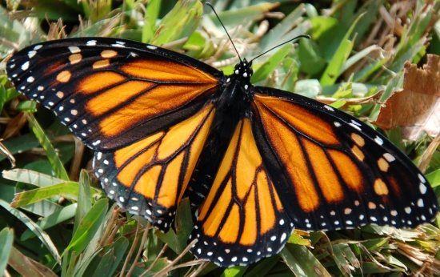
Are caterpillars Pests?

Slide 22
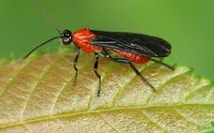
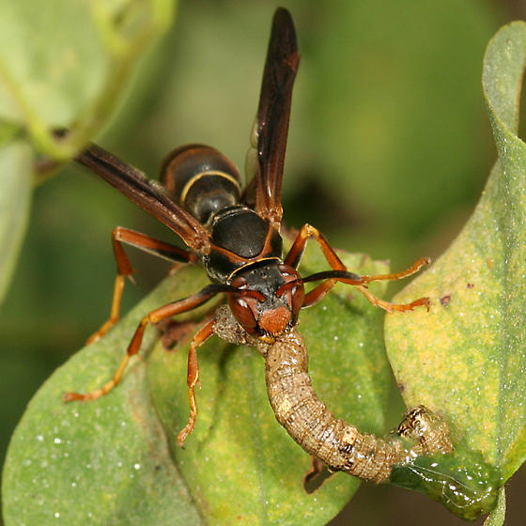
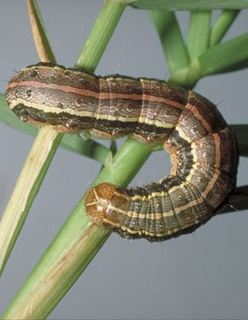
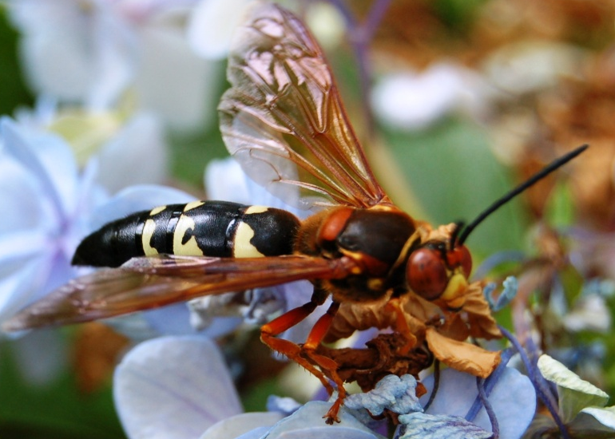
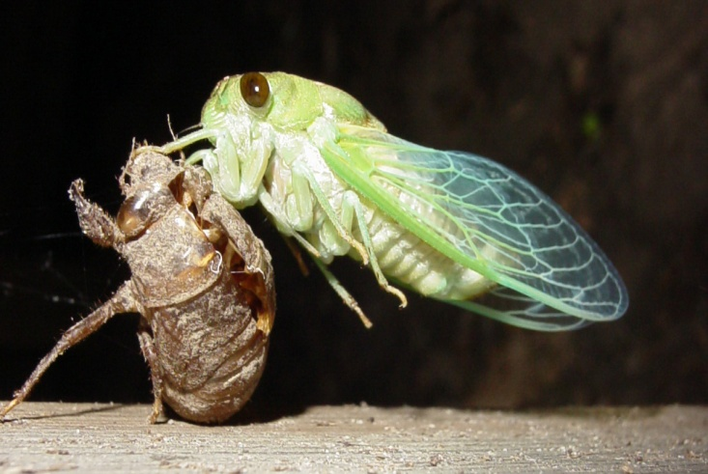
How about wasps?

Slide 23
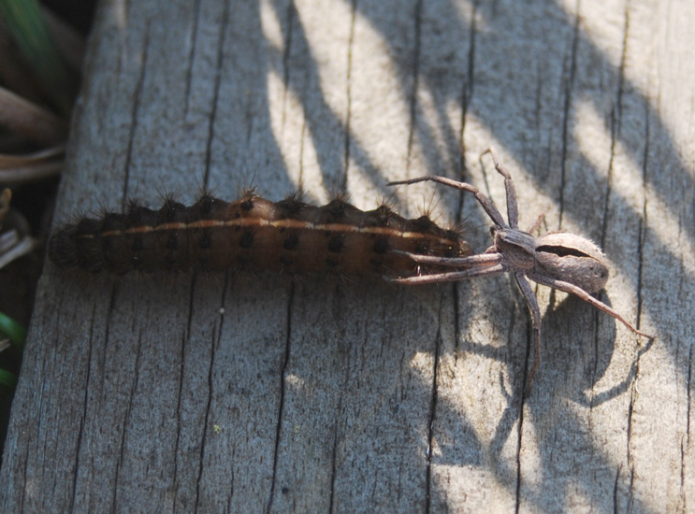
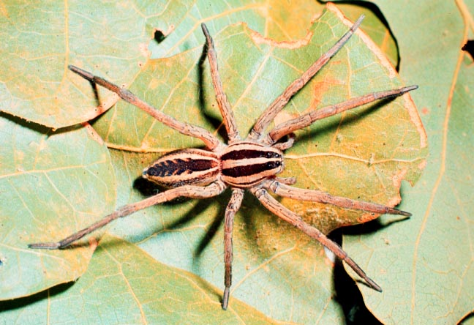
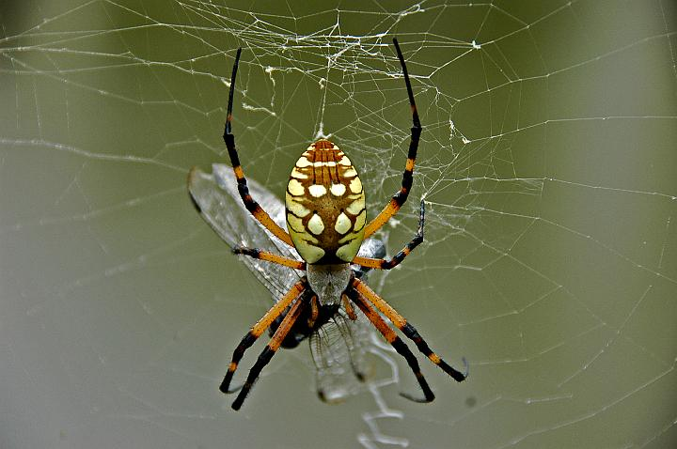
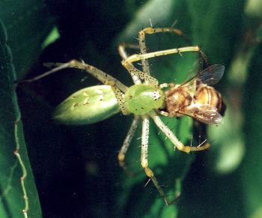
Hmm, Spiders?
Spiders are not insects!

Slide 24
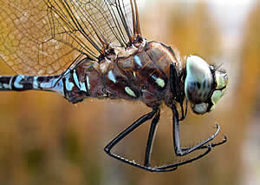
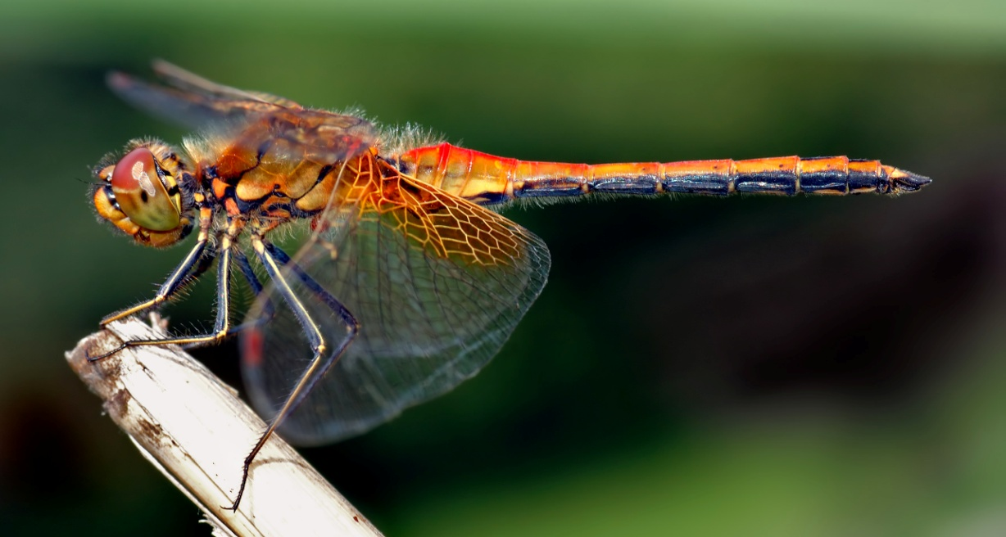
Dragonfly
Mosquito Hawks

Slide 25
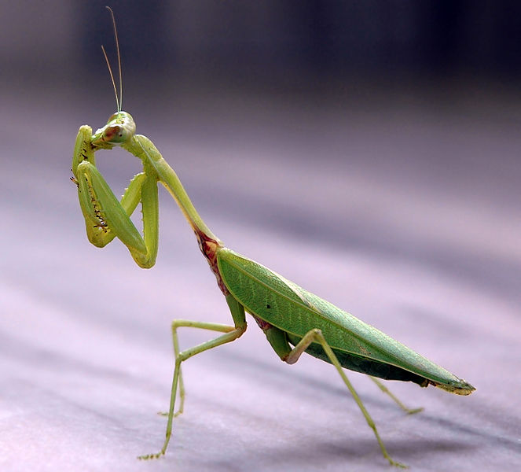
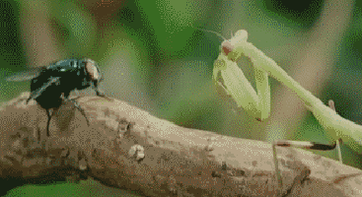
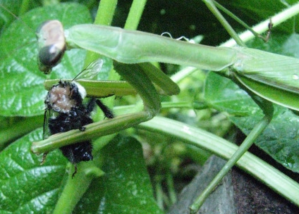
Praying mantis
A deadly predator!

Slide 26
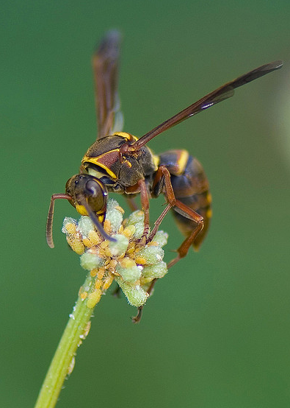
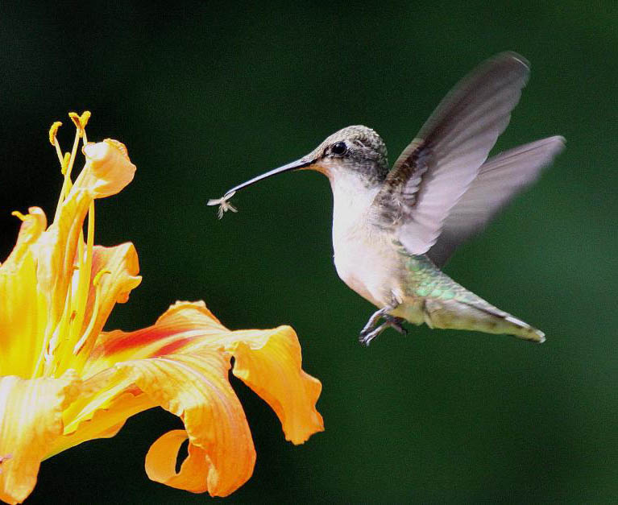
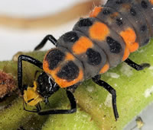
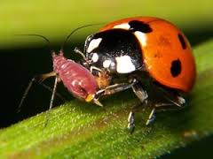
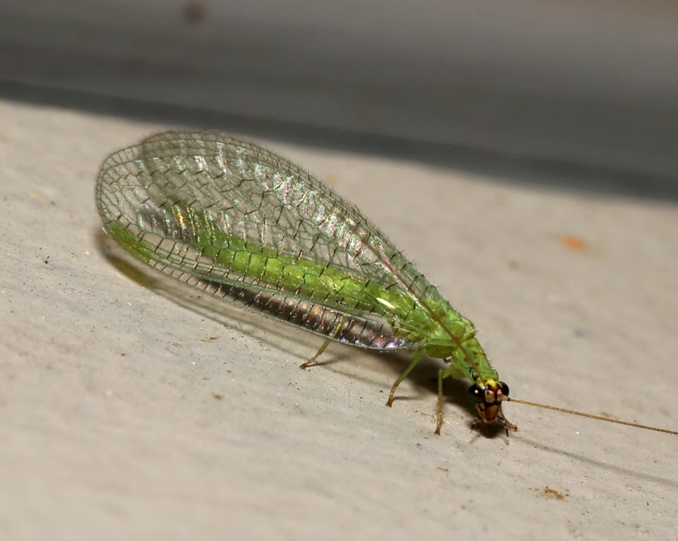
Some Natural Pest Controls
How can we get rid of aphids without insecticides?

Slide 27
Control Mosquitoes?

Slide 28
How to control Caterpillars?

Slide 29
Can plants be pests?
Leaves of three,
let it be!
If it’s hairy,
it’s scary!!

Slide 30
Insect safety – stinging flying insects

Slide 31
Insect safety – ants
Fire Ant Twig or Elongate twig ant

Slide 32
Insect safety – Red velvet ant
It is really a wasp, not an ant!
The red velvet ant hunts ground nesting insects for food.
Only male red velvet ants have wings.

Slide 33
Insect safety – the flannel moth
Asp (Puss Caterpillar)– the larva of the moth
Touching it can cause severe pain and blisters.

Slide 34
Spider safety
Brown recluse spider
Black widow spider
Brown widow spider

