Slide 1
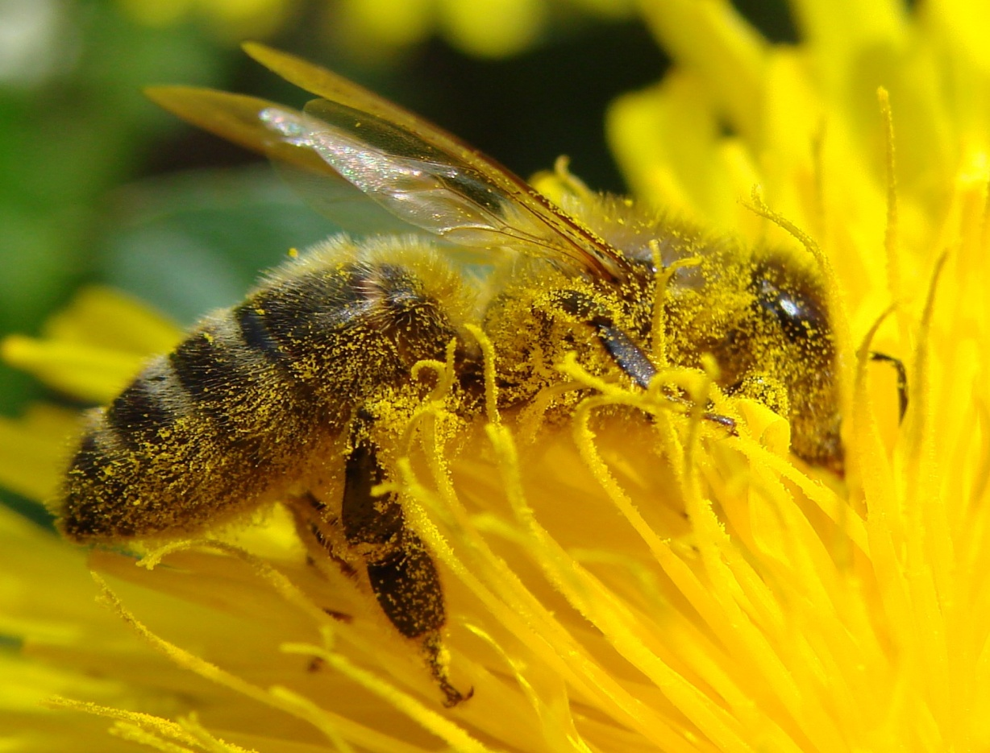
pollination

Slide 2
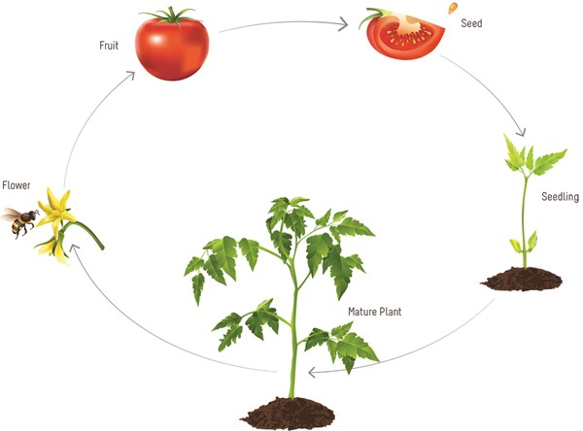
Pollination - definition
Pollination is the act of transferring pollen grains from the anther of a flower to the stigma. The goal of every living thing, is to create offspring for the next generation. One of the ways that plants can produce offspring is by making seeds.

Slide 3
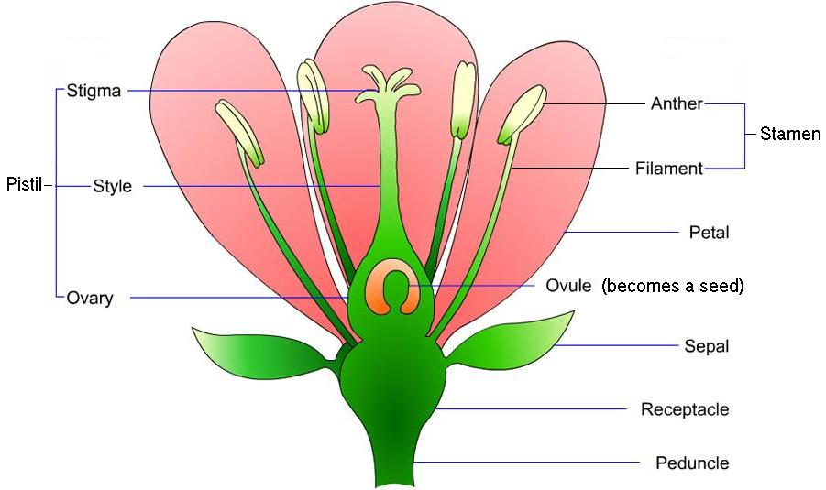
Parts of a flower
Pollen is located on the anthers

Slide 4
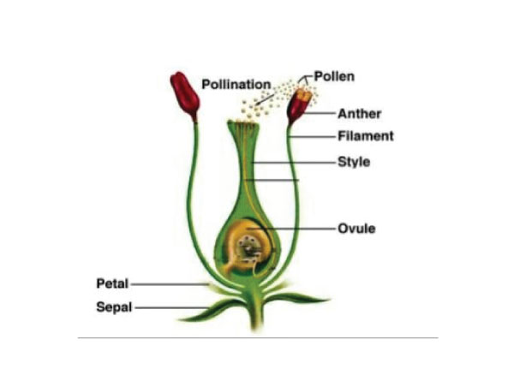
Pollination = fertilization = seed
Stigma ------------------------------
Pollen Tube

Slide 5
Different types of pollination
In self-pollination, the pollen from the anther of a flower is transferred to the stigma of the same flower or the stigma of a different flower on the same plant.
In cross-pollination, the pollen from the anther of a flower on one plant is transferred to the stigma of the flower on another plant of the same species.

Slide 6
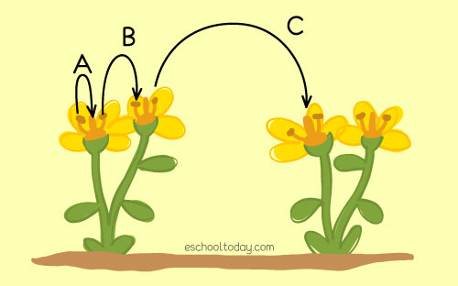
Review of pollination
A = self pollination C = cross pollination
B = self pollination

Slide 7
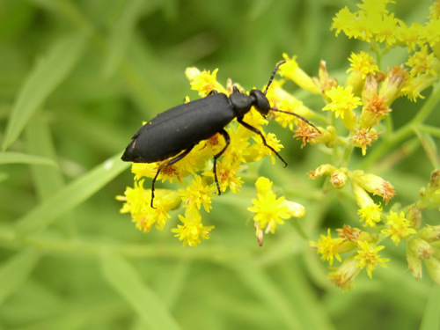
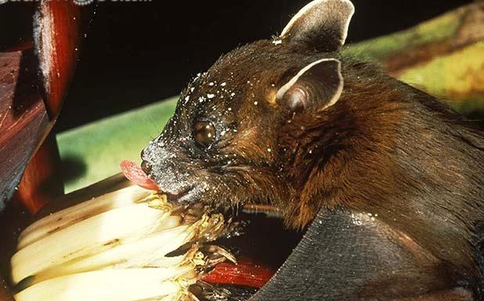
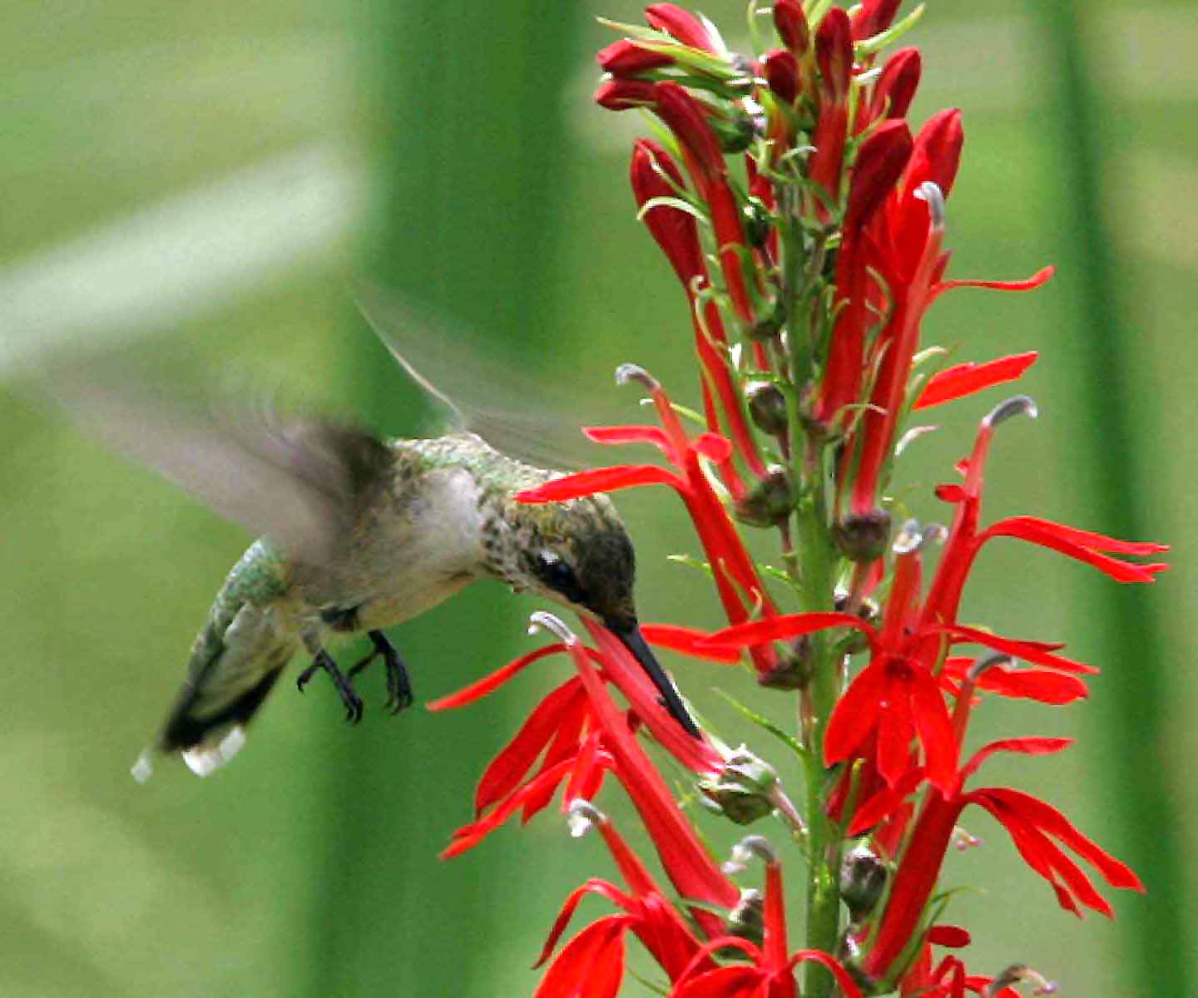
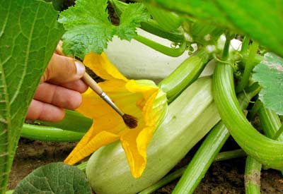
Moving Pollen to stigma
Mammals - Bats
Insects
Humans
Birds

Slide 8
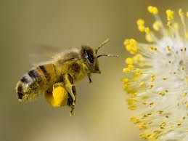
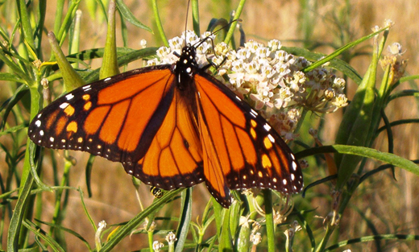
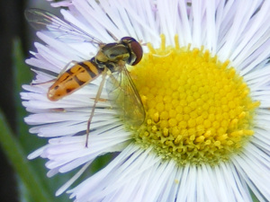
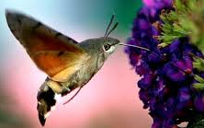
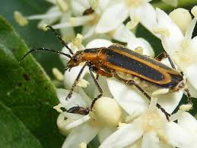
Insect pollinators
European Honeybee
Monarch Butterfly
Syrphid Fly
Bumblebee
Hawk Moth
Beetle
Wasp

Slide 9
Mutualism – a form of interdependence
Mutualism is a symbiotic relationship between two species where both the species benefit from each other.

Slide 10
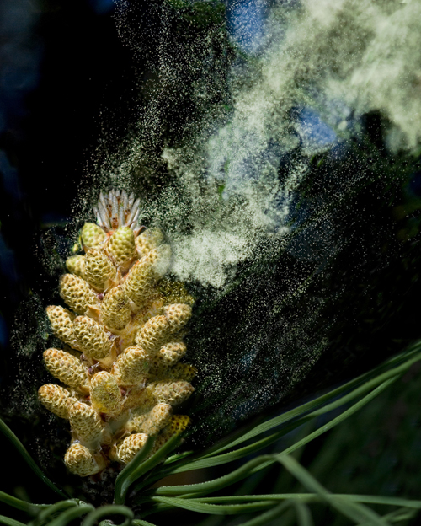
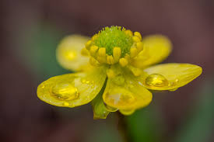
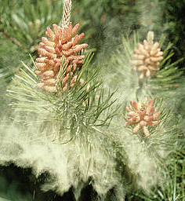
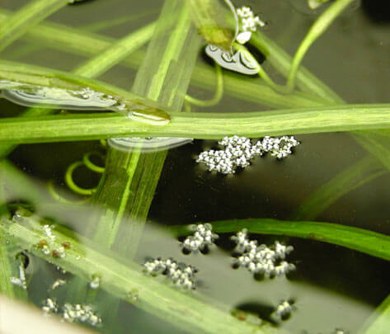
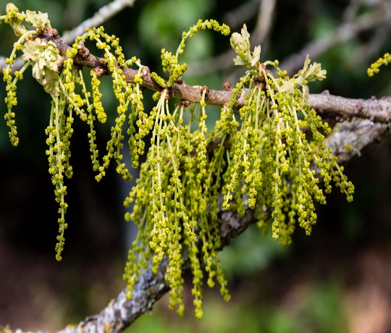
Other agents of Pollination
Rain - Water
Wind

Slide 11
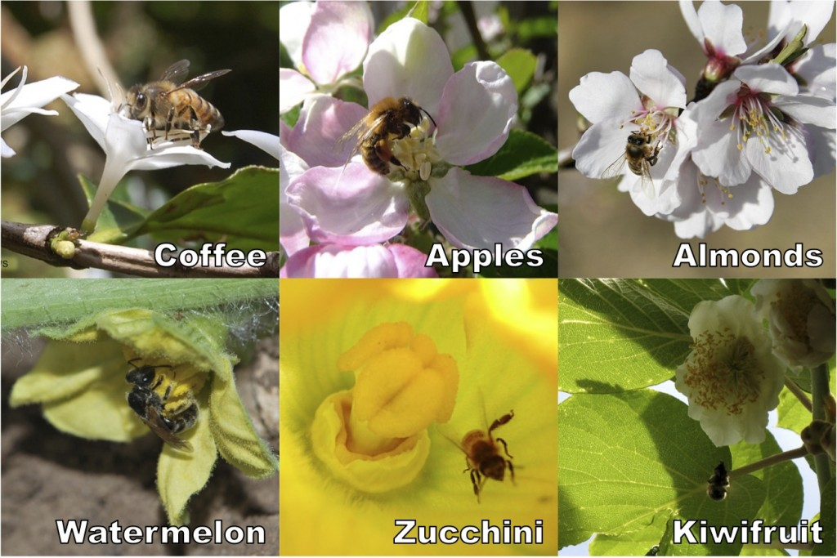
35% of the food humans eat comes from insect pollinated plants
Bees, European honey bees and native bees, are the most important pollinators. However, more than 100,000 invertebrate species, including bees, moths, butterflies, beetles, and flies, serve as pollinators — as well as 1,035 species of vertebrates, including birds, mammals, and reptiles.

Slide 12
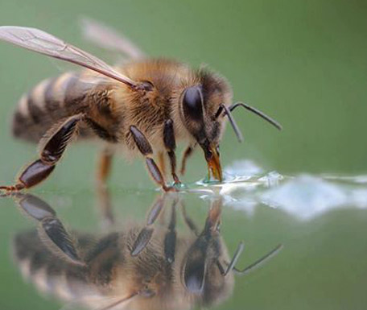
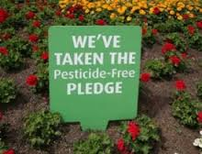
Protect our insect pollinators
Provide food for them
Provide a water source
Provide shelter
Don’t use insecticides

Slide 13
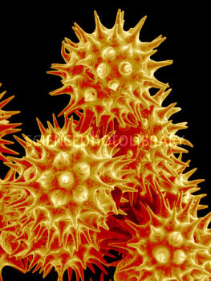
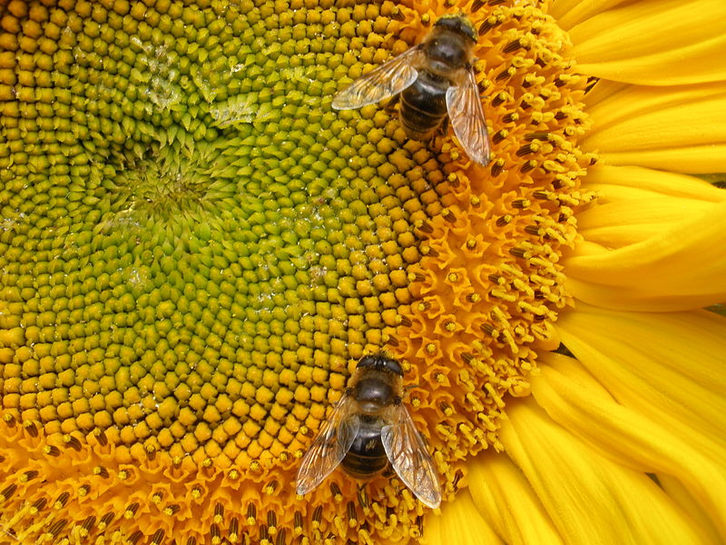
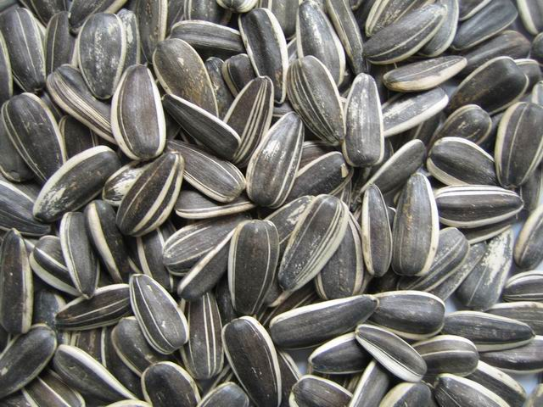
Pollen to seed
Sunflower
Pollen

Slide 14
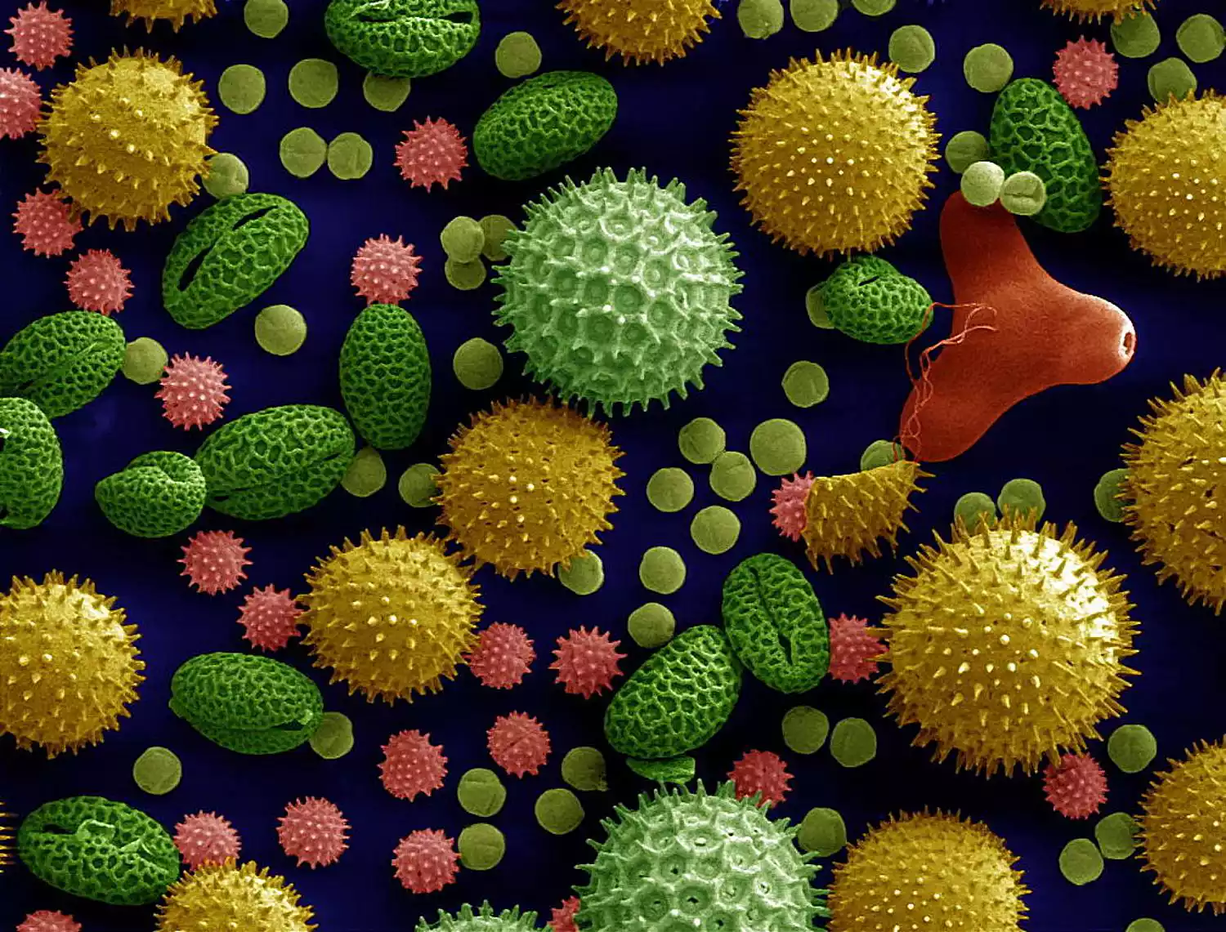
Pollen
Since insect pollinators such as bees, can't see red, plants produce yellow (or sometimes blue) pollen to attract them. This is why most plants have yellow pollen, but there are some exceptions. For instance, birds and butterflies are attracted to red colors, so some plants produce red pollen to attract these organisms.
Pollen grains from different common plants.

Slide 15
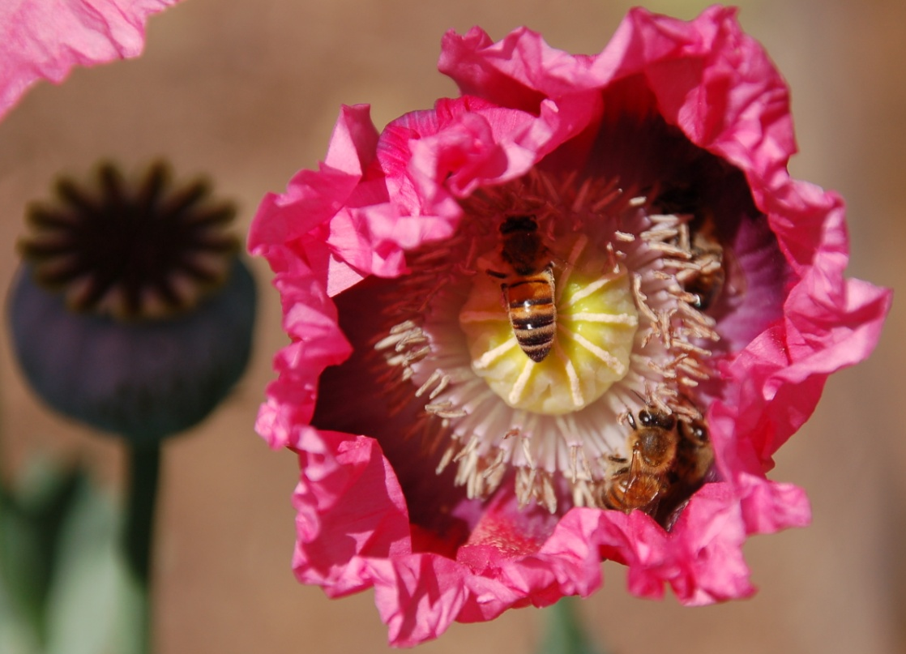
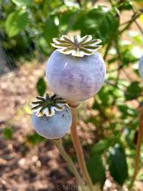
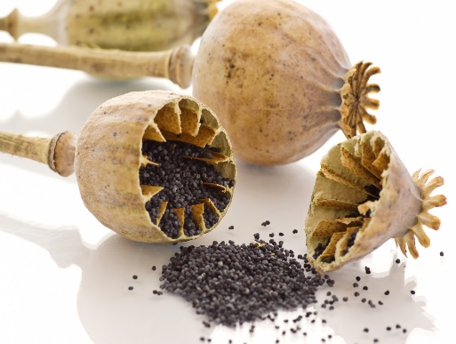
Poppy
Bees pollinating poppy
Poppy Flower Point out the anthers and stigma
Seed inside poppy pod
Poppy seed pod

Slide 16
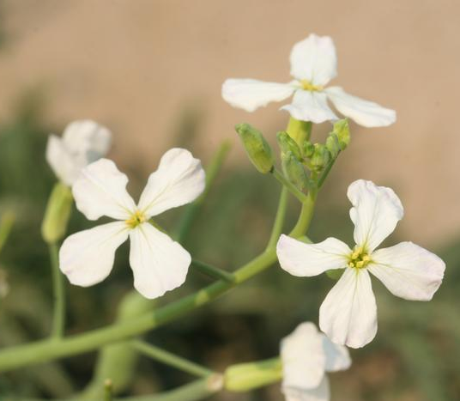
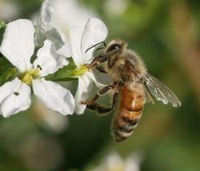
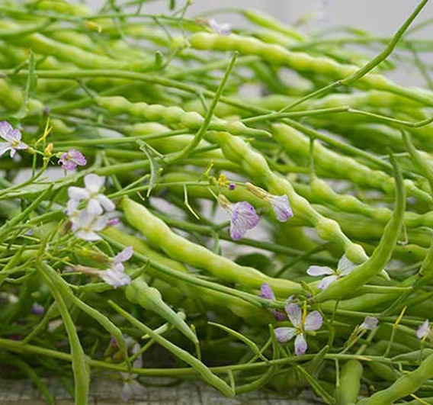
Radish
Radish flowers Flowers being pollinated
If we harvest radishes, will the plant make seeds?
Green radish seed pods Seeds inside pod

Slide 17
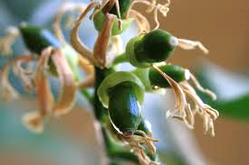
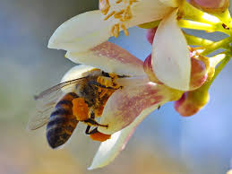
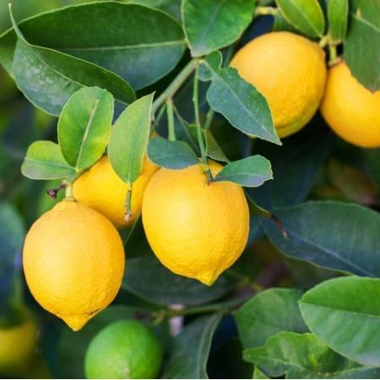
Meyer lemon
Bee pollinating flower Pollinated flowers with petals dropping off showing young fruit
Lemon Flower –
Can you find the anthers and the stigma?
Mature lemon fruit Seeds in the fruit

Slide 18
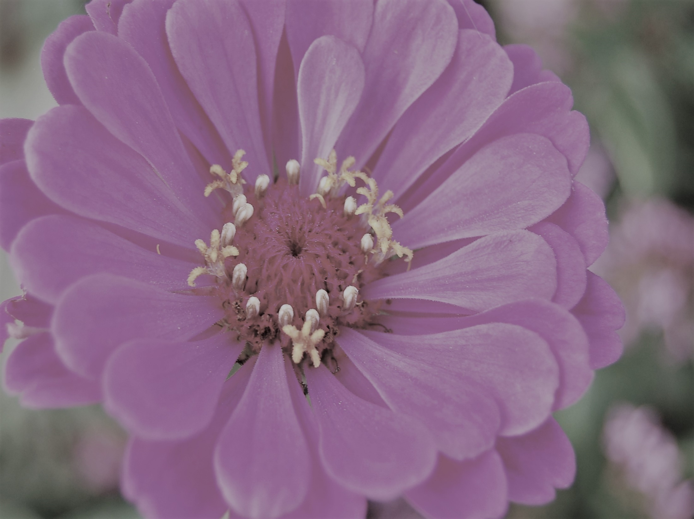
ANSWER THESE QUESTIONS
CAN YOU ANSWER THESE QUESTIONS?
Pollination is the transfer of ____________from __________to___________
Pollination results in ___________________________
Fertilization results in___________________ being formed.
What are the five agents of pollination?
What three things do native pollinators need?
Are European honeybees the best pollinators?
Can you think of ways that seeds might travel?
Pollination is the transfer of ____________from __________to___________
Pollination results in ___________________________
Fertilization results in___________________ being formed.
What are the five agents of pollination?
What three things do native pollinators need?
Are European honeybees the best pollinators?
Can you think of ways that seeds might travel?

