Slide 1
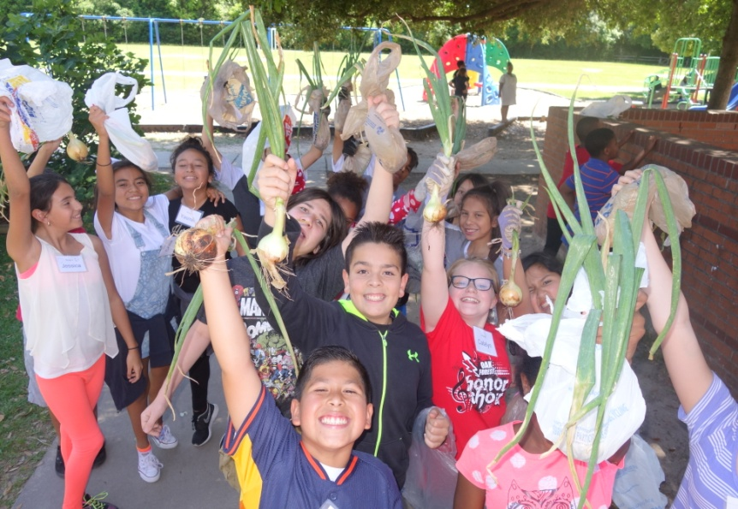
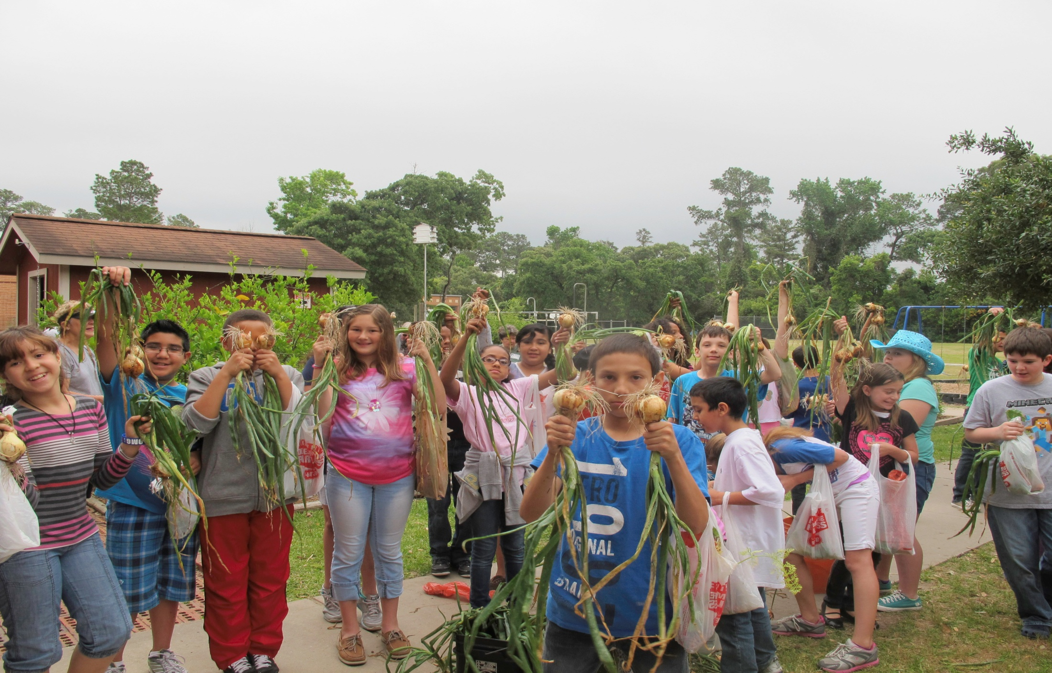
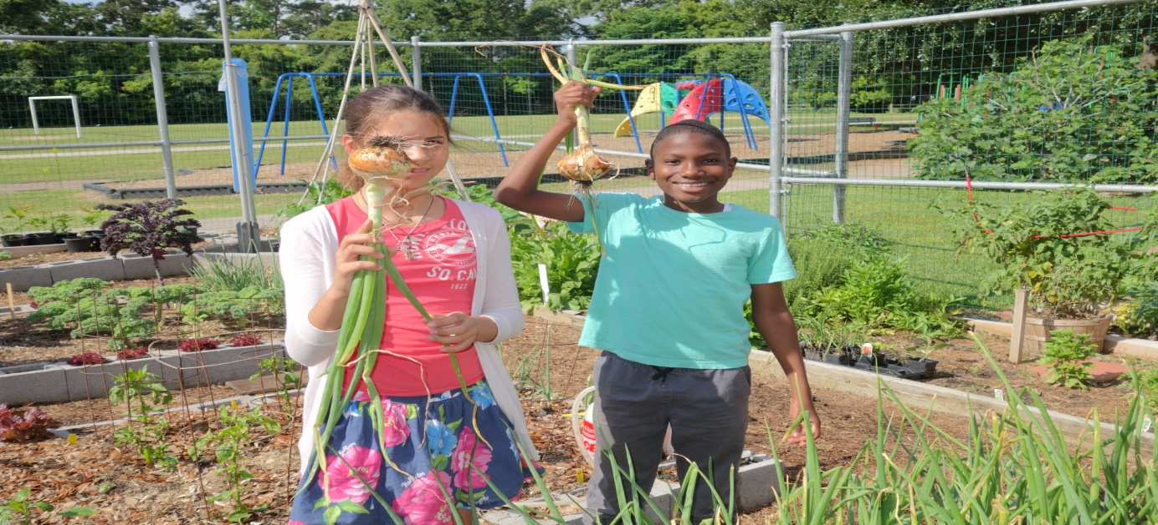

Onions – Allium Cepa

Slide 2
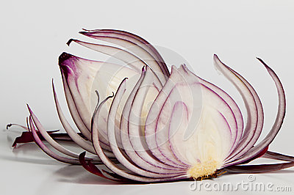
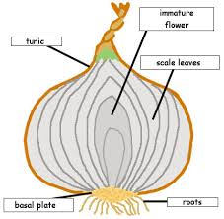
Onions are in the Amaryllidaceae family
They are true bulbs

Slide 3
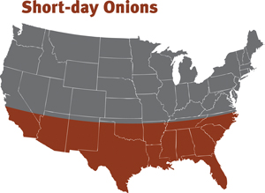
Types of onions
Onions are cool season plants
14+ hours of sunlight/day
10 – 12 hours of sunlight/day
Long Day Onions Short Day Onions

Slide 4
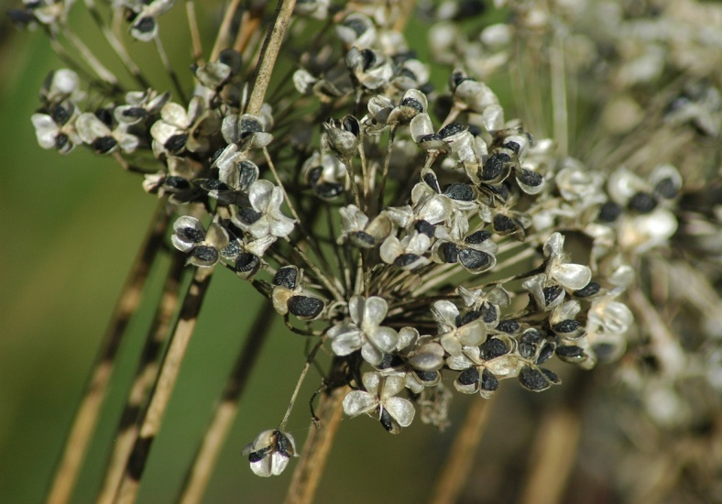
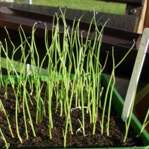
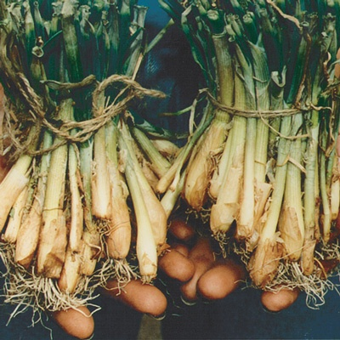
Planting onions
Onion seedlings
Onion seed head
Onion Sets

Slide 5
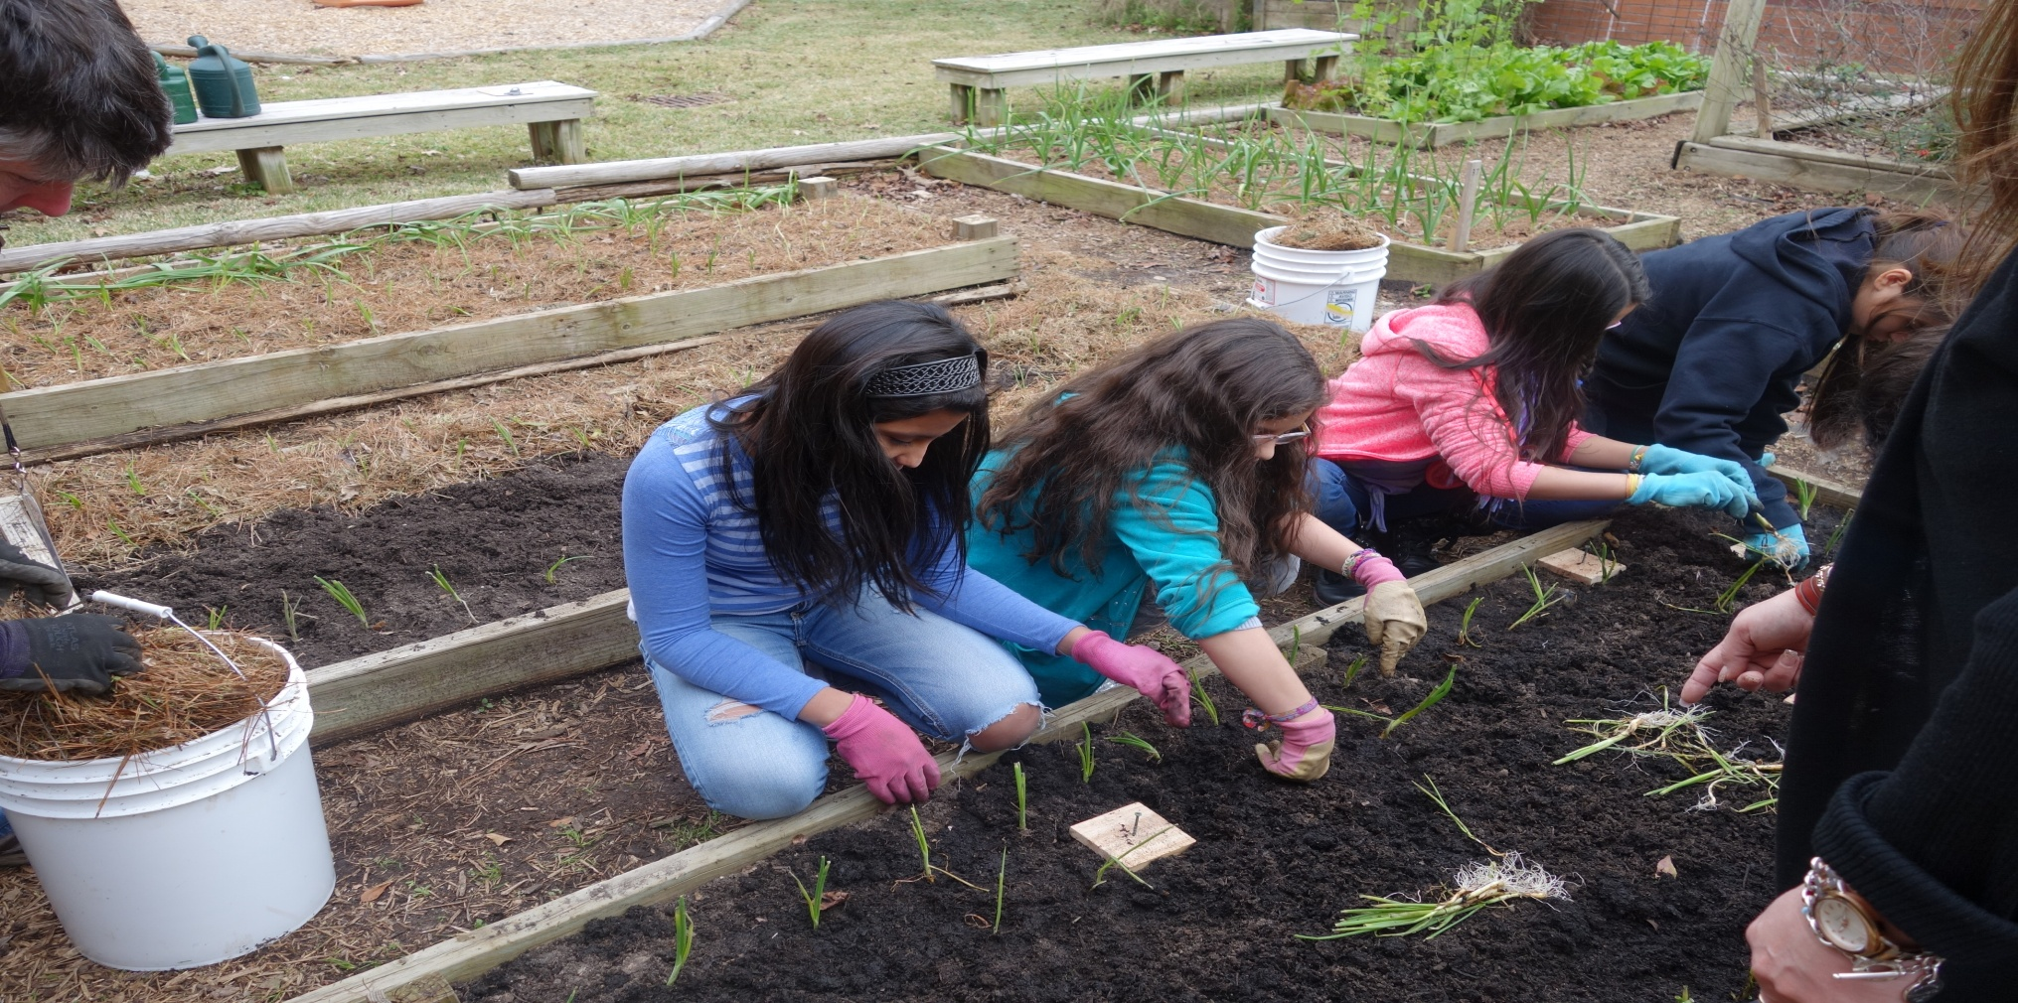
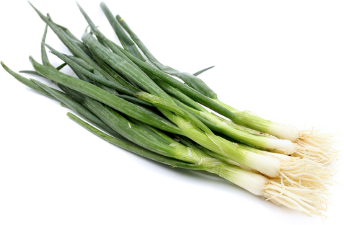
How to plant onions-
They need: Plant them:
Sunlight 1 inch deep & 4 inches apart
Loose fertile soil
Even water
(They can be planted 2 inches apart. Then every other plant can be thinned and used as green onions.)

Slide 6
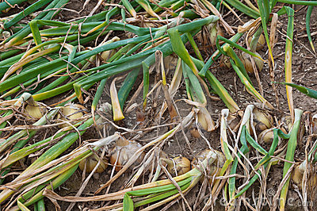
Harvesting onions
When onions have 13 leaves or more
When the tops of the onions have fallen over, they are fully mature and can be pulled from the ground.
When neck of
onion is soft and
looks dried up

Slide 7
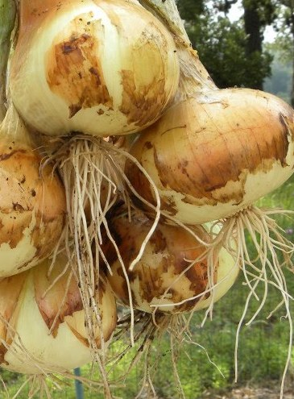
Texas state Vegetable
The Texas 1015Y
Onion became the state vegetable in 1997!
Seed is planted on/about 10/15
Sets are planted on/about 1/15
Harvested on/about 5/15

Slide 8
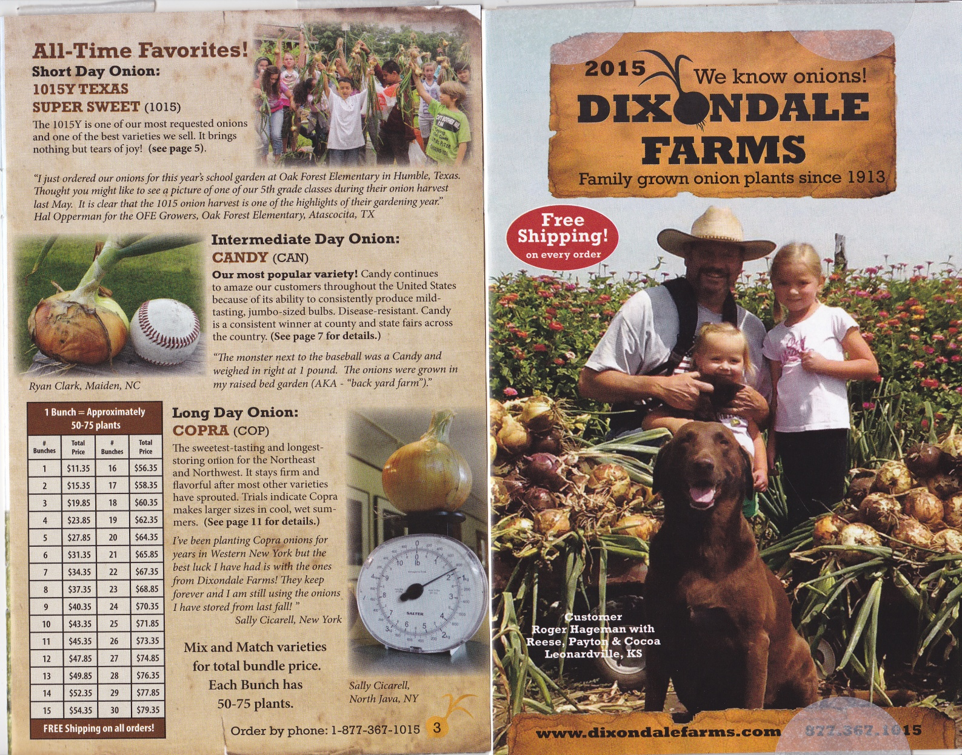
Source of onions – Dixondale farms
GBO for OFE 2015

Slide 9
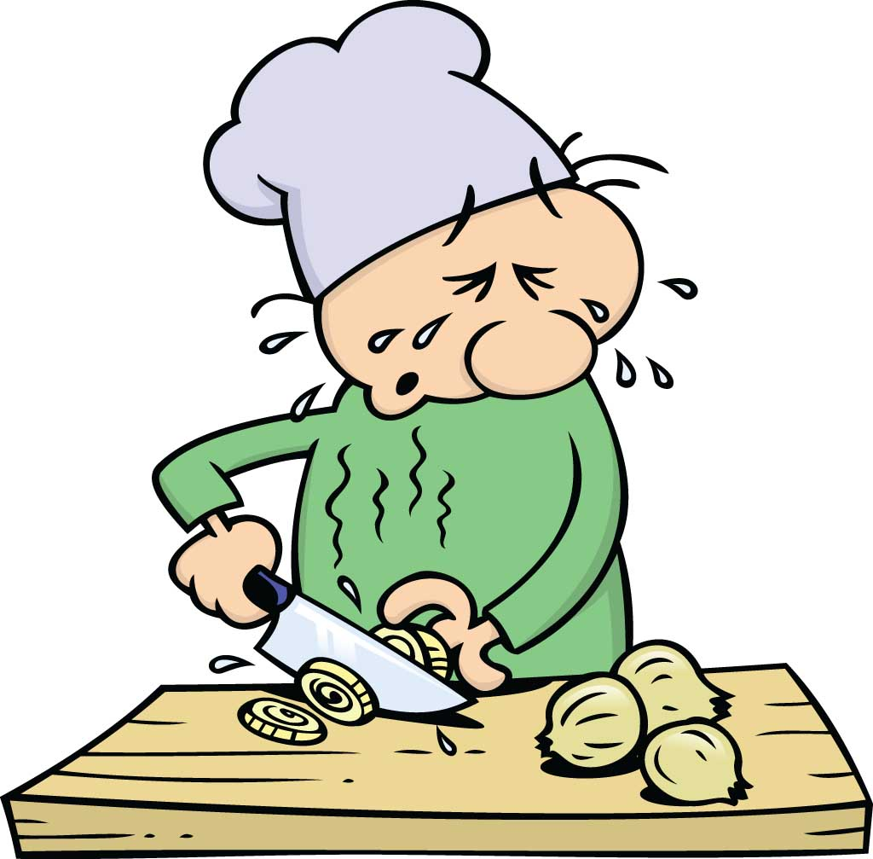
Why onions make you cry
Onions contain an oil, which has lots of sulfur in it.
When you cut the onion, this oil is released.
It evaporates very quickly. It causes irritation when it hits your eyes and sends signals to your tear gland to produce tears.
The tears wash away the irritant from your eyes.

Slide 10

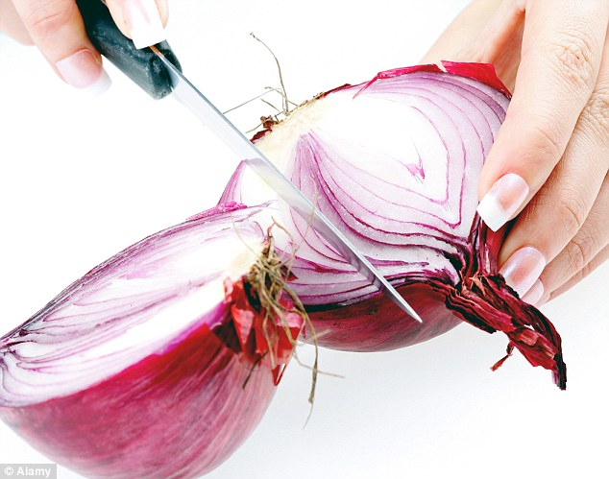
Preventing the Tears
1. Put the onion in the freezer for 10 minutes. The frozen cells don’t explode as fast and won’t release as much of the gas.
2. Chop onions under the stovetop ventilation fan.
3. Don’t cut the root end. The sulfur compounds are concentrated here.
4. Always use a sharp knife. The sharper the knife, the less you will smash the cells of the onion, or tear up.
5. Wear goggles to keep the fumes from getting into your eyes.

Slide 11
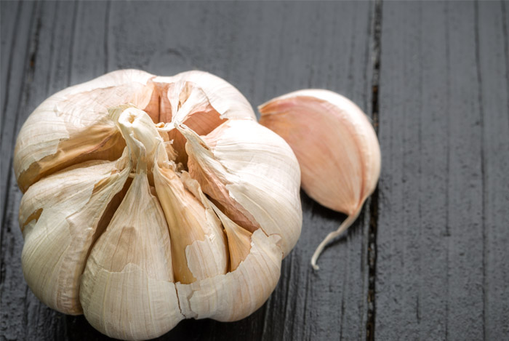
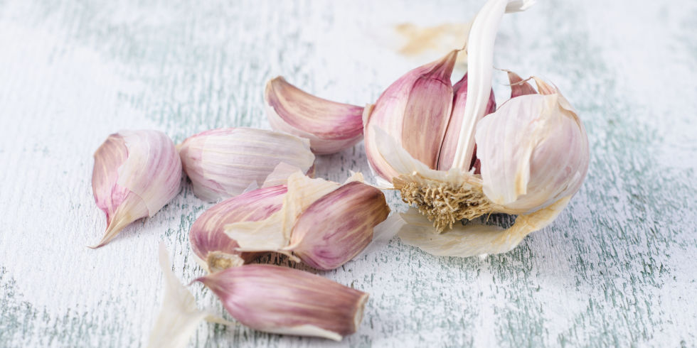
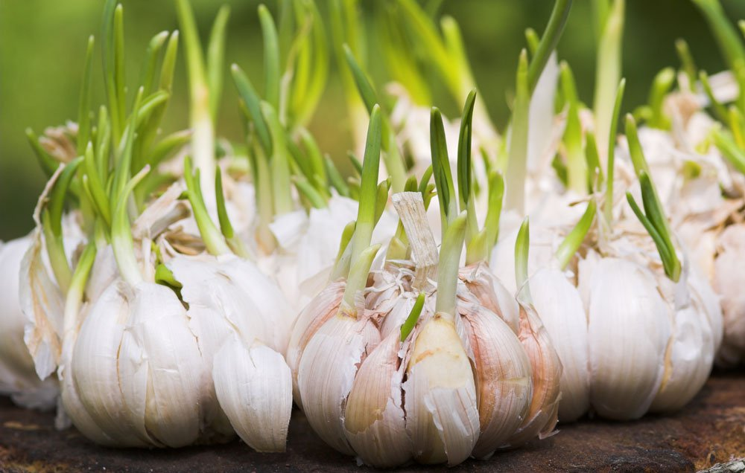
Garlic – Allium sativum
Garlic bulbs are divided into sections called cloves.
Cloves are used to plant garlic.
Each clove will grow into a garlic bulb.
Garlic has been used as long as 5000 years.
It has many medicinal properties, beside making food taste good.

Slide 12
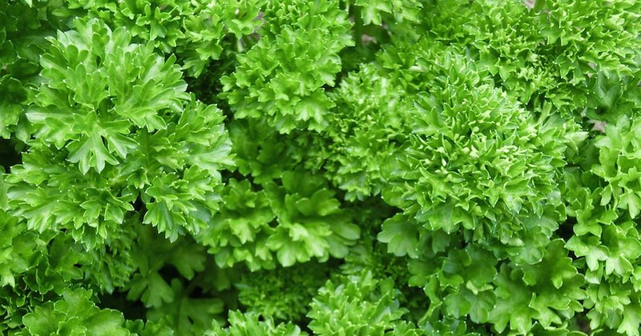
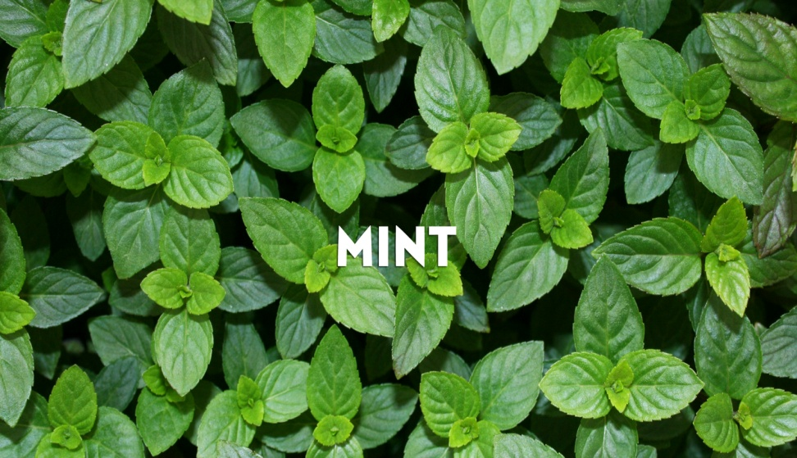
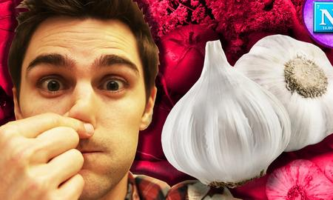
How do you prevent onion/garlic breath?
Hint: Eat some of these herbs.
PARSLEY

